Slide 2
Lifestyle recommendations for hypertriglyceridemia-induced pancreatitis
After discharge
Somayeh hosseinpour-Niazi
Nutrition and Endocrine Research center
Research Institute for Endocrine Sciences
Shahid Beheshti University of Medical Sciences

Slide 3
Lifestyle recommendations
Once patient can tolerate oral intake, adjunctive lipid lowering therapy should be started with the goal of achieving long term TGs control.
Consultation with dietician should be sought and patient should be counseled on the importance of low fat diet to prevent recurrence. Lifestyle changes including better diabetes control should be reinforced.

Slide 4
Lifestyle recommendations (cont’d)
low fat diet
Fat: 10 to 15 percent of energy (33 g for a 2000-calorie diet, 50 g for a 3000-calorie diet)
Protein: 15% of energy
Carbohydrate: ≥70% of energy
Very Low fat diet. Circulation 2018;98:935–939

Slide 5
Lifestyle recommendations (cont’d)
Low fat diet
Increased risk for fat-soluble vitamins deficiencies (A, E, D, and K)
Calcium, magnesium, iron, selenium and zinc supplementation

Slide 6
Lifestyle recommendations (cont’d)
Low fat diet
Increased risk for essential fatty acids deficiencies (2-4% of caloric intake)
Food source of essential fatty acids :
Alpa-linolenic acid : soybeans, flaxseeds, walnuts
Linoleic acids: whole grains, corn and safflower oils

Slide 7
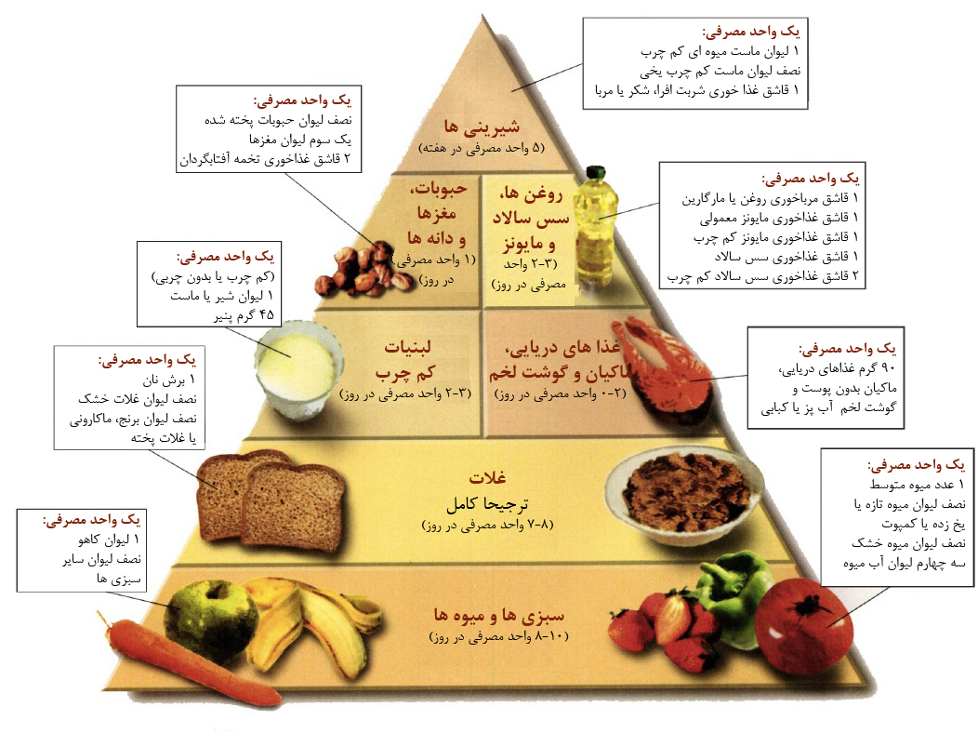
Lifestyle recommendations (cont’d)

Slide 8
Lifestyle recommendations (cont’d)
Low fat diet
low-fat sources of protein:
low-fat yogurt, low-fat or skim milk, low-fat cheese
Dried beans and peas
Egg white
Fish, poultry, and lean meats

Slide 9
Lifestyle recommendations (cont’d)
3. Dietary fat (cont’d)
consuming the omega-3 fatty acids (3-4 g/d):
2 servings (120 g) of fatty fish per week:
TG by 25% or more (depending on baseline concentration)
slight in LDL-C levels
HDL-C levels
Unsalted nuts (1 serving/day)
Jellinger PS et al. Endocr Prac 2017 Apr;23(Suppl 2):1-87
Jacobson TA et al. J Clin Lipidol. 2015;9(6 Suppl):S1-122.e1.
Anagnostis et al. Maturitas 2018; 108: 45–52

Slide 10
Lifestyle recommendations (cont’d)
Minimum effective dose of omega-3 fatty acids: approximately 1 g daily
A dose of 3–4 g daily to reduce the TG levels by 30–50% in patients with HTG
Medium-chain triglyceride oil?????
Combination of medium chain triglycerides and omega 3 fatty acids has been reported to lower TGs levels by 67% over one-week period
Jellinger PS et al. Endocr Prac 2017 Apr;23(Suppl 2):1-87

Slide 11
Lifestyle recommendations (cont’d)
2. Dietary carbohydrate
Carbohydrates in diet (≥70% of total energy)
Limit Refined starches and simple carbohydrates
Carbohydrates from less refined sources, such as brown rice and whole-grain bread, can also raise the TG concentration
added sugars: up to 5%
Jellinger PS et al. Endocr Prac 2017 Apr;23(Suppl 2):1-87
Jacobson TA et al. J Clin Lipidol. 2015;9(6 Suppl):S1-122.e1.
Anagnostis et al. Maturitas 2018; 108: 45–52

Slide 12
Lifestyle recommendations (cont’d)
5 . Dietary fructose (sugar sweetener beverages, cookies and cakes)
Borderline TG (200-499 mg/dl)
<100 g/d
High TG (200–499 mg/dl)
50-100 g/d
Very high TG (>500 mg/dl)
<50 g/d
Fructose in each serving of Fruits: 6-18 g
Figs, dried; Mango; Grapes, seedless (green or red); Raisins; Pear; Watermelon; Persimmon; Apple
Jellinger PS et al. Endocr Prac 2017 Apr;23(Suppl 2):1-87
Jacobson TA et al. J Clin Lipidol. 2015;9(6 Suppl):S1-122.e1.
Anagnostis et al. Maturitas 2018; 108: 45–52

Slide 13
Lifestyle recommendations (cont’d)
Carbohydrate counting (cont’d)
15%
10 %
25
%
10 %
30 %
10 %
Krause’s Food & The Nutrition Care Process. 2017

Slide 14
توزيع عادلانه واحدهاي توصیه شده دریافتی در وعده ها و ميان وعده ها علی ط.
گروههای غذایی | تعداد واحد توصیه شده | صبحانه | نیم چاشت | نهار | عصرانه | شام | قبل از خواب
لبنیات کم چرب | 3 |  | 1 | 1 |  | 1
سبزی | 8 |  | 1 | 3 | 1 | 3
میوه | 4 |  | 1 |  | 2 |  | 1
غلات | 11 | 3 | 1 | 3 |  | 3 | 1
حبوبات | 1 |  |  |  |  | 1
قند ساده | --- | --- | --- | ---- | ---- | ---- | ----
گوشت بسیار کم چرب | 4 | 1 |  | 2 |  |  | 1
چربی | 2 | 1 |  | 1
شمارش کربوهیدرات (گرم) |  | 40 | 27 | 64 | 30 | 77 | 27
شمارش کربوهیدارت استاندارد (گرم) | 260 | 39 | 26 | 65 | 26 | 78 | 26

Slide 15
Lifestyle recommendations (cont’d)
گوشتهای بسیار کم چرب و کم چرب
گوشت ماکیان، مرغ یا بوقلمون، ماهی (بدون پوست)
پنیر کم چرب یا بدون چربی
سفیده تخم مرغ
گوشت گوساله و راسته
گوشت گوسفند، ران و راسته

Slide 16
Lifestyle recommendations (cont’d)
c. Physical activity
At least 30 minutes of moderate-intensity aerobic activity, 4 to 6 times weekly
brisk walking, riding a stationary bike, water aerobics, cleaning/ scrubbing, mowing the lawn, and sporting activities
Muscle-strengthening activity is recommended at least 2 days a week
Jellinger PS et al. Endocr Prac 2017 Apr;23(Suppl 2):1-87

Slide 17
Lifestyle recommendations (cont’d)
Loss of excessive body weight (5–10%)
Borderline TG (150–199 mg/dl): weight loss of up to 5%
3-kg loss of body weight: ∼ 15 mg/dl in TG
High TG (200–499 mg/dl) or very high TG (>500 mg/d): weight loss of 5–10%
weight loss of 5–10% 20% in TG
Jellinger PS et al. Endocr Prac 2017 Apr;23(Suppl 2):1-87
Jacobson TA et al. J Clin Lipidol. 2015;9(6 Suppl):S1-122.e1.
Anagnostis et al. Maturitas 2018; 108: 45–52

Slide 18
Lifestyle recommendations (cont’d)
Small meals
avoid dehydration
Alcohol restriction
Strict glycemic control in diabetics
Modulation of gut microbiota could play an important role in further therapeutic management
Avoidance of medications that raise serum triglyceride levels

Slide 19
از توجه شما سپاسگزارم

