Slide 1
Dr fatemeh kokabeh

Slide 2
Consensus on diagnosis and management of Cushing’s
disease: a guideline update

Slide 3
AGENDA:
introduction
lab test
Diagnosis of Cushing’s syndrome: screening,
confirmatory, and localisation modaliti
Clinical considerations and recommendations for laboratory tests
Introducing the real case number one
Non-neoplastic hypercortisolism
Imaging and tumour localisation
Clinical considerations and recommendations for imaging and
tumour localisation

Slide 4
AGENDA:
Introducing the real case number two
Distinguishing between Cushing’s disease and ectopic
Clinical considerations and recommendations for
distinguishing between Cushing’s disease and ectopic
Complications of Cushing’s disease
Initial treatment of Cushing’s disease
Introducing the real case number three
monitoring for recurrence

Slide 5
AGENDA:
recommendations for recurrence monitormonitoring for recurrence
Medical therapy for Cushing’s disease
Clinical considerations and recommendations for
medical therapy
Initial treatment selection for medical therapy
Monitoring response to medical therapy
Medical therapy for Cushing’s disease a summary

Slide 6
AGENDA
Summary of treatment
Primary and preoperative medical therapy for de novo chushig’s disease
Clinical considerations and recommendations for primary and
preoperative medical therapy for de novo Cushing’s disease
Radiotherapy
Clinical considerations and recommendations for
radiotherapy

Slide 7
AGENDA
Adrenalectomy
Clinical considerations and recommendations for
adrenalectomy
Genetics of Cushing’s disease
Diagnosis and management of Cushing’s
syndrome in children
Conclusions

Slide 8
Cushing’s disease, the most common cause of endogenous
Cushing’s syndrome, is caused by an adrenocorticotropic
hormone (ACTH)-secreting pituitary
tumour.
Optimal patient outcomes require accurate
diagnosis, careful treatment selection, and management
of the disease and its associated comorbidities to optimise
patient outcome

Slide 9
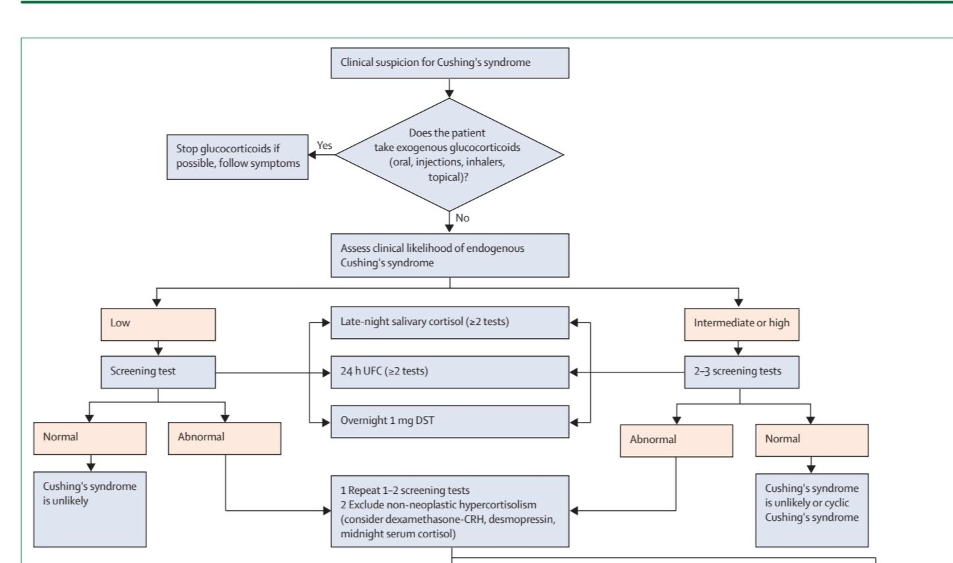
Diagnosis of Cushing’s syndrome: screening,
confirmatory, and localisation modaliti
If Cushing’s syndrome is suspected:
• Start with urinary-free cortisol (UFC), late-night salivary
cortisol (LNSC), or both; dexamethasone suppression test
(DST) could also be an option if LNSC not feasible
• Multiple LNSC might be easier for patient collection
Raff H, Carroll T. Cushing's syndrome: from physiological principles to diagnosis and clinical care. J Physiol. 2015 Feb 1;593(3):493-506. doi: 10.1113/jphysiol.2014.282871. Epub 2015 Jan 5. PMID: 25480800; PMCID: PMC4324701.
.

Slide 10
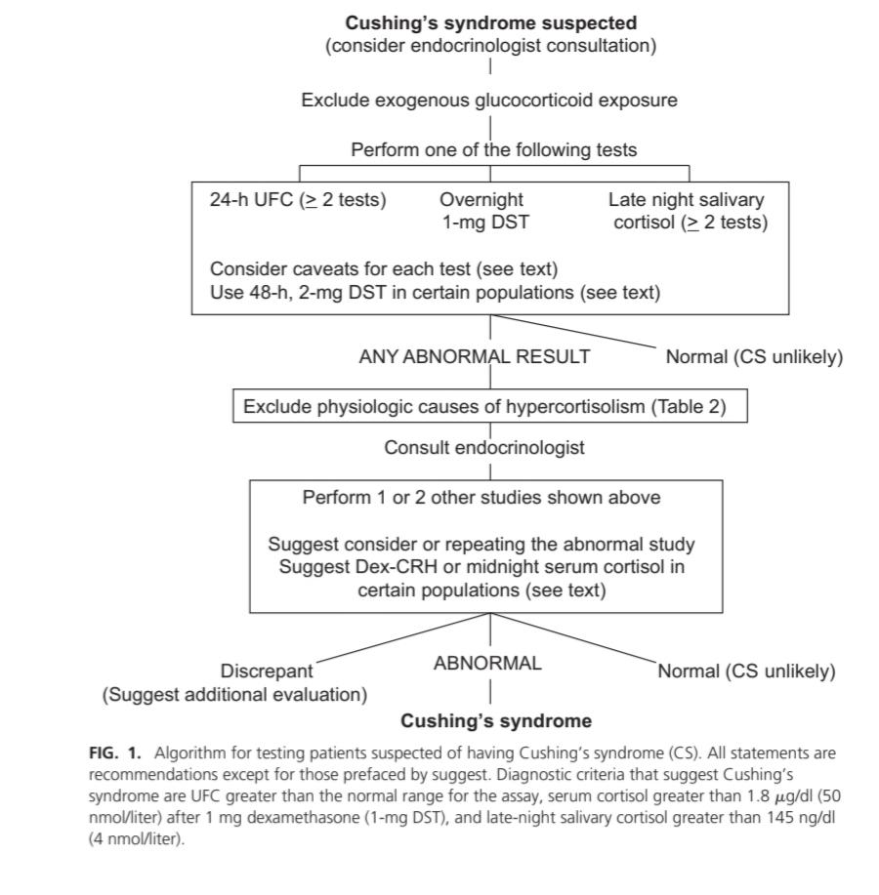

Slide 11
Sensitivity and specificity of screen tests:
All three tests have a sensitivity above 90%
specificity was less sensitivity
Brandon P Galm, Nidan Qiao, Anne Klibanski, Beverly M K Biller, Nicholas A Tritos, Accuracy of Laboratory Tests for the Diagnosis of Cushing Syndrome, The Journal of Clinical Endocrinology & Metabolism, Volume 105, Issue 6, June 2020, Pages 2081–2094, https://doi.org/10.1210/clinem/dgaa105
max sensitivity:DST and LNSC
max:LNSC
min:UFC ,DST
min sensitivity:UFC
Raff H, Carroll T. Cushing's syndrome: from physiological principles to diagnosis and clinical care. J Physiol. 2015 Feb 1;593(3):493-506. doi: 10.1113/jphysiol.2014.282871. Epub 2015 Jan 5. PMID: 25480800; PMCID: PMC4324701.

Slide 12
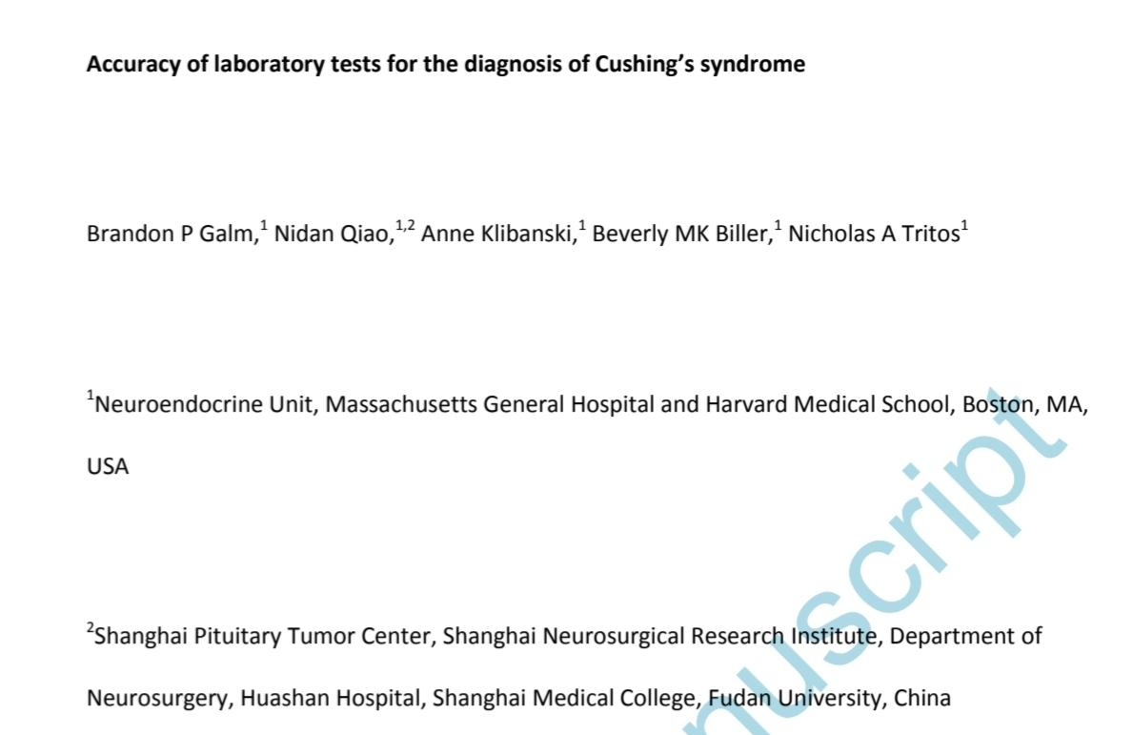
Brandon P Galm, Nidan Qiao, Anne Klibanski, Beverly M K Biller, Nicholas A Tritos, Accuracy of Laboratory Tests for the Diagnosis of Cushing Syndrome, The Journal of Clinical Endocrinology & Metabolism, Volume 105, Issue 6, June 2020, Pages 2081–2094, https://doi.org/10.1210/clinem/dgaa105

Slide 13
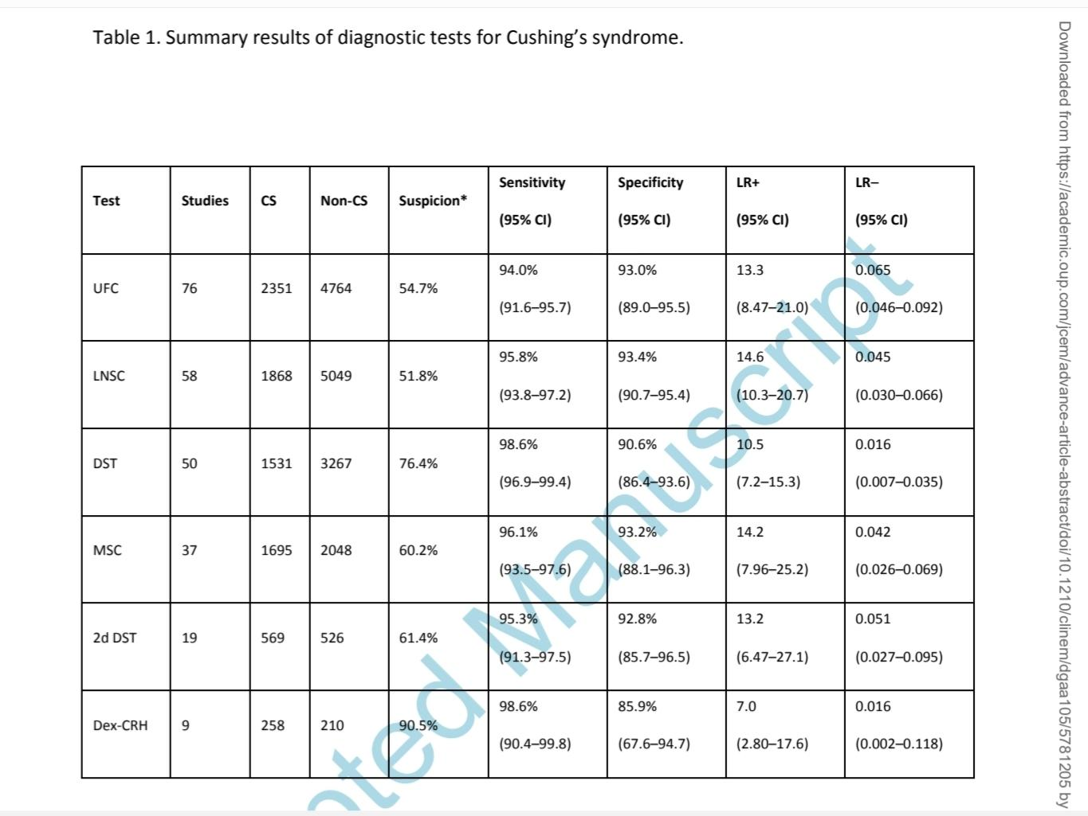

Slide 15
LNSC:
The diagnostic utility of LNSC is based on the assumption
that patients with Cushing’s syndrome lose the normal
circadian nadir of cortisol secretion, at least two or
three LNSC tests are recommended. Patients with mild
Cushing’s syndrome may have LNSC just above the
upper limit of normal (ULN). Sampling saliva at usual
bedtime rather than at midnight could decrease falsepositive
results, as cortisol nadir is tightly entrained to
sleep onset. Liquid chromatography tandem mass
spectrometry can detect both cortisol and cortisone,
thereby identifying contamination from topical
hydrocortisone preparations, which typically do not
contain cortisone. Thus, specificity is higher when using
mass spectrometry while immunoassay has higher
sensitivity for Cushing’s syndrome.
Petersenn S. Biochemical diagnosis of Cushing's disease: Screening and confirmatory testing. Best Pract Res Clin Endocrinol Metab. 2021 Jan;35(1):101519. doi: 10.1016/j.beem.2021.101519. Epub 2021 Mar 15. PMID: 33757676.

Slide 16
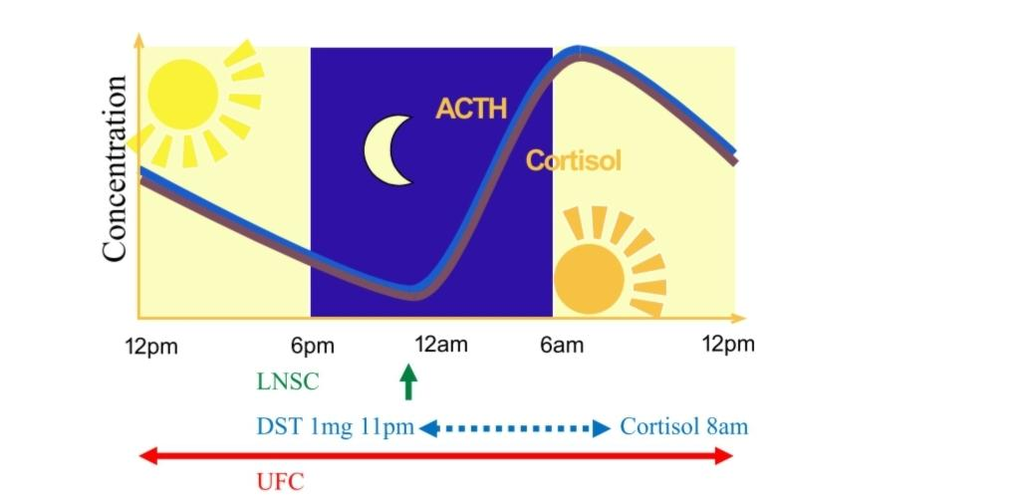
LNSC:
The diagnostic utility of LNSC is based on the assumption
that patients with Cushing’s syndrome lose the normal
circadian nadir of cortisol secretion, at least two or
three LNSC tests are recommended. Patients with mild
Cushing’s syndrome may have LNSC just above the
upper limit of normal (ULN). Sampling saliva at usual
bedtime rather than at midnight could decrease falsepositive
results, as cortisol nadir is tightly entrained to
sleep onset. Liquid chromatography tandem mass
spectrometry can detect both cortisol and cortisone,
thereby identifying contamination from topical
hydrocortisone preparations, which typically do not
contain cortisone. Thus, specificity is higher when using
mass spectrometry while immunoassay has higher
sensitivity for Cushing’s syndrome.
Petersenn S. Biochemical diagnosis of Cushing's disease: Screening and confirmatory testing. Best Pract Res Clin Endocrinol Metab. 2021 Jan;35(1):101519. doi: 10.1016/j.beem.2021.101519. Epub 2021 Mar 15. PMID: 33757676.

Slide 17
LNSC:
Multiple, periodic,
sequential LNSC tests are particularly useful for the
longitudinal surveillance needed in distinguishing
patients with cyclic Cushing’s syndrome who exhibit
weeks to months of normal cortisol secretion interspersed
with episodes of cortisol excess. By contrast, LNSC
should not be done in patients with disruption of the
normal day and night cycle, such as night-shift worker
Petersenn S. Biochemical diagnosis of Cushing's disease: Screening and confirmatory testing. Best Pract Res Clin Endocrinol Metab. 2021 Jan;35(1):101519. doi: 10.1016/j.beem.2021.101519. Epub 2021 Mar 15. PMID: 33757676.

Slide 18
Overnight 1-mg DST
In healthy individuals, a supraphysiological dexamethasone
dose inhibits vasopressin and ACTH secretion,
thereby decreasing cortisol concentrations. Thus, a serum
cortisol concentration of less than 1·8 µg/dL (50 nmol/L)
at 0800 h in the morning after 1 mg dexamethasone given
between 2300 h and midnight is considered to be a normal
response.
A negative result strongly predicts absence of
Cushing’s syndrome. At higher cutoff points (eg, 5 µg/dL
[138 nmol/L]), DST sensitivity is reduced. Cortisol
concentrations of less than 1·8 µg/dL excludes
dysregulated cortisol production from an adrenal
incidentaloma;in this setting, values higher than 5 µg/dL
generally identify patients with dysregulated cortisol
secretion from an incidentaloma with overt Cushing
Miguel Debono, Mike Bradburn, Matthew Bull, Barney Harrison, Richard J. Ross, John Newell-Price, Cortisol as a Marker for Increased Mortality in Patients with Incidental Adrenocortical Adenomas, The Journal of Clinical Endocrinology & Metabolism, Volume 99, Issue 12, December 2014, Pages 4462–4470, https://doi.org/10.1210/jc.2014-3007
Petersenn S. Biochemical diagnosis of Cushing's disease: Screening and confirmatory testing. Best Pract Res Clin Endocrinol Metab. 2021 Jan;35(1):101519. doi: 10.1016/j.beem.2021.101519. Epub 2021 Mar 15. PMID: 33757676.

Slide 19
overnight false-positive
False positive results might be seen with rapid absorption or malabsorption of dexamethasone due to increased gut transit time, chronic diarrhoea, or coeliac disease; from concomitant treatment with CYP3A4 inducers (eg, phenobarbital, carbamazepine, and from increased corticosteroid-binding globulin (CBG) concentrations caused by oral oestrogens, pregnancy, or chronic active hepatitis, which can increase total cortisol concentrations. Measuring dexamethasone concomitantly with cortisol, using laboratory-specific ranges of expected values, can reduce the risk for false-positive results
Ueland GÅ, Methlie P, Kellmann R, Bjørgaas M, Åsvold BO, Thorstensen K, Kelp O, Thordarson HB, Mellgren G, Løvås K, Husebye ES. Simultaneous assay of cortisol and dexamethasone improved diagnostic accuracy of the dexamethasone suppression test. Eur J Endocrinol. 2017 Jun;176(6):705-713. doi: 10.1530/EJE-17-0078. Epub 2017 Mar 15. PMID: 28298353.

Slide 20
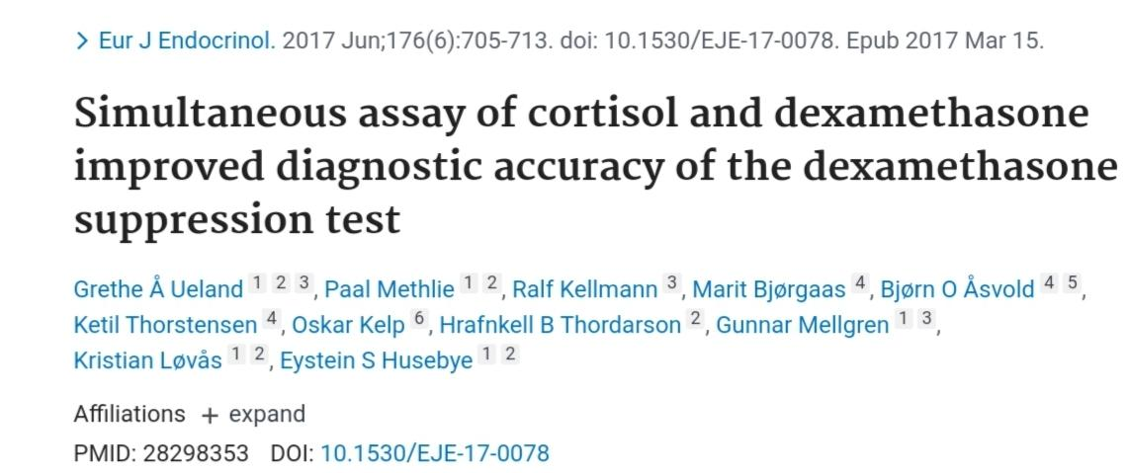
Ueland GÅ, Methlie P, Kellmann R, Bjørgaas M, Åsvold BO, Thorstensen K, Kelp O, Thordarson HB, Mellgren G, Løvås K, Husebye ES. Simultaneous assay of cortisol and dexamethasone improved diagnostic accuracy of the dexamethasone suppression test. Eur J Endocrinol. 2017 Jun;176(6):705-713. doi: 10.1530/EJE-17-0078. Epub 2017 Mar 15. PMID: 28298353.

Slide 21
False-negative DST
False-negative results are less common, typically resulting from inhibition of dexamethasone metabolism by concomitant medications such as fluoxetine, cimetidine, or diltiazem, leading to a higher biologically available dose. Decreased CBG and albumin concentrations, which can be noted in patients with concurrent nephrotic syndrome, also might produce a falsely low value.
Findling JW, Raff H, Aron DC. The low-dose dexamethasone suppression test: a reevaluation in patients with Cushing's syndrome. J Clin Endocrinol Metab. 2004 Mar;89(3):1222-6. doi: 10.1210/jc.2003-030207. PMID: 15001614.

Slide 22
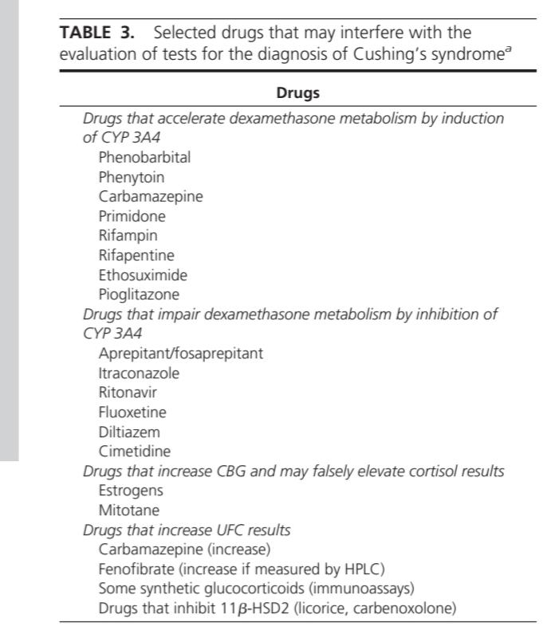

Slide 23
UFC
At least two or three 24-h urine collections are advised to
measure UFC to account for intra-patient variability.
One advantage with UFC over DST is that overall cortisol
production is independent of CBG changes and
dexamethasone metabolism or compliance.
As with LNSC, UFC relies on accurate
collection by the patient.
Sex, body-mass index (BMI), age, very high or low
urinary volume, and sodium intake can all influence UFC
concentrations and should be taken into account for
interpretation. Because urine volume and glomerular
filtration rate strongly predict UFC, other screening tests
such as LNSC might be preferred for patients with renal
impairment (creatinine clearance <60 mL/min) or
clinically significant polyuria (>5 L/24 h)
Raff H, Cohen EP, Findling JW. A commentary on Diagnosing Cushing's disease in the context of renal failure. Eur J Endocrinol. 2019 Oct;181(4):C9-C11. doi: 10.1530/EJE-19-0560. PMID: 31349218.

Slide 24
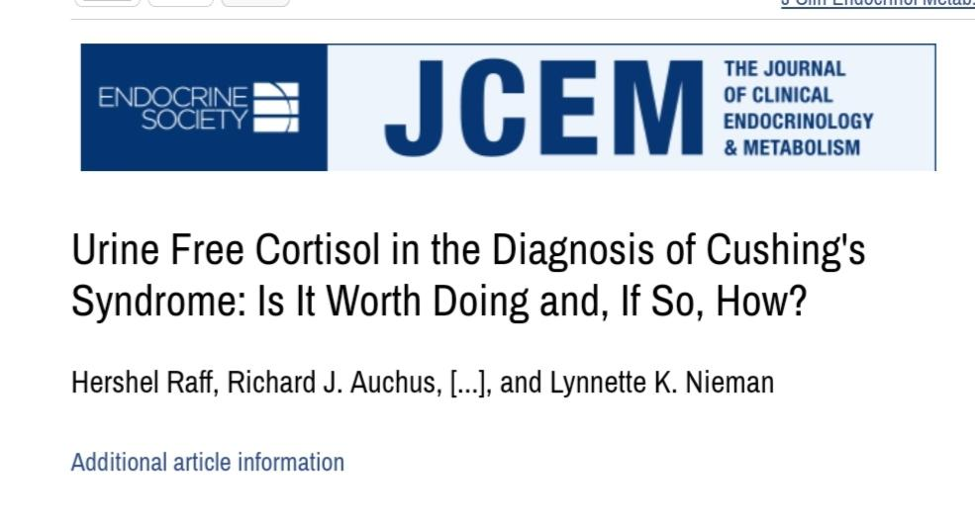
UFC
At least two or three 24-h urine collections are advised to
measure UFC to account for intra-patient variability.
One advantage with UFC over DST is that overall cortisol
production is independent of CBG changes and
dexamethasone metabolism or compliance.
As with LNSC, UFC relies on accurate
collection by the patient.
Sex, body-mass index (BMI), age, very high or low
urinary volume, and sodium intake can all influence UFC
concentrations and should be taken into account for
interpretation. Because urine volume and glomerular
filtration rate strongly predict UFC, other screening tests
such as LNSC might be preferred for patients with renal
impairment (creatinine clearance <60 mL/min) or
clinically significant polyuria (>5 L/24 h)
Raff H, Cohen EP, Findling JW. A commentary on Diagnosing Cushing's disease in the context of renal failure. Eur J Endocrinol. 2019 Oct;181(4):C9-C11. doi: 10.1530/EJE-19-0560. PMID: 31349218.

Slide 25
Petersenn S. Biochemical diagnosis of Cushing's disease: Screening and confirmatory testing. Best Pract Res Clin Endocrinol Metab. 2021 Jan;35(1):101519. doi: 10.1016/j.beem.2021.101519. Epub 2021 Mar 15. PMID: 33757676.

Slide 26
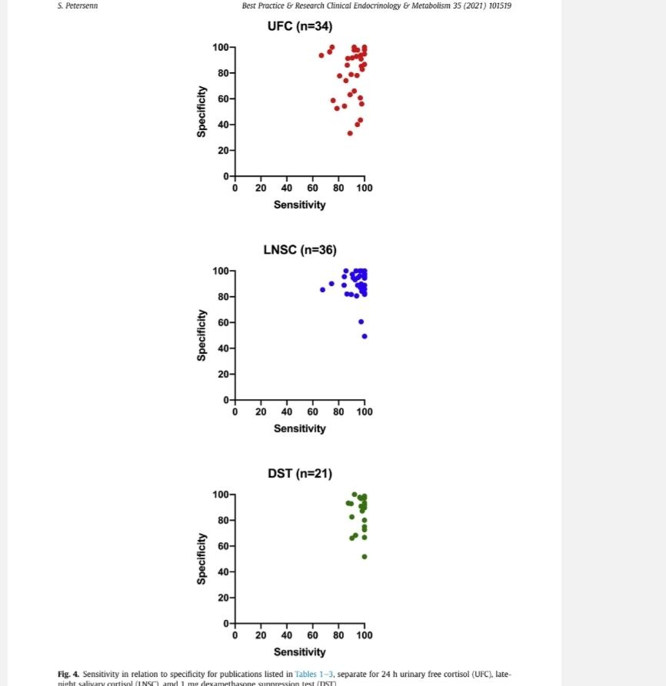

Slide 27
Clinical considerations and recommendations for laboratory tests
We recommend starting with UFC, LNSC, DST, or a combination (high quality,
strong recommendation) depending on local availability; multiple LNSCs might be
easier for the patient to complete (high quality, strong recommendation
If an adrenal tumour is suspected, we recommend starting with DST (moderate
quality, strong recommendation) and only using LNSC if cortisone concentrations
can be also reported (moderate quality, strong recommendation
DST might be the preferred test for shift workers and patients with disrupted
circadian rhythm due to uneven sleep schedules, but might not be reliable in
women treated with oral oestrogen (high quality, strong recommendation).

Slide 28
Clinical considerations and recommendations for laboratory tests
Measuring dexamethasone levels can be useful if a falsepositive DST is suspected due
clinical scenario (moderate quality, strong recommendation).
If UFC is used, two or three collections should be obtained to evaluate variability (high quality,
strong recommendation).
If LNSC is used, we recommend at least two or three tests (high quality, strong recommendation)
(IPSS) should not be used to diagnose hypercortisolism because the centraltoperipheral ACTH
gradient in healthy controls and pseudoCushing’s syndrome overlaps with that observed in patients
with Cushing’s disease (high quality, strong recommendation).

Slide 29
Clinical considerations and recommendations for laboratory tests
Measuring dexamethasone levels can be useful if a falsepositive DST is suspected due to the
clinical scenario (moderate quality, strong recommendation).
If UFC is used, two or three collections should be obtained to evaluate variability (high quality,
strong recommendation
If LNSC is used, we recommend at least two or three tests (high quality, strong recommendation)
(IPSS) should not be used to diagnose hypercortisolism because the centraltoperipheral ACTH
gradient in healthy controls and pseudoCushing’s syndrome overlaps with that observed in patients
with Cushing’s disease (high quality, strong recommendation).

Slide 30
Clinical considerations and recommendations for laboratory tests
In classical cyclic Cushing’s disease or in patients with
unpredictable fluctuating cortisol concentrations, dynamic testing
and localisation testing, including IPSS, should be preceded by a
confirmatory LNSC or UFC to document that the patients are in
the active phase

Slide 31
Diagnosis of Cushing’s syndrome: screening,
confirmatory, and localisation modaliti
If Cushing’s syndrome is suspected:
• Start with urinary-free cortisol (UFC), late-night salivary
cortisol (LNSC), or both; dexamethasone suppression test
(DST) could also be an option if LNSC not feasible
• Multiple LNSC might be easier for patient collection
Raff H, Carroll T. Cushing's syndrome: from physiological principles to diagnosis and clinical care. J Physiol. 2015 Feb 1;593(3):493-506. doi: 10.1113/jphysiol.2014.282871. Epub 2015 Jan 5. PMID: 25480800; PMCID: PMC4324701.
.

Slide 33
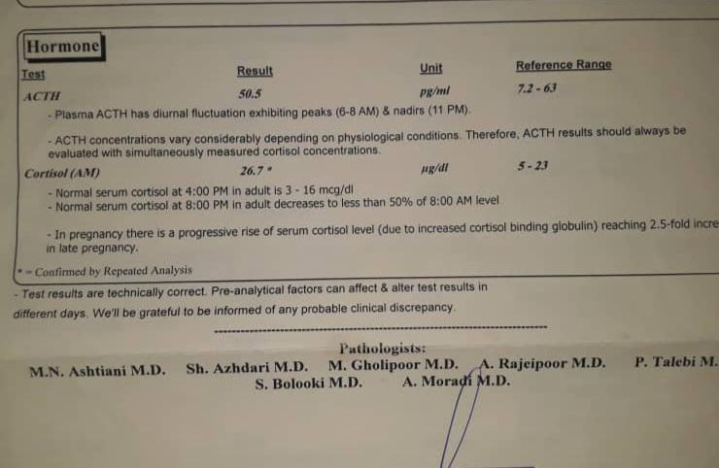
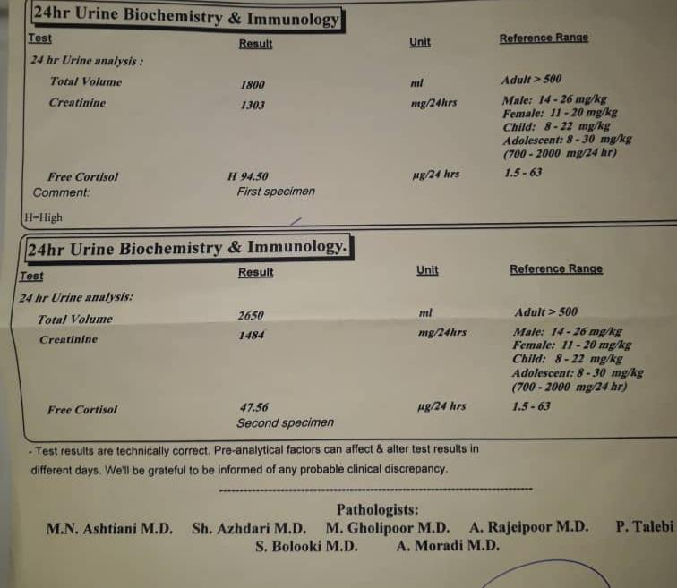
Introducing the real case number one
The patient was a 35-year-old woman who had been suffering from eating disorders, weight gain, and striae for the past eight months.Hirsutism Mens disorder and eating disorder.mri and normal adrenal CT.moon face but with out striae

Slide 34
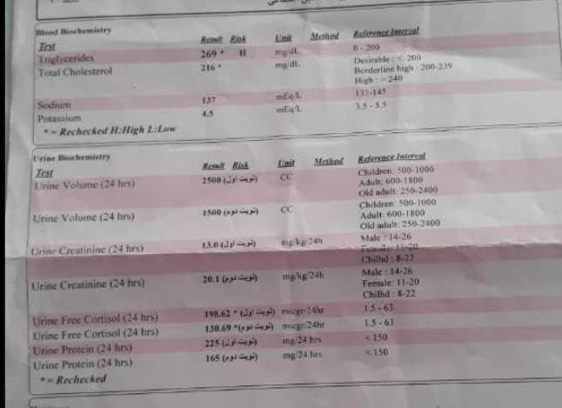

Slide 35
LDDST

Slide 36
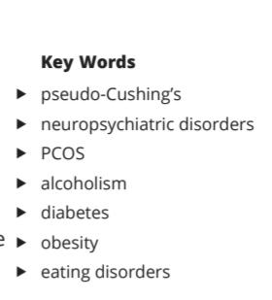
Scaroni C, Albiger NM, Palmieri S, Iacuaniello D, Graziadio C, Damiani L, Zilio M, Stigliano A, Colao A, Pivonello R; Altogether to Beat Cushing’s Syndrome (ABC) study group. Approach to patients with pseudo-Cushing's states. Endocr Connect. 2020 Jan;9(1):R1-R13. doi: 10.1530/EC-19-0435. PMID: 31846432; PMCID: PMC6993268.

Slide 37
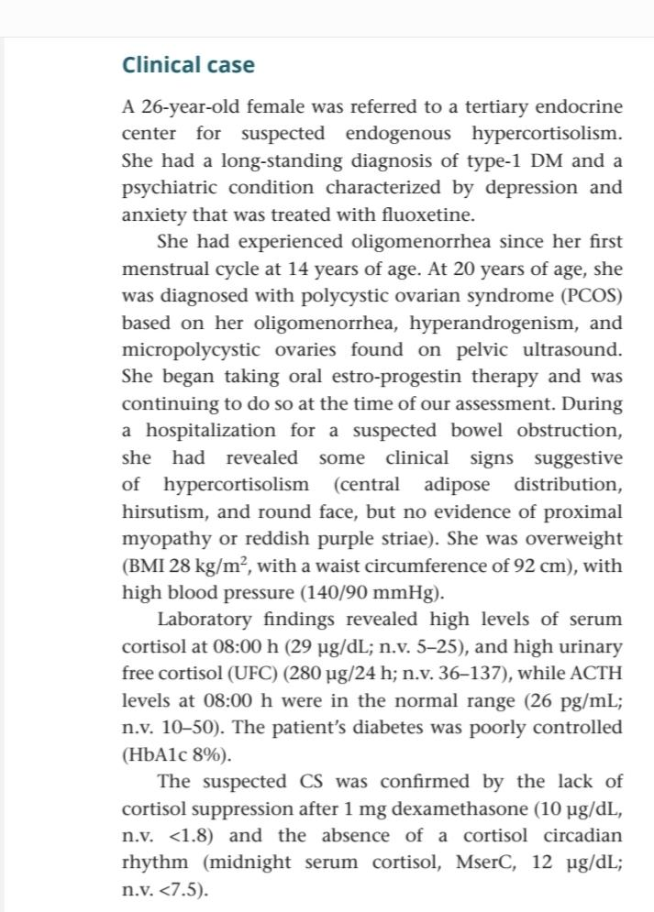

Slide 38
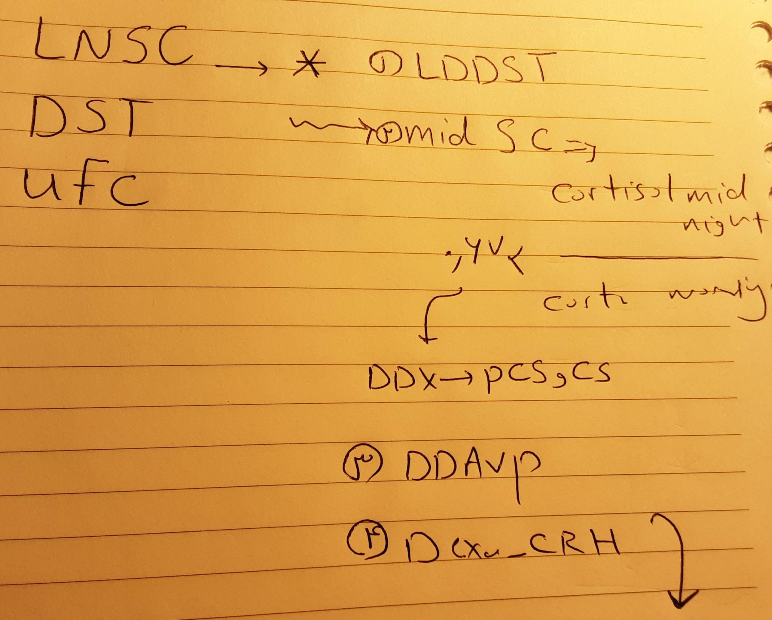
When a diagnosis is unreliable, we suggest treating the associated conditions and adopting a close follow-up, because the hypercortisolism associated with CS may progress, and the condition might consequently be diagnosed at a later date.

Slide 39
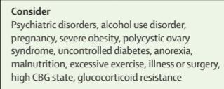
Non-neoplastic hypercortisolism
Psychiatric disorders, alcohol use disorder, polycystic ovary
syndrome, and obesity can activate the hypothalamic–
pituitary–adrenal (HPA) axis. Such patients might also
have concomitant features of Cushing’s syndrome that are
common in the general population (eg, weight gain) that
lead to biochemical screening. DST, LNSC, and UFC can
all show positive (abnormal) results in these patients with
non-neoplastic clinical hypercortisolism, or so-called
pseudo-Cushing’s syndrome.Furthermore, concomitant
medications could result in steroid cross-reactivity or
otherwise interfere with laboratory test results. However,
these abnormal results tend to be mildly elevated; UFC is
almost always within 3-fold of normal concentrations. The
combined LDDT–corticotrophin-releasing hormone
(CRH; Dex-CRH) test, LDDT, or the desmopressin test
might be able to distinguish between ACTH-dependent
Cushing’s syndrome and pseudo-Cushing’s syndrome
Scaroni C, Albiger NM, Palmieri S, Iacuaniello D, Graziadio C, Damiani L, Zilio M, Stigliano A, Colao A, Pivonello R; Altogether to Beat Cushing’s Syndrome (ABC) study group. Approach to patients with pseudo-Cushing's states. Endocr Connect. 2020 Jan;9(1):R1-R13. doi: 10.1530/EC-19-0435. PMID: 31846432; PMCID: PMC6993268.

Slide 40
pseudo-Cushing’s syndrome
Utility of the Dex-CRH test in this setting is based on the
assumption that only patients with ACTH-dependent
Cushing’s syndrome will show a cortisol response to CRH
after dexamethasone suppression. However, test
reliability can differ because of different protocols, use of
ovine or human CRH in varying doses, characteristics of
cortisol and ACTH assays, and patient characteristics
(eg, degree of hypercortisolism, adrenal versus pituitary
Cushing’s syndrome, and comorbidities). Use of the
desmopressin test is based on the finding that ACTHsecreting
adenomas express vasopressin V1b receptors
(also known as vasopressin 3 receptors), producing an
increase in plasma ACTH concentration after desmopressin
injection.The desmopressin test has a high
specificity for Cushing’s disease and is less complex and
expensive than the Dex-CRH test, but both tests have
shown good diagnostic performance in distinguishing
Cushing’s syndrome from pseudo-Cushing’s syndrome in
some studies; when both tests are done, they showed
excellent agreement
Scaroni C, Albiger NM, Palmieri S, Iacuaniello D, Graziadio C, Damiani L, Zilio M, Stigliano A, Colao A, Pivonello R; Altogether to Beat Cushing’s Syndrome (ABC) study group. Approach to patients with pseudo-Cushing's states. Endocr Connect. 2020 Jan;9(1):R1-R13. doi: 10.1530/EC-19-0435. PMID: 31846432; PMCID: PMC6993268.

Slide 41
Non-neoplastic hypercortisolism
remains one of the most challenging
diagnoses. Because the cause of pseudo-Cushing’s
syndrome varies, there is no single approach to rule it
out.We recommend considering the patient’s clinical
history, particularly the duration of symptoms, and
repeating tests to avoid implementing inappropriate
treatment if Cushing’s syndrome is .
monitored for 3–6 months to see whether symptoms
resolve; treatment of the underlying condition (such as
depression) can restore normal HPA axis function and
cortisol conce. Standard diagnostic testing is
unreliable in this population. LDDT or serial LNSC
tests over time correlate with . Desmopressin
is easy to use and easily administered in an outpatient
setting. Dex-CRH in this setting could be valuable, but
published diagnostic accuracy results have varied;
use at an expert centre with measurement of
dexamethasone concentrations is advised

Slide 42
Imaging and tumour localisation
MRI is the imaging method of choice for detecting ACTHsecreting
pituitary adenomas. However, in part because
most lesions are very small, with use of standard 1·5T MRI
only approximately 50% of microadenomas are clearly
depicted
PET: an alternative to, or in combination with, MRI for
localisation of corticotroph adenomas.
18FFDG PET/CT: detecting pituitary lesions. Prior CRH stimulation
can increase . FFDG uptake and thus increase detection.
Mathioudakis N, Pendleton C, Quinones-Hinojosa A, Wand GS, Salvatori R. ACTH-secreting pituitary adenomas: size does not correlate with hormonal activity. Pituitary. 2012 Dec;15(4):526-32. doi: 10.1007/s11102-011-0362-8. PMID: 22057967; PMCID: PMC4648273.

Slide 43
Imaging and tumour localisation
PET co-registration with volumetric MRI combines functional and anatomical
imaging: this technique correctly localised corticotroph adenomas in patients
with de novo disease and persistent or recurrent hypercortisolism after primary
surgery, most of whom had negative or equivocal standard-spin echo MRI.
However, this approach is not available or approved in most countrie
•Alternative strategies (eg, targeting CRH1 receptors on corticotroph tumours)
have also recently been proposed, but require further study.
Walia R, Gupta R, Bhansali A, Pivonello R, Kumar R, Singh H, Ahuja C, Chhabra R, Singh A, Dhandapani S, Sahoo S, Rana N, Vatsa R, Dutta P, Kumar Bhadada S, Sachdeva N, Mittal BR, Nahar U, Shukla J. Molecular Imaging Targeting Corticotropin-releasing Hormone Receptor for Corticotropinoma: A Changing Paradigm. J Clin Endocrinol Metab. 2021 Mar 25;106(4):e1816-e1826. doi: 10.1210/clinem/dgaa755. PMID: 33079979.

Slide 44
Clinical considerations & recommendations for
imaging & tumour localisation
MRI remains the imaging modality of choice for
ACTH-secreting pituitary adenomas (high quality,
strong recommendation).
We suggest 3T instead of 1·5T MRI where available
(low quality, discretionary recommendation).
Koulouri O, Steuwe A, Gillett D, Hoole AC, Powlson AS, Donnelly NA, Burnet NG, Antoun NM, Cheow H, Mannion RJ, Pickard JD, Gurnell M. A role for 11C-methionine PET imaging in ACTH-dependent Cushing's syndrome. Eur J Endocrinol. 2015 Oct;173(4):M107-20. doi: 10.1530/EJE-15-0616. Epub 2015 Aug 5. PMID: 26245763.

Slide 45
Distinguishing between Cushing’s disease and ectopic
Desmopressin and CRH stimulation testing have proven useful in distinguishing between
pituitary and ectopic tumors. Increased plasma ACTH and increased cortisol
concentrations after CRH or desmopressin administration usually indicates Cushing’s
disease. Nevertheless, well differentiated neuroendocrine tumours can also express any or all
of these receptors, potentially leading to false-positive results.
High-dose (8 mg) DST, although it has low accuracy overall, is still used in some countries.
Biller BM, Grossman AB, Stewart PM, Melmed S, Bertagna X, Bertherat J, Buchfelder M, Colao A, Hermus AR, Hofland LJ, Klibanski A, Lacroix A, Lindsay JR, Newell-Price J, Nieman LK, Petersenn S, Sonino N, Stalla GK, Swearingen B, Vance ML, Wass JA, Boscaro M. Treatment of adrenocorticotropin-dependent Cushing's syndrome: a consensus statement. J Clin Endocrinol Metab. 2008 Jul;93(7):2454-62. doi: 10.1210/jc.2007-2734. Epub 2008 Apr 15. PMID: 18413427; PMCID: PMC3214276.

Slide 46
Distinguishing between Cushing’s disease and ectopic
IPSS, which measures ACTH in pituitary versus peripheral venous drainage,
has long been the gold standard to reliably exclude ectopic ACTH production.
A central to peripheral ACTH gradient less than 2 before or less than 3 after
stimulation suggests an ectopic tumour; however, both false-negatives and
false-positives have been reported. Prolactin measurement might improve
diagnostic accuracy and it is essential that the patient is hypercortisolaemic at
the time of IPSS.

Slide 47
Distinguishing between Cushing’s disease and ectopic
noninvasive approach using a combination of three or four tests,
specifically CRH and desmopressin stimulation plus MRI, followed
by whole-body CT if diagnosis is equivocal, correctly diagnosed
Cushing’s disease in approximately half of patients in one series,
potentially eliminating the need for IPSS. A positive CT scan,
negative CRH and desmopressin stimulation, and negative MRI, had
a negative predictive value of 100% for Cushing’s disease.
Nieman, Lynnette K. "Is it time for a new approach to the differential diagnosis of ACTH-dependent Cushing syndrome?." The Journal of Clinical Endocrinology & Metabolism 105.12 (2020): e4964-e4966.

Slide 48
Prolactin
measurement can be useful in ruling out a false-negative
IPSS
Although IPSS has high diagnostic accuracy for localisation
to the pituitary gland, it is not sufficiently reliable for
tumour lateralisation to the right or left side of the gland
HDDST
low
Pit MRI
whole body CT
IPSS
CRH Test

Slide 49
Distinguishing between Cushing’s disease and ectopic
GaDOTATATE is a modified (Tyr3) octreotide molecule covalently linked to -
tetraazacyclododecane tetraacetic acid (DOTA) combined with the radioactive Ga isotope. The
radiopharmaceutical, with a halflife of approximately 1 h, binds to somatostatin receptors with
affinity similar to octreotide and can be used as a tracer in PET imaging of ectopic ACTHsecreting
neuroendocrine tumours. GaDOTATATE localises about 65% of these tumours, including those
not seen or not definitively identified on crosssectional imaging, and images are sharper than with
single photon ¹¹¹InDTPApentetreotide, with greater sensitivity for small tumours. False-positives
can occur because of chronic inflammation, and a positive scan does not definitively prove that the
neuroendocrine tumour is the source of ACTH, but GaDOTATATE imaging can be useful in
guiding clinical management.
Hofman MS, Lau WF, Hicks RJ. Somatostatin receptor imaging with 68Ga DOTATATE PET/CT: clinical utility, normal patterns, pearls, and pitfalls in interpretation. Radiographics. 2015 Mar-Apr;35(2):500-16. doi: 10.1148/rg.352140164. PMID: 25763733.

Slide 50
Clinical considerations and recommendations for
distinguishing between Cushing’s disease and ectopic
No single laboratory test or combination of tests can
absolutely differentiate between pituitary and ectopic
ACTH-secreting tumours .
.We recommend using both the
clinical context and test results to guide management
pituitary tumour with a diameter of 10 mm or larger
is detected on MRI and dynamic testing results are
consistent with Cushing’s disease, IPSS is not necessary
There was consensus that all patients
with lesions less than 6 mm should have IPSS and those
with lesions of 10 mm or larger do not need IPSS
Expert opinions differ
regarding tumors 6–9 mm, but the majority recommended
IPSS to confirm the diagnosis in this circumstance

Slide 51
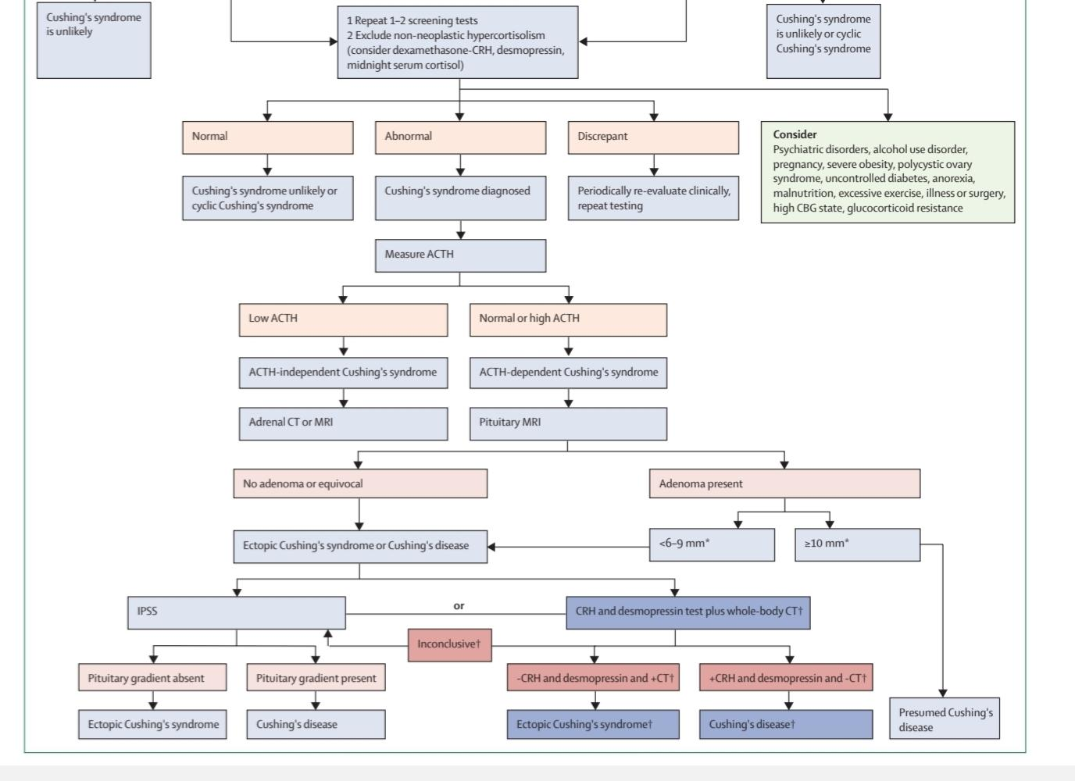

Slide 52
Introducing the real case number two
A 41-year-old woman with symptomatic Cushing's syndrome from two years ago who underwent the following examination

Slide 53
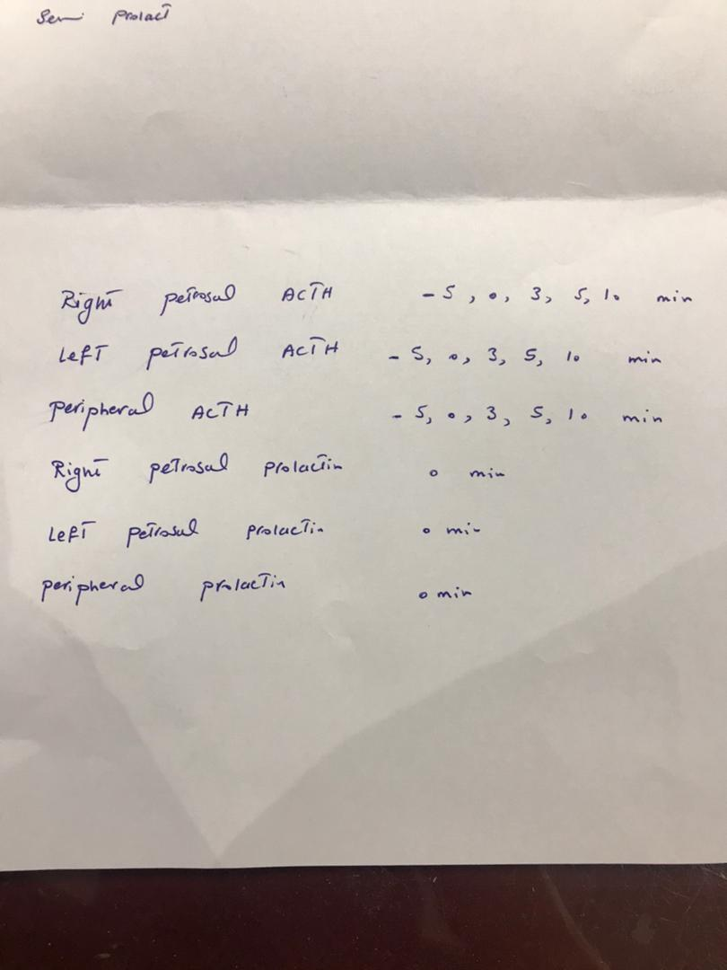
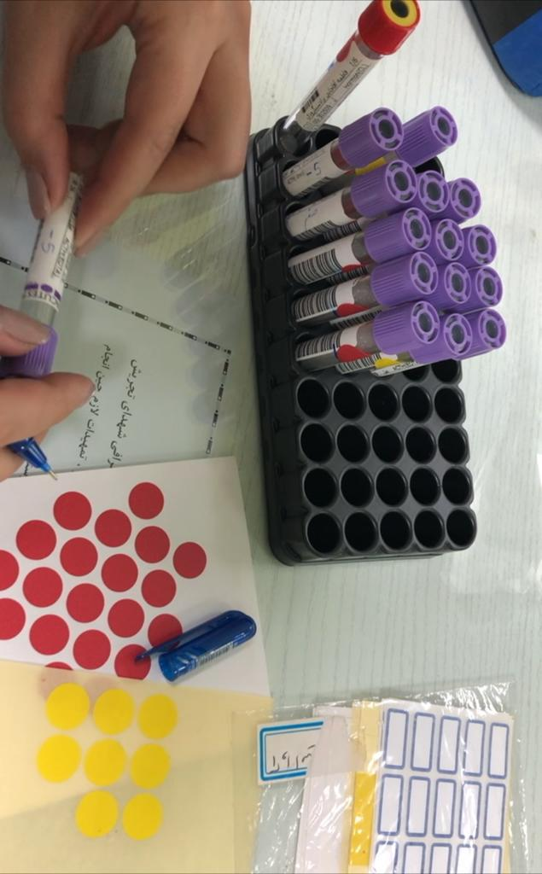
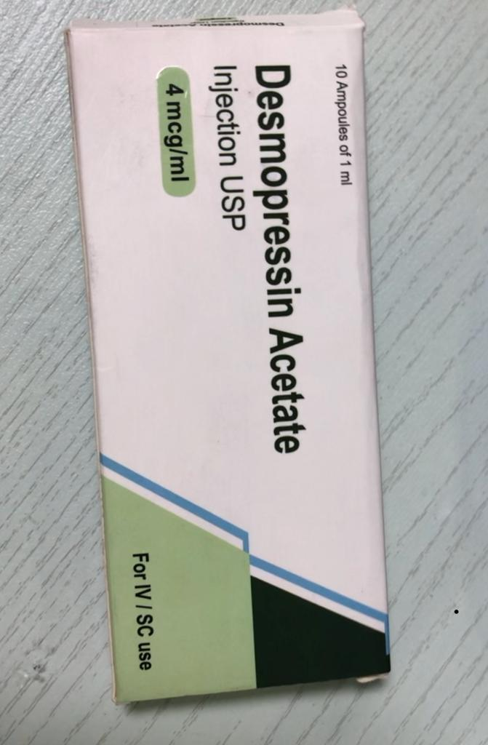

Slide 54
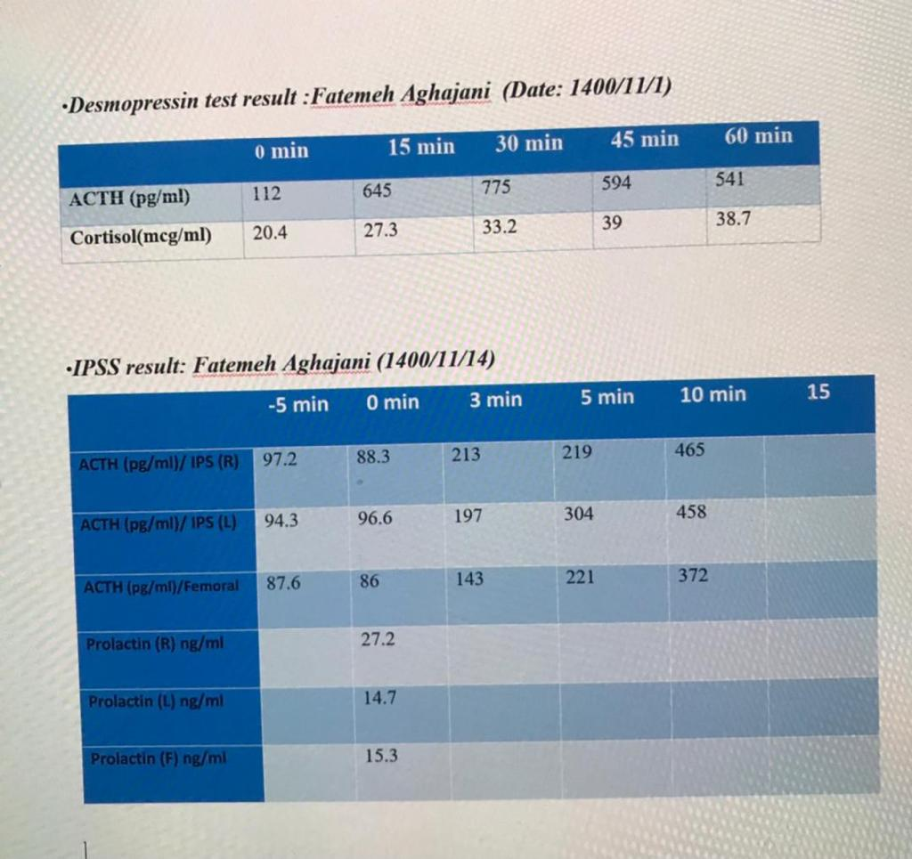

Slide 55
Complications of Cushing’s disease
Hypercoagulability
2. Cardiovascular disease
3. Bone disease
4. Growth hormone deficiency
5. Other complications

Slide 56
Hypercoagulability
DEC PTT,inc fibrinogen, vwf, factor vlll, PAI-1,pro c,S ,anti plasmin, thrombin ,TAXa2!PLT
Hypercoagulability in Cushing’s syndrome resulting in
increased risk of thromboembolic events is paradoxically
coupled with an increased bleeding tendency due to skin
atrophy and capillary fragility
VTE risk persists in the first few
months after Cushing’s disease surgery, indicating that
hypercoagulability is not immediately reversible with
cortisol normalisation
The incidence of venous thromboembolic events (VTE)
in patients with endogenous Cushing’s syndrome is more
than ten times higher versus those with nonfunctioning
pituitary adenomas undergoing surgery with an odds
ratio (OR) of 17·82 (95% CI 15·24–20·85)
Thromboprophylaxis can decrease the incidence of postoperative VTE, particularly when
extended to 30 days.
Stuijver DJ, van Zaane B, Feelders RA, Debeij J, Cannegieter SC, Hermus AR, van den Berg G, Pereira AM, de Herder WW, Wagenmakers MA, Kerstens MN, Zelissen PM, Fliers E, Schaper N, Drent ML, Dekkers OM, Gerdes VE. Incidence of venous thromboembolism in patients with Cushing's syndrome: a multicenter cohort study. J Clin Endocrinol Metab. 2011 Nov;96(11):3525-32. doi: 10.1210/jc.2011-1661. Epub 2011 Aug 31. PMID: 21880802.

Slide 57
Hypercoagulability
There is currently no standard practice for preoperative or
postoperative thromboprophylaxis in patients with
Cushing’s disease. Some experts pause oestrogen therapy
in women who are awaiting surgery, but care should be
taken if it was being used as contraception, because
pregnancy also is associated with increased risk of
thrombosis (low quality, discretionary recommendation)
Prophylactic anticoagulation should be considered for
patients at risk for venous thromboembolic events,
including history of embolism or abnormal coagulation
testing; severe preoperative hypercortisolism; current use
of oestrogen or oral contraceptives; poor mobility;
extended preoperative or postoperative hospital stay;
and high postoperative cortisol concentrations or cortisol
over-replacement in patients with adrenal insufficiency
(moderate quality, strong recommendation)

Slide 58
Hypercoagulability
Early postoperative ambulation and use of compression
stockings should be encouraged for all patients (high
quality, strong recommendation)
If thromboprophylaxis is administered, there was strong
consensus for preference of low molecular weight heparin
over oral anticoagulants given the long half-life of the
latter and the absence of therapy to reverse their effect,
which could be especially concerning in the preoperative
setting (low quality, discretionary recommendation)

Slide 59
Hypercoagulability
Anticoagulants could be discontinued before surgery to
minimise intraoperative bleeding risk, although the timing
of when to stop and when to reinitiate after surgery is
unclear (low quality, discretionary recommendation)
Among meeting participants, recommended
anticoagulation duration in the preoperative setting
ranged from 2–4 days to 1–2 weeks, and in the
postoperative setting from 1–2 days of the hospital stay
up to 2–4 weeks, or even longer, to 2–3 months
(low quality, discretionary recommendation)

Slide 60
Hypercoagulability
Thromboprophylaxis should not be routinely used in
paediatric patients because of bleeding risk but is reserved
for selected patients

Slide 61
Cardiovascular disease
Type 2 diabetes is present in up to 30% of patients and dyslipidaemia, and low
HDL, high LDL, and high triglycerides were reported in 16–64% of cases at
diagnosis
Structural cardiovascular changes improve, including left ventricular
hypertrophy, concentric remodeling, dilated cardiomyopathy, increased intima
media thickness, and increased formation of atherosclerotic plaques, as well as
their clinical manifestations, including hypertension and heart failure, but
might not fully resolve despite remission of hypercortisolism.
Stuijver DJ, van Zaane B, Feelders RA, Debeij J, Cannegieter SC, Hermus AR, van den Berg G, Pereira AM, de Herder WW, Wagenmakers MA, Kerstens MN, Zelissen PM, Fliers E, Schaper N, Drent ML, Dekkers OM, Gerdes VE. Incidence of venous thromboembolism in patients with Cushing's syndrome: a multicenter cohort study. J Clin Endocrinol Metab. 2011 Nov;96(11):3525-32. doi: 10.1210/jc.2011-1661. Epub 2011 Aug 31. PMID: 21880802.

Slide 62
Cardiovascular disease
Myocardial infarction, stroke and other vascular
events are a primary cause of increased standardised
mortality ratio (4·1–16·0) in patients with active or
persistent Cushing’s disease. Most studies show these
rates do not entirely normalise, but are lowered upon
remission, and in one study, patients in remission after a
single pituitary surgery had a normal standardised
mortlity ratio at 10 years. Screening and risk assessment
for cardiovascular risk factors before and after surgery is
therefore essential.
Dekkers OM, Horváth-Puhó E, Jørgensen JO, Cannegieter SC, Ehrenstein V, Vandenbroucke JP, Pereira AM, Sørensen HT. Multisystem morbidity and mortality in Cushing's syndrome: a cohort study. J Clin Endocrinol Metab. 2013 Jun;98(6):2277-84. doi: 10.1210/jc.2012-3582. Epub 2013 Mar 26. PMID: 23533241.

Slide 63
Cardiovascular disease
• Evaluate, monitor, and treat according to current guidelines
for patients at high risk of cardiovascular disease
(high quality, strong recommendation)
• Management approach should be individualised (high
quality, strong recommendation) on the basis of the
complications present (eg, hypertension or
hyperlipidaemia) and care should be coordinated with
primary care and cardiology physicians as needed (very
low quality, discretionary recommendation)

Slide 64
Bone disease
Vertebral fractures occur in 30–50% of patients, largely
correlating with hypercortisolism severity
Dual Xray absorptiometry of the lumbar spine might show
low bone mineral density (BMD), but fractures can occur
even in patients with BMD in the normal or osteopenic
range
Feldt-Rasmussen U, Abs R, Bengtsson BA, Bennmarker H, Bramnert M, Hernberg-Ståhl E, Monson JP, Westberg B, Wilton P, Wüster C; KIMS International Study Board of KIMS Study Group. Growth hormone deficiency and replacement in hypopituitary patients previously treated for acromegaly or Cushing's disease. Eur J Endocrinol. 2002 Jan;146(1):67-74. doi: 10.1530/eje.0.1460067.

Slide 65
Bone disease
Although BMD increases are reported
after hypercortisolism resolution, some patients show
persistently high fracture risk, with men at higher risk
than women. Conventional osteoporosis treatments, such
as bisphosphonates, as well as supportive treatment with
vitamin D and calcium, can induce a more rapid improvement
in BMD than cortisol normalisation alone, and
could be useful in patients with persistent postsurgical
hypercortisolism to prevent further bone loss.Data
about the role of specific bone treatments for patients with
osteopenia who are in remission after Cushing’s disease
treatment are scarce.

Slide 66
Recommendations
• Risk assessment for bone loss and fracture recommended in
all patients (high quality, strong recommendation)
• Given the risk for fracture even in patients without
osteoporosis, standard dual X-ray absorptiometry alone
may not be sufficiently informative; bone quality
(microscanner or trabecular bone score) or morphometric
vertebral assessment is recommended where available
(high quality, strong recommendation) and can be useful in
detecting subclinical fractures (high quality, strong
recommendation), but might not be practical for all
patients. The FRAX tool to assess fracture risk is not
validated for Cushing’s disease

Slide 67
Recommendations
Monitor and follow-up as for all adult high-risk populations
(high quality, strong recommendation)
• Consider conventional osteoporosis treatments
(eg, bisphosphonates) for patients with persistent Cushing’s
disease, even if bone mineral density is normal, because of
increased fracture risk due to cortisol excess (high quality,
strong recommendation)

Slide 68
Growth hormone deficiency
Glucocorticoids, both endogenous and exogenous, inhibit
growth hormone secretion, thereby decreasing IGF-I
production by the liver in patients with Cushing’s
syndrome. Although growth hormone production can
be fully restored in most patients after successful therapy
and recovery of the HPA axis, even years after remission,
persistence of growth hormone deficiency can potentially
worsen hypercortisolism complications such as bone loss,
myopathy, and memory deficits

Slide 69
Growth hormone deficiency
Using the insulin tolerance or glucagon stimulation test, prevalence of
growth hormone deficiency in adults varies with timing of
the diagnosis, ranging from 50–60% when testing was
done within 2 years after surgery to 8–13% when done
more than 2 years after surgery. A prevalence rate of
65% was observed with the GHRH-arginine test after a
median remission time of 3 years after surgery, whereas
36% of patients were diagnosed with growth hormone
deficiency at 99 months after remission post-radiotherapy.
Prevalence using the macimorelin stimulation test is not
known.Notably, IGF-I is an insensitive screening test for
diagnosing growth hormone deficiency in adults.

Slide 70
Growth hormone deficiency
Compared with other causes of growth hormone
deficiency, growth hormone deficiency in patients with
Cushing’s syndrome is more common in women and
young patients; generally, these patients have a higher
prevalence of type 2 diabetes, hypertension, low bone
mass, fractures, and worse quality of life. Myopathy
might be partially related to growth hormone deficiency
among patients in remission. Although preoperative
IGF-I concentrations during active Cushing’s syndrome
did not predict long-term myopathy risk, low 6-month
postoperative IGF-I concentrations strongly predicted
more severe long-term muscle atrophy and weakness
after Cushing’s syndrome remission.

Slide 71
Growth hormone replacement ameliorates several
complications associated with metabolic syndrome and
risk for cardiovascular and cerebrovascular disease.
Studies show decreased bodyweight, waist circumference,
and total and LDL-cholesterol, as well as quality
of life and BMD improvement. Conversely, in patients
with pre-existing glucose intolerance, replacement can
worsen glucose metabolism. Growth hormone
replacement has not yet been shown in randomised,
prospective trials to reverse metabolic syndrome and
cardiovascular or cerebrovascular complications.

Slide 72
Recommendations:
• There is currently no standard practice for whether, when,
and how to test for growth hormone deficiency in adults
with Cushing’s disease. As postoperative hypothalamic–
pituitary–adrenal (HPA) axis recovery is often delayed, we
recommend waiting at least 6–12 months after surgery
before considering growth hormone deficiency assessment
(moderate quality, strong recommendation)
• Patients with macroadenomas and more aggressive surgical
resection are at increased risk of hypopituitarism; patients
with three or more pituitary hormone deficiencies are more
likely to have growth hormone deficiency and do not need
dynamic testing (high quality, strong recommendation)
• Serum insulin-like growth factor I concentration alone is
not likely to be a reliable indicator of growth hormone
deficiency, because concentrations can be in the lower half
of the normal range.

Slide 73
Accessibility of growth hormone replacement can be an
important factor in determining testing and treatment
considerations. If growth hormone replacement is
implemented earlier than 2 years after pituitary surgery,
we recommend retesting periodically to determine whether
growth hormone secretion has normalised upon HPA axis
recovery (moderate quality, strong recommendation)
• As Cushing’s syndrome-associated myopathy does not
always spontaneously resolve during remission, physical
rehabilitation is recommended for all patients (low quality,
discretionary recommendation).
• In children, evaluate for growth hormone deficiency
3–6 months after surgery and immediately initiate growth
hormone replacement if needed to ensure proper growth

Slide 74
Other complications
Increased risk of infection,dysfunction of one or
more pituitary axes such as central hypothyroidism,
gonadal function impairment, infertility, and other
complications can be seen in patients with Cushing’s
disease. Physical and psychological morbidity
commonly affects quality of life, even after successful
treatment in some patients. Persistence of several
features associated with prior hypercortisolism,
including affective disorders, cognitive dysfunction,
and negative illness perception can have a sustained
effect on patients’ wellbeing.

Slide 75
Proximal myopathy is characteristic of Cushing’s syndrome and may persist
despite biochemical remission. The pathology is
multifactorial, including protein degradation through
the forkhead box O3 pathway, as well as accumulation
of intramuscular fat and inactivity-associated muscle
atrophy.Furthermore, hypercortisolism remission
can induce exacerbation of pre-existing autoimmune
disorders.

Slide 76
Initial treatment of Cushing’s disease and
monitoring for recurrence
Pituitary surgery
Transsphenoidal surgery is recommended as first-line
therapy for patients with Cushing’s disease.Remission,
typically defined as postoperative serum cortisol concentrations
lower than 55 nmol/L (<2 µg/dL), is seen in
approximately 80% of patients with microadenomas and
60% with macroadenomas if the procedure is performed
by an experienced surgeon. Patients in remission
require glucocorticoid replacement until HPA axis
recovery. As remission could be delayed, monitoring
until postoperative cortisol nadir can usually identify such
cases.

Slide 77
Initial treatment of Cushing’s disease and monitoring for recurrence
Occasionally, patients with mild hypercortisolism,
cyclic Cushing’s disease, or those treated medically before
surgery can achieve remission without marked postoperative
hypocortisolism. Treatment at a high-volume
centre by an experienced surgeon and tumour
characteristics such as detection on MRI, noninvasiveness,
and size smaller than 10 mm appear to correlate with
increased remission rates; whether there is a potential
incremental benefit with an endoscopic approach for
macroadenomas remains unclear.

Slide 78
complication rates
complication rates are low, with more experienced
surgeons having even lower rates than less experienced
surgeons. New-onset hypopituitarism (in approximately
10% of patients), as well as permanent diabetes insipidus,
CSF leak, and VTE (in <5% of patients), are the most
common complications; peri-operative mortality
is <1%.

Slide 79
Who is an experienced surgeon?
How to measure surgical expertise for Cushing’s disease
remains unclear. Hospitals that limit the number of
neurosurgeons performing transsphenoidal surgery and
therefore increase surgeon experience show better
outcomes and fewer complications, compared with other
hospitals, as well as shorter postoperative length of stay,
and lower costs. Among neurosurgeons who perform
transsphenoidal surgery, survey data demonstrate that
those who have done more than 200 transsphenoidal
surgeries have the lowest complication rates.
Regionalised neurosurgery teams of four or five experts
per 2·5–5 million inhabitants could potentially allow for
optimal outcomes, reduced costs, and increased quality of
care overall

Slide 80
Clinical considerations and recommendations for pituitary surgery
Monitoring for recurrence
Recurrence after successful pituitary surgery is
characterised as the reappearance of clinical and
biochemical features of hypercortisolism after initial
remission. Low or undetectable cortisol concentrations
in the immediate postoperative period is a defining
criterion of remission, but does not necessarily predict
lack of recurrence; some patients who show early
remission with very low (<2–5 μg/dL) postoperative
cortisol concentrations might experience recurrence
later. Published recurrence rates vary between 5%
and 35%, with half of recurrences appearing within the
first 5 years after surgery and half after up to 10 years or
more

Slide 81
Monitoring for recurrence
Lifelong monitoring for recurrence is required
In patients who responded preoperatively to
desmopressin, early postoperative loss of response to
desmopressin with or without dexamethasone or CRH
could predict recurrence risk, but is not consistently
used or recommended by most experts.
• Consider which tests were
abnormal at initial diagnosis
• LNSC most sensitive, should be done annually
• DST and UFC usually become abnormal after LNSC
• UFC is usually the last to become abnormal
Evaluation for recurrence should begin after HPA axis
recovery, and then annually or sooner if there is clinical
suspicion. In practice, however, clinical manifestations
and biomarkers can be discordant

Slide 82
recommendations for recurrence monitor
We recommend lifelong monitoring for recurrence of
Cushing’s disease (moderate quality, strong recommendation).
Postoperative dynamic testing can potentially
predict recurrence (low quality, discretionary recommendation),
but its utility in clinical practice remains to be
established as some patients with low predicted likelihood
of recurrence can recur many years later.
Among the tests available, LNSC is the most sensitive
for detecting recurrence and should be done annually
after HPA axis recovery postoperatively (moderate
quality, strong recommendation)

Slide 83
recommendations for recurrence monitor
LNSC usually shows abnormal results before DST and UFC, although
monitoring for recurrence should also take into
consideration which specific tests showed abnormal
result for an individual patient at initial diagnosis
(moderate quality, strong recommendation)
If only slight biochemical abnormalities are seen without
clinical features of hypercortisolism, close monitoring
with repeat testing and treatment of comorbidities rather
than treatment of the underlying disorder can be
considered (low quality, discretionary recommendation).

Slide 84
Repeat pituitary surgery
Repeat transsphenoidal surgery can be considered in
patients with biochemical evidence of recurrent Cushing’s
disease with visible tumour on MRI. At selected
expert centres where successful reoperation has been
reported despite the absence of detectable adenoma on
MRI, either ACTH-staining adenoma on pathology or a
central ACTH gradient on IPSS at initial operation was
often present

Slide 85
Complications of reoperation
Tumour factors, including size and presence of
extrasellar extension, should be considered regarding
eligibility for reoperation, and neurosurgeon experience
probably plays a role in achieving good results.
Remission rates after reoperation vary widely in the
literature, ranging from 37% to 88%, at least in part
because of different remission criteria and follow-up
durationAlthough some studies have reported a
substantially higher incidence of both surgical (eg, CSF
leak, meningitis) and endocrinological complications
(eg, diabetes insipidus and hypopituitarism) with repeat
versus initial surgery, serious morbidity is less likely in
experienced hands

Slide 86
Medical therapy for Cushing’s disease
Drugs used for treatment of Cushing’s disease target
adrenal steroidogenesis, somatostatin and dopamine
receptors in the pituitary gland, and glucocorticoid
receptors.
Targeting adrenal steroidogenesis
Adrenal steroidogenesis inhibitors that have been
available for many years, including ketoconazole,
metyrapone, mitotane, and etomidate, as well as the
recently approved osilodrostat, block one or more adrenal
enzymes, decreasing glucorticoid synthesis or adrenal
androgen production and secretion, or both
They are
effective in controlling cortisol excess, but do not directly
target the pituitary ACTH-secreting adenoma, nor do
they restore HPA-axis circadian rhythm

Slide 87
Targeting adrenal steroidogenesis
■Ketoconazole
A review of 310 patients with
Cushing’s syndrome treated in five studies with a mean
dose of 673·9 mg per day of ketoconazole and followed
for a mean of 12·6 months showed UFC normalisation in
64·3% of patients (median 50%, range 44·7–92·9%), but
up to 23% of initially responsive patients lost biochemical
control.Similarly, data derived from the largest
retrospective study of 200 patients with Cushing’s disease
who took ketoconazole showed that 33 (64·7%) of
51 patients treated for more than 24 months with a mean
dose of 600 mg per day normalised UFC concentrations,
but 15·4% escaped
studies:

Slide 88
Ketoconazole
Improvement in clinical features of
Cushing’s syndrome has also been observed, including
decreased bodyweight and blood pressure, improved
glucose metabolism, and decreased muscle weakness.
Hepatotoxicity (10–20% of patients) is mostly
asymptomatic with mild or moderate increases in liver
enzymes (≤5 ×ULN), and typically appears within the
first 6 months of treatment; these increases seem not to
be dose-dependent and reverse within 2–12 weeks after
dose decrease or discontinuation
ketoconazole use for Cushing’s syndrome is off-label in the USA.
Gastrointestinal disturbances and adrenal insufficiency
are also common, seen in 5–20% of patients, and skin
rash is observed in approximately 5%. There are
several drug–drug interactions with ketoconazole;
careful review of the patient’s medication list for
potentially problematic interactions is essential.

Slide 89
Targeting adrenal steroidogenesis
Metyrapone
The second drug:
studies:
Treatment with the 11β-hydroxylase inhibitor metyrapone
in 120 patients with Cushing’s syndrome (five studies;
mean dose 2127·5 mg per day, mean follow-up 8·7 months)
showed UFC normalisation in 71% (median 75·5%;
range 45·4–100%), with up to 18% escaping after initial
response.

Slide 90
Metyrapone
A subsequent retrospective multicentre study
of 164 patients with Cushing’s syndrome reported that
43% achieved biochemical control with UFC, with a mean
of 8 months monotherapy, at a mean starting dose of
1040 mg per day and escalating to 1425 mg per day
an observational study of 31 patients with Cushing’s
syndrome, including 20 with Cushing’s disease, showed
that a median dose of 1000 mg per day for 9 months
induced a rapid decrease from baseline in both UFC (–67%)
and LNSC (–57%) after the first month of treatment, with
sustained normalisation in UFC in 70% of patients and in
LNSC in 37% of patients at last visit.Three patients had
loss of control at 9 months despite normal UFC
concentrations at 6 months and two patients also showed
normal LNSC.
prospective study of 50 patients with Cushing’s syndrome
showed that 23 (47%) had UFC normalisation at 12 weeks
(final median metyrapone dose at week 12 was 1500 mg
[250; 5500] mg per day) and adrenal insufficiency was
reported in 6 (12%) of patients

Slide 91
Osilodrostat
Proof-of-concept and phase 2 prospective studies showed
that osilodrostat, an 11β-hydroxylase and aldosterone
synthase inhibitor, was effective in reducing cortisol and
was well-tolerated.

Slide 92
Osilodrostat
studies:
in 137 patients with Cushing’s disease enrolled in a
phase 3, prospective, multicentre, double-blind,
randomised withdrawal study. After 12 weeks of
open-label dose-titrated treatment and 12 additional
weeks of open-label dose-optimised treatment, 72 (53%)
patients had maintained normal UFC and were eligible
for randomisation. By week 34, at the end of the
randomised treatment period, 31 (86%) of 36 randomly
assigned to osilodrostat maintained normal UFC versus
10 (29%) of 35 randomly assigned to placebo (OR 13·7,
95% CI 3·7–53·4; p<0·0001).

Slide 93
Osilodrostat
Treatment with osilodrostat also yielded clinical
improvements. By week 48, patients showed decreases in
bodyweight, blood pressure, total cholesterol, and LDL
cholesterol compared with baseline, and decreased
fasting serum glucose and HbA1c concentrations. Quality
of life and depression scores also improved
side effects:
Nausea, anaemia, and headache were reported in
8–11% of patients, and adverse events related to
hypocortisolism were reported in about half of patients,
mostly during the open-label dose-titration period.
These adverse events were generally manageable with
dose reductions or interruptions, although
glucocorticoid replacement was required in 25 (36%) of
70 patients with one or more hypocortisolism-related
adverse events.

Slide 94
Osilodrostat
58 (42%) of 137 treated patients in the phase 3 study showed effects from
increased levels of adrenal steroid precursors, including
hypokalaemia and hypertension; 12 (11%) of 106 women
reported hirsutism. In another prospective phase 3
study of 44 patients, a significantly greater proportion of
patients receiving osilodrostat (77%) achieved mean
UFC below or equal to the ULN after 12 weeks of
treatment versus placebo (8%), with improvements
seen in clinical features, cardiovascular disease markers,
and quality of life. Hypocortisolism-related adverse
events occurred in 27% of patients

Slide 95
Mitotane
Mitotane inhibits several steroidogenic enzymes and has
a long-lasting adrenolytic action in steroid-secreting
adrenocortical cells. It suppresses hypercortisolism in
80% of cases, but with a slow onset of action and highly
variable bioavailability. Induction of CYP3A4-mediated
rapid inactivation of cortisol leads to a requirement for a
2–3-times increased glucocorticoid replacement dose
when treatment of adrenal insufficiency is needed, or
with a block-and-replace strategy. It is rarely used for
Cushing’s disease. Most workshop participants
considered that use of mitotane should be limited to
patients with adrenal carcinoma

Slide 96
Etomidate
Originally developed as an anaesthetic, etomidate was
shown to rapidly normalise cortisol concentrations,
leading to use for acute control of severe hypercortisolism
in patients treated in an intensive care setting. Low-dose
etomidate (0·04–0·05 mg/kg/h) produces partial
blockade; a high dose (0·5–1 mg/kg/h) provides for
complete blockade, with intravenous hydrocortisone used
to avoid etomidate-induced adrenal insufficiency. Very
low doses (0·025 mg/kg/h) can be used in patients treated
in hospital outside of intensive care,although this might
depend on local practice.
Compared with the lipid formulation, the propylene
glycol preparation of etomidate is more frequently
associated with thrombophlebitis and pain on injection,
and also with additional adverse events, such as
haemolysis and renal tubular injury, as well as lactic
acidosis at high doses

Slide 97
Etomidate

Slide 98
Somatostatin receptor ligands

Slide 99
Somatostatin receptor ligands
Pasireotide
In a phase 3 study of 162 patients with Cushing’s disease
treated with subcutaneous pasireotide, UFC normalised
at month 6 in 15–26% of those without dose increases.
Higher rates of UFC normalisation were seen in patients
with baseline UFC less than five times ULN and
significant clinical improvement was noted in most
patients
Another phase 3 study treated 150 patients with
Cushing’s disease with 10 mg or 30 mg monthly intramuscular
pasireotide long-acting release (LAR). At
month 7, 62 (40%) patients in both groups showed
normalised UFC, regardless of dose titration, with
highest response in those with baseline UFC less than
two times ULN. At month 12, improvements in blood
pressure were greater in those with normalised UFC
than in those without normalised UFC; BMI, weight,
waist circumference, and quality of life were all improved
regardless of UFC control

Slide 100
Pasireotide
Long-term extension studies showed that biochemical and clinical improvements
could be maintained for up to 5 years in select patients
who continued the study.
Treatment with pasireotide LAR also decreased median tumour volume by 17·8%
with the 10 mg dose and 16·3% with the 30 mg dose.
15 (43%) patients who received the 10 mg dose and
18 (47%) who received the 30 mg dose had at least a
20% reduction in median tumour volume
A longitudinal study in five patients with Cushing’s
disease with Nelson’s syndrome after bilateral
adrenalectomy showed that pasireotide LAR rapidly
suppressed ACTH concentrations and yielded sustained
reductions over 24 weeks

Slide 101
Pasireotide
Between a third and two-thirds of Cushing’s disease
tumours harbour a mutation in USP8,
and these mutated tumours can show higher SST5 expression
compared with wild-type tumoursBecause
pasireotide has a high affinity for this receptor, USP8
mutational status might prove to be a useful marker for
predicting treatment response
The risk for hyperglycaemia is high with
pasireotide. In the two phase 3 studies,
approximately 70% of patients reported hyperglycaemiarelated
adverse events, with new antidiabetic medication
initiation or dose adjustments required in approximately
half of patients. The high rates of hyperglycaemia are
thought to result from inhibition of insulin and incretin
secretion combined with a lesser degree of glucagon
inhibition. Management with GLP-1 receptor agonists
or DDP-4 inhibitors is therefore thought to be useful.

Slide 102
Cabergoline
A retrospective, multicentre cohort study of 53 patients
treated with a median cabergoline dose of 2·3 mg per week
(range 0·5–6·0) yielded normal UFC in 40% of patients
during the first year, but only 23% of those showed
sustained UFC normalisation after a median 32·5 months
follow-up.The low control rate could be due to undertitration,
as a smaller study of 20 patients on cabergoline
titrated to maximum of 7 mg per week (median 3·5 mg
per week) showed normalised UFC in eight (40%) of
patients at 24 months. Weight, glycaemic control, and
hypertension improved in 25–40% of complete
responders, and tumour shrinkage was reported
in 50%. .

Slide 103
Cabergoline
Pratients with Nelson’s syndrome can also
respond to cabergoline, and both ACTH normalisation
and tumour shrinkage have been reported Although not
approved in this setting, cabergoline has been used in
pregnant patients with prolactinomas and other pituitary
adenomas, including Cushing’s disease
Cabergoline-induced impulse-control disorder is probably
under-reported, and can manifest as hypersexuality,
pathological gambling, excessive alcohol consumption,
overeating, and uncontrolled shopping.This behaviour
can occur within months of initiating cabergoline therapy,
or might manifest later, and improves or resolves after
treatment discontinuation

Slide 104
Cabergoline
High cumulative doses of ergotamine-derived
dopamine agonists used in patients with Parkinson’s
disease were associated with risk of cardiac valve
regurgitation. Although one study in prolactinomas
found that moderate tricuspid regurgitation was more
frequent with higher doses, a large multicentre study
it remains an open question whether such echocardiographic
findings ar

Slide 105
Targeting the peripheral tissue glucocorticoid receptor
Mifepristone
The glucocorticoid receptor blocker mifepristone is
effective in controlling some effects of hypercortisolism,
regardless of the cause.
An open-label study of 50 patients with endogenous
Cushing’s syndrome, including 43 with Cushing’s
disease, showed that after 24 weeks of treatment, 15 (60%)
of 25 patients with a concurrent diagnosis of type 2
diabetes or impaired glucose tolerance had a significant
reduction of at least 25% from baseline in area under the
curve for glucose during an oral glucose tolerance test,
and eight (38%) of 21 patients with hypertension showed
a significant reduction of at least 5 mm Hg in diastolic
blood pressure. Insulin resistance, weight, waist circumference,
an

Slide 106
Mifepristone
Twelve patients had increased blood pressure, including
nine with hypokalaemia who required spironolactone,
consistent with mineralocorticoid receptor activation.
Endometrial hypertrophy and irregular menstrual
bleeding were also reported, consistent with the antiprogesterone
activity of mifepristone. Dexamethasone was
administered in seven patients with signs and symptoms
of adrenal insufficiency, underscoring the need for careful
monitoring. Cortisol concentrations remain high despite
treatment with mifepristone, and measures of low cortisol
typically used to confirm adrenal insufficiency due to
overtreatment with other medical therapies cannot be
used with mifepristone. Rather, only clinical features can
be used.

Slide 107
Mifepristone
Continued mifepristone treatment of 27 patients with
Cushing’s disease included in a long-term extension study
showed sustained increases in ACTH concentrations of at
least two times, but tumour volume progression, seen in
three patients with macroadenomas up to 25 months
from baseline, did not correlate with ACTH increases
Thyroid function should be closely monitored and thyroid
hormone replacement adjusted as needed.218 All
concomitant medications should be carefully reviewed
given the potential for drug–drug interactions with
mifepriston

Slide 108
Clinical considerations and recommendations for
medical therapy
We recommend individualising medical therapy for all
patients with Cushing’s disease based on the clinical
scenario, including severity of hypercortisolism. Regulatory
approvals, treatment availability, and drug costs vary
between countries and often influence treatment selection.
However, where possible, it is important to consider
balancing cost of treatment with the cost and the adverse
consequences of ineffective or insufficient treatment. In
patients with severe disease, the primary goal is to treat
aggressively to normalise cortisol concentrations (or
cortisol action if using mifepristone). Multiple serial tests
of both UFC and LNSC are used to monitor treatment
outcomes

Slide 109
Initial treatment selection for medical therapy
Adrenal steroidogenesis inhibitors are usually used first
given their reliable effectiveness. For patients with mild
disease and no visible tumour on MRI, ketoconazole,
osilodrostat, or metyrapone are typically preferred.
Cabergoline can also be used for mild Cushing’s disease;
it is less effective and has a slower onset of action, but
requires less frequent dosing than the drugs previously
described. For patients with mild-to-moderate disease
and some residual tumour, there might be a preference
for cabergoline or pasireotide because of the potential for
tumour shrinkage. However, the high rate of hyperglycaemia
with pasireotide would make patient selection
crucial.

Slide 110
Initial treatment selection for medical therapy
For patients with severe disease, rapid normalisation of
cortisol is the most important goal. With osilodrostat and
metyrapone, response will typically be seen within hours,
and with ketoconazole within a few days. Intravenous
etomidate also works rapidly and could be used if the
patient cannot take oral medications. For patients with
severe hypercortisolism, combinations of steroidogenesis
inhibitors might be necessary. However, if hypercortisolism
is severe and not responsive to optimised medical therapy,
including combinations, bilateral adrenalectomy should
be considered to avoid worsening outcomes

Slide 111
Initial treatment selection for medical therapy
Other patient factors can be important for initial
treatment selection. For example, cabergoline should not
be used in patients with a history of bipolar or impulse
control disorder, but might be preferred in a young
woman desiring pregnancy. Although none of these
drugs are specifically approved for use in pregnancy,
metyrapone might be considered with precautions in
selected women who are pregnant. In such cases, given
the higher normal cortisol levels during pregnancy, a
higher cut-off target for cortisol (eg, 1·5×ULN) is used.

Slide 112
Initial treatment selection for medical therapy
Mifepristone improves key clinical features associated
with hypercortisolism, specifically hyperglycaemia and
weight gain. However, it could be challenging to use in
standard clinical practice, and often worsens hypokalaemia.
There are no reliable biochemical markers for
monitoring cortisol concentrations, increasing the risk of
adrenal insufficiency due to overtreatment, and the long
half-life of mifepristone and its metabolite requires several
days of stress-dose glucocorticoid replacement, preferably
dexamethasone, if adrenal insufficiency ensues
,mifepristone should be used only by clinicians
with extensive experience in Cushing’s disease; it is also
important to counsel patients that monitoring cortisol
concentrations is not reliable, especially for adrenal
insufficiency

Slide 113
Initial treatment selection for medical therapy
There are few rigorous data supporting specific regimens
for combination therapy, but several have been
described. Many experts consider combining ketoconazole
with metyrapone to maximise adrenal blockade
when monotherapy is not effective or to allow lower doses
of both drugs, although a steroidogenesis inhibitor plus a
tumour-targeting agent, such as ketoconazole plus
cabergoline, is also a rational combination, especially if
visible tumour is present. Other combinations that could
be used include triplets of cabergoline, pasireotide, plus
ketoconazole; and metyrapone, ketoconazole, plus
mitotane. Risk of potentiating adverse effects with combination
therapy, such as QTc prolongation, should also be
considered.

Slide 114
Selecting an adrenal steroidogenesis inhibitor
The longest clinical experience for adrenal steroidogenesis
inhibitors is with ketoconazole and metyrapone.
These agents are approved for use in Cushing’s disease
in Europe by the EMA, but not in the USA (where only
osilodrostat is approved in this category by the FDA), and
they might not be available in some countries.
Ketoconazole might be favoured for ease of dose titration,
but it is often under-dosed for fear of inducing
hepatotoxicity. Liver function tests should be regularly
monitored, but treatment does not necessarily have to be
discontinued if liver function tests are mildly elevated,
yet stable

Slide 115
Selecting an adrenal steroidogenesis inhibitor
Osilodrostat and metyrapone can induce
rapid control in the majority of patients. They are not
limited by monitoring of liver function tests and
hypogonadism does not occur in men. It is expected that
osilodrostat will be increasingly used as it becomes
widely available given its high efficacy and twice-daily
dosing. It is necessary to monitor for adrenal insufficiency
and osilodrostat effects on androgens, but whether
treatment selection should be based on patient sex in
long-term treatment is not yet known. Mitotane, rarely
used for patients with Cushing’s disease in most centres,
has a slower onset of action.

Slide 116
Selecting an adrenal steroidogenesis inhibitor
A block-and-replace regimen could be considered for
patients with severe disease or cyclical Cushing’s syndrome,
and in patients ineligible for surgery. This might
be a particularly useful approach if monitoring visits are
infrequent because of external factors such as the
COVID-19 pandemic, lack of transportation, or other
issues. Caution is needed to avoid glucocorticoid overreplacement
and inducing iatrogenic Cushing’s
syndrome

Slide 117
Monitoring response to medical therapy
For all patients, regular monitoring for treatment efficacy
is required, including measures of cortisol (except with
mifepristone) and patient symptoms and comorbidities,
especially weight, glycaemia, and blood pressure. In
addition, quality of life is important to take into account,
preferably through patient-reported outcomes. Cortisol
concentrations are often measured by UFC; notably, this
test is not useful for diagnosis of adrenal insufficiency.
Morning cortisol, LNSC, or both could be used as an
alternative, but because of the loss of circadian rhythm, it
is unclear whether targeting diurnal secretion alone is
meaningful

Slide 118
Monitoring response to medical therapy
Nevertheless, morning cortisol values might
be especially pertinent in patients taking higher medication
doses in the evening than in the morning. Patients
who normalised both UFC and LNSC with pasireotide
LAR had better clinical outcomes than those who
normalised UFC alone and a higher treatment dose at
bedtime for twice daily medications might help restore
circadian rhythm patterns, but there is no rigorous
evidence to support the latter approach

Slide 119
Monitoring response to medical therapy
Is it easy to compare different drugs with evidence?
As designs, medication up-titration schemes, comparator
arms, inclusion and exclusion criteria, and primary
endpoints differ even among prospective studies, it is
difficult to directly compare treatment outcomes, either for
efficacy or for adverse effects. Furthermore, some drugs
have not been prospectively studied for Cushing’s
syndrome. When using UFC normalisation as a target,
osilodrostat has the highest efficacy on the basis of data
from several prospective clinical trials, followed by
metyrapone (retrospective and prospective data),
ketoconazole (retrospective data), pasireotide (prospective
data), and cabergoline (retrospective and prospective data).
Because improvement in clinical features of Cushing’s
syndrome and diabetes are used as markers of mifepristone
efficacy, this drug cannot be directly compared for
biochemical efficacy with other available treatments

Slide 120
Monitoring response to medical therapy
Change in treatment should be considered if cortisol
concentrations are persistently elevated after 2–3 months
on maximum tolerated doses. If cortisol does not
normalise but is reduced or there is some clinical
improvement, combination therapy can be considered. If
there is clear resistance to treatment, we suggest
switching to a different therapy. However, it is important
to ensure that insufficient disease control due to underdosing
is not misinterpreted
compliance

Slide 121
Monitoring response to medical therapy
With adrenal-targeting agents, there can be concern for
tumour growth due to ACTH-cortisol feedback interruption.
However, it can be difficult to determine whether
such tumour progression is due to this loss of feedback or
reflects the underlying behaviour of aggressive, recurrent
disease. We suggest monitoring ACTH concentrations, as
substantial increases could portend new tumour growth
and a need for MRI, with the caveats that ACTH has a
short half-life and concentrations fluctuate, and so they
might not necessarily reflect tumour growth. If progressive
increase in tumour size is noted، treatment should be
suspended and management reassessed. MRI is typically
done 6–12 months after initiating treatment and repeated
every few years, depending on the clinical scenario.
With combination therapies, it is also important to
monitor for potential overlapping toxicities, particularly
QTc prolongation, as well as drug–drug interactions

Slide 122
Medical therapy for Cushing’s disease a summary
Which factors are helpful in selection of a medical therapy?
• If there is a need for rapid normalisation of cortisol,
we recommend an adrenal steroidogenesis inhibitor;
osilodrostat and metyrapone have the fastest action and are
orally available, while etomidate can be used intravenously
in very severe cases (high quality, strong recommendation)
• In mild disease, if residual tumour is present and there is a
potential for tumour shrinkage, consider pasireotide or
cabergoline (moderate quality, strong recommendation)
• If there is a history of bipolar or impulse control disorder,
consider avoiding cabergoline (moderate quality, strong
recommendation)

Slide 123
Medical therapy for Cushing’s disease a summary
Which factors are helpful in selection of a medical therapy?
• If an expert pituitary endocrinologist is not available to
monitor treatment response, use mifepristone cautiously
(low quality, discretionary recommendation); we recommend
counselling patients that cortisol cannot be used to monitor
treatment response or adrenal insufficiency (high quality,
strong recommendation). Drug–drug interactions must be
considered when this medication is used
• In pregnant women or those desiring pregnancy, consider
cabergoline or metyrapone (low quality, discretionary
recommendation), although no Cushing’s disease
medications are approved for use in pregnancy

Slide 124
Medical therapy for Cushing’s disease a summary
Which factors are helpful in selection of a medical therapy?
Drug intolerance or side-effects, as well as concomitant
comorbidities such as type 2 diabetes and hypertension,
should further guide type of medication used (moderate
quality, strong recommendation)
• Consider cost and estimated therapy duration, especially if
definitive treatment (ie, pituitary or adrenal surgery) is
planned or while awaiting effects of radiotherapy
(low quality, discretionary recommendation)

Slide 125
Which factors are used in selecting an adrenal
steroidogenesis inhibitor?
Medical therapy for Cushing’s disease a summary
Rapidity of action, tolerability, ease-of-use, degree of
probable biochemical normalisation, and specific clinical
improvement, as well as local availability and cost of each
drug, should be considered at therapy start (moderate
quality, strong recommendation)
Ketoconazole might be favoured for ease of dose titration;
concern about inducing hepatotoxicity and the need to
monitor liver enzymes can lead to under-dosing (moderate
quality, strong recommendation). Drug–drug interactions
must be considered and hypogonadism may occur in men

Slide 126
Medical therapy for Cushing’s disease a summary
Which factors are used in selecting an adrenal
steroidogenesis inhibitor?
Mitotane is rarely used as monotherapy in Cushing’s disease
in most centres (low quality, discretionary recommendation

Slide 127
Medical therapy for Cushing’s disease a summary
How is tumour growth monitored when using an adrenal
steroidogenesis inhibitor or glucocorticoid receptor blocker?
MRI is typically obtained 6–12 months after initiating
treatment and repeated every few years depending on the
clinical scenario (moderate quality, strong recommendation)
It can be difficult to determine whether tumour progression
is due to loss of cortisol feedback or reflects the underlying
behaviour of aggressive, recurrent disease (low quality,
discretionary recommendation)
We suggest monitoring ACTH concentrations, because
progressive elevations in ACTH could be a sign of tumour
growth and a need for MRI; although the half-life of ACTH is
short, concentrations fluctuate, and they do not necessarily
reflect tumour growth (low quality, discretionary

Slide 128
Medical therapy for Cushing’s disease a summary
When is preoperative medical therapy used?
There are no rigorous data supporting use of preoperative
medical therapy (moderate quality, strong recommendation)
Most experts would consider use of adrenal steroidogenesis
inhibitors if surgery is delayed, either because of scheduling
or because of external factors (low quality, discretionary
recommendation)
Patients with severe Cushing’s disease who have potentially
life-threatening metabolic, psychiatric, infectious, or
cardiovascular or thromboembolic complications might
benefit from preoperative medical therapy in select cases
(low quality, discretionary recommendation)

Slide 129
Medical therapy for Cushing’s disease a summary
How is treatment response monitored? Which factors are
considered in deciding whether to use combination therapy
or to switch to another therapy?
Response should be defined on the basis of a combination
of clinical endpoints (eg, improved phenotype, weight,
hypertension, glucose metabolism, quality of life) and
biochemical endpoints, or only clinical endpoints when
glucocorticoid receptor blockers are used (moderate quality,
strong recommendation)
Cortisol concentrations are often measured by urinary free
cortisol (except when using mifepristone); urinary free cortisol
is not useful if adrenal insufficiency is a concern and morning
serum cortisol is preferred (high quality, strong
recommendation)

Slide 130
Medical therapy for Cushing’s disease a summary
How is treatment response monitored? Which factors are
considered in deciding whether to use combination therapy
or to switch to another therapy?
Because of the loss of biological circadian rhythm, it is unclear
whether targeting diurnal secretion alone with morning
cortisol or with late-night salivary cortisol is meaningful
(low quality, discretionary recommendation)
Change in treatment should be considered if cortisol levels
are persistently elevated after 2–3 months on maximum
tolerated doses (moderate quality, strong recommendation)
If cortisol does not normalise but is reduced orthere is some
clinical improvement, combination therapy can be considered
(low quality, discretionary recommendation)
If there is clear resistance to treatment despite dose
escalation, we suggest switching to a different therapy
(low quality, discretionary recommendation)

Slide 131
Medical therapy for Cushing’s disease a summary
Which drugs are used for optimal combination therapy?
There are few rigorous data supporting specific regimens for
combination therapy (high quality, strong
recommendation)
Many experts consider combining ketoconazole with
metyrapone or potentially ketoconazole with osilodrostat
to maximise adrenal blockade when monotherapy is not
effective, or to allow lower doses of both drugs (low quality,
discretionary recommendation)
Ketoconazole plus cabergoline or pasireotide, and
pasireotide plus cabergoline could be rational combinations
if there is visible tumour present (low quality, discretionary
recommendation)

Slide 132
Medical therapy for Cushing’s disease a summary
Which drugs are used for optimal combination therapy?
Other combinations that can be used include triplets of
cabergoline, pasireotide, plus ketoconazole, and
ketoconazole, metyrapone, plus mitotane (low quality,
discretionary recommendation)

Slide 133
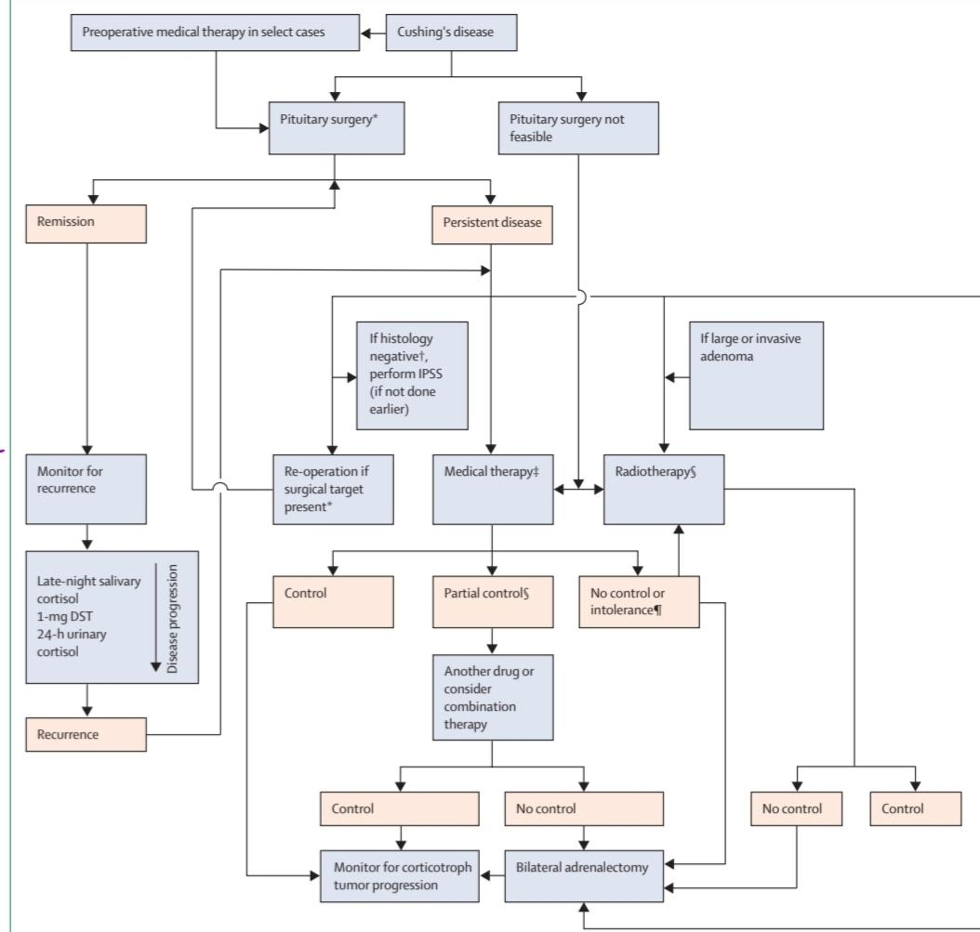
Summary of treatment

Slide 134
Primary and preoperative medical therapy for de novo chushig’s disease
Primary medical therapy is used when successful
adenoma resection is unlikely because of unfavourable
localisation, clinically significant invasiveness, or lack of
visualisation on MRI
Published evidence regarding preoperative medical
therapy in patients with Cushing’s disease is sparse, and it
is not used in most patients, although there are regional
variations. A meta-analysis showed no differences in
cortisol normalisation rate between participants who
received cortisol-lowering medications in the preoperative
setting versus later use as adjuvant treatment.

Slide 135
Primary and preoperative medical therapy for de novo chushig’s disease
preoperative medical therapy could be an option in severely ill
patients for whom surgery is contraindicated or if waiting
time for surgery is long, or in patients with lifethreatening
complications of hypercortisolism requiring
rapid cortisol control. Physician surveys show that
preoperative therapy, mostly with ketoconazole or
metyrapone, is used in up to 20% of patients with
Cushing’s disease, especially those with more severe
clinical features or nonvisible adenoma

Slide 136
Primary and preoperative medical therapy for de novo chushig’s disease
Retrospective studies show that therapy with preoperative
steroidogenesis inhibitors for a mean of 4 months yields
cortisol normalisation rates of 50–72%, although subjective
symptom improvement was observed in only a third of
cases. Lower rates of postoperative hypoadrenalism
from preoperative medical therapy could, in theory, protect
against the occurrence of a proinflammatory and procoagulant
state, but postsurgical complications,
including VTE, are similar regardless of its use.If the
HPA axis recovers during preoperative treatment, adrenal
insufficiency might not occur postoperatively, so it can be
more difficult to determine whether remission is presen
Preoperative cabergoline probably has limited value,
because a substantial decrease in cortisol was seen in
only a quarter of patients in a cohort treated prospectively
for 6 weeks

Slide 137
Clinical considerations and recommendations for primary and preoperative medical therapy for de novo Cushing’s disease
There are no rigorous data supporting use of primary or
preoperative medical therapy. Most experts would consider
such an approach with adrenal steroidogenesis inhibitors
if surgery is delayed, either because of scheduling or due to
external factors such as a pandemic (very low quality,
discretionary recommendation)
Patients with severe Cushing’s disease who have potentially
life-threatening metabolic, psychiatric, infectious, or
cardiovascular or thromboembolic complications might
also benefit from preoperative medical therapy in select
cases (low quality, discretionary recommendation).

Slide 138
Clinical considerations and recommendations for primary and preoperative medical therapy for de novo Cushing’s disease
Although this benefit has not been clearly confirmed,
some experts consider it might have a potentially favourable
effect on glucose, cardiovascular, and coagulation
parameters (very low quality, discretionary recommendation).
Few experts use it to decrease the extent of postoperative
cortisol withdrawal manifestations.
Monitoring and follow-up of patients treated with
preoperative therapy can be challenging because postoperative
cortisol assessments for surgical cure are not
reliable. The patient’s perspective regarding this approach
would be valuable to incorporate into future research
studies (very low quality, discretionary recommendation)

Slide 139
Radiotherapy
Radiotherapy is primarily used as adjuvant therapy for
patients with persistent or recurrent disease after transsphenoidal
surgery or for aggressive tumour growth.
Approximately two-thirds of patients achieve biochemical
remission during the years after treatment with conventional
external-beam radiotherapy, typically 45–50 Gy
administered in less than 2 Gy fractions, or stereotactic
radiosurgery, which is administered as single dose or a
few fractions of approximately 20 Gy
recent series with stereotactic radiosurgery, including
whole sellar radiotherapy, show higher biochemical
remission rates. In a multicentre study of GammaKnife
stereotactic radiosurgery in 278 participants followed for a
mean of 5·6 years, biochemical control was attained in
193 (80%) and durable hypercortisolism control was
maintained in 158 (57%). Tumour control rates are
typically higher, with approximately 95% of patients
treated with stereotactic radiosurgery showing decreased
or stable tumour volume as observed on MR

Slide 140
Radiotherapy
single-centre study of proton-beam radiotherapy showed
complete response (either cortisol or ACTH normalisation)
in patients with persistent corticotroph adenomas
due to Cushing’s disease or Nelson’s syndrome, with low
morbidity after a median follow-up of 62 months.
Stereotactic radiosurgery can also be used as primary
therapy in patients with high surgical risk or who refuse
surgery. In this setting, endocrine remission was attained
in 17 (81%) of 21 patients with Cushing’s disease at 5 years
of follow-up. Long-term follow-up is needed as
recurrence and tumour growth have been described postradiot
Given the latency until post-radiotherapy remission,
adjuvant medical therapy is needed to control hypercortisolism;
periodic withdrawal allows evaluation of cortisol secretion to assess treatment effect.

Slide 141
Radiotherapy
data are mixed on whether ketoconazole or
cabergoline treatment at the time of stereotactic
radiosurgery limits efficacy, they are often withheld
temporarily at the time of radiotherapy.
Hypopituitarism is the most common side-effect of
both conventional radiotherapy and stereotactic radiosurgery,
seen in 25–50% of patients, and generally
increases over time. Risk of secondary malignancy,
cranial nerve damage, and stroke are low with stereotactic
radiosurgery. In patients treated with stereotactic
radiosurgery, a distance of at least 3–5 mm between the
tumour and the optic chiasm and a chiasm dose less than
8 Gy is recommended to limit treatment damage.Longterm
data will help address whether use of different
stereotactic radiosurgery modalities (eg, GammaKnife,
linear accelerator, proton beam) confers lower rates of
stroke and hypopituitarism compared with conventional
radiotherapy

Slide 142
Clinical considerations and recommendations for
radiotherapy
Radiotherapy is most commonly used in cases of persistent
hypercortisolism after incomplete corticotroph tumour
resection, particularly if the tumour is aggressive or
invasive or is considered unresectable (high quality, strong
recommendation). Stereotactic radiosurgery is probably
more convenient as few treatment sessions are required,
but avoiding optic chiasm exposure is crucial (high quality,
strong recommendation). Lifelong monitoring for pituitary
hormone deficiencies and recurrence is required in all
patients undergoing radiotherapy (high quality, strong
recommendation). Imaging for secondary neoplasia in the
radiation field should also be considered (high quality,
strong recommendation)

Slide 143
Adrenalectomy
Bilateral adrenalectomy offers immediate control of
cortisol excess in patients with persistent or recurrent
Cushing’s disease that is not responsive to medical
therapy, but it is only considered for selected patients
because of the resultant adrenal insufficiency and need
for life-long glucocorticoid and mineralocorticoid replacement
therapy. Laparoscopic bilateral adrenalectomy
using either a transperitoneal or posterior retroperitoneal
approach was associated with a 10–18% complication rate
and a mortality rate of less than 1% in the largest
series. Long-term clinical relapse of hypercortisolism
due to adrenal re stimulation by high ACTH is uncommon
(<10%), whereas clinical improvement in BMI,
type 2 diabetes, hypertension, and muscle weakness has
been reported in more than 80% of patients

Slide 144
Adrenalectomy
Corticotroph tumour progression after bilateral
adrenalectomy is a long-term concern in 25–40% of
patients after 5–10 years. Most cases can be managed
with surgery, radiotherapy, or medical therapy. However,
a subset of aggressive tumours will continue to grow and
long-term monitoring is required.
Corticotroph tumour progression after bilateral
adrenalectomy does not seem to be influenced by
pregnancy. This might make bilateral adrenalectomy a
preferred option in female patients with an immediate
pregnancy plan. In most cases, however, bilateral
adrenalectomy is rarely performed as the first-line
treatment after failure of initial pituitary surgery, and
duration of disease before adrenal surgery is typically
3–4 years or longer. Whether and how this might affect
long-term treatment outcomes remains unknown.

Slide 145
Clinical considerations and recommendations for
adrenalectomy
In patients with Cushing’s disease, bilateral adrenalectomy
is often considered to be a treatment of last resort in most
centres after all other options have failed (moderate
quality, strong recommendation). However, bilateral
adrenalectomy can be warranted earlier in patients with
severe hypercortisolism in whom a rapid, definitive effect
on cortisol is needed to avoid prolonged systemic effects
of uncontrolled disease (moderate quality, strong
recommendation). Many expert centres recommend
bilateral adrenalectomy earlier in the course of the disease
for female patients with Cushing’s disease desiring
pregnancy (moderate quality, strong recommendation).

Slide 146
Clinical considerations and recommendations for
adrenalectomy
After bilateral adrenalectomy, plasma ACTH and serial
pituitary imaging are used for monitoring at intervals
dictated by the clinical scenario, usually starting 6 months
after surgery (high quality, strong recommendation).
More frequent evaluation might be necessary if there is a
clinical suspicion of corticotroph tumour progression
(high quality, strong recommendation).

Slide 147
Genetics of Cushing’s disease
Corticotroph adenomas are predominantly of sporadic origin, based on a monoclonal expansion of
a singular mutated cell. These adenomas abundantly express EGFR, which signals to induce
ACTH production.
Somatic activating driver mutations in USP8 are present in 36–60% of corticotroph adenomas.
These mutations lead to persistent overexpression of EGFR, thereby perpetuating the hypersynthesis
of ACTH.
NR3C1
BRAF
Deubiquitinase USP48
TP53
familial tumour syndromes, such as MEN1, FIPA, and DICER1, rarely develop corticotroph
adenomas

Slide 148
Diagnosis and management of Cushing’s
syndrome in children
Endogenous Cushing’s syndrome is very rare before age 18 years.
Germline mutations in MEN1, RET, AIP, PRKAR1A, CDKN1B, DICER1,
CABLES1, and SDH-related genes can all predispose children to Cushing’s
disease.
screening is usually reserved for cases in which there is either family history or
other signs suggestive of a genetic syndrome.
Lack of height increase concomitant with weight gain.

Slide 149
Diagnosis and management of Cushing’s
syndrome in children
Documentation of hypercortisolism with 24h UFC, LNSC, or overnight 1 mg
DST are all used to confirm diagnosis. The diagnostic approach and test
performances are slightly different from adults, as recently extensively
reviewed. The DexCRH test is not useful in children. In children older than 6
years, Cushing’s disease is the most common cause of Cushing’s syndrome.
The role of IPSS in children is more limited than in adults.

Slide 150
Diagnosis and management of Cushing’s
syndrome in children
As in adults, surgical resection of the ACTHsecreting tumour is the firstline treatment in
children. However, unlike in adults, thromboprophylaxis should not be routinely used
because of bleeding risk, but is reserved for selected paediatric patients. With successful
treatment, adrenal function typically recovers within approximately 12 months. Evaluation
for growth hormone deficiency should be done by 3–6 months postoperatively, and
immediate growth hormone replacement given if needed.
For paediatric patients requiring medical therapy, ketoconazole or metyrapone is typically
used with morning cortisol for monitoring response. Pasireotide is not recommended and
clinical trials of osilodrostat in children are underway. Blockandreplace regimens with
metyrapone.

Slide 151
Conclusions
Academic investigators and clinical experts from 13
countries across five continents gathered virtually to
discuss recent evidence regarding Cushing’s disease.
Consensus was reached on many recommendations for
diagnosis and management.

Slide 152
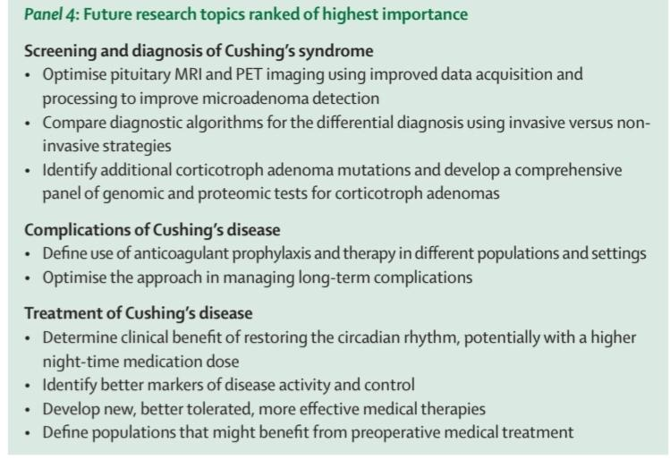

Slide 153
Thank you for your attention

