Slide 1
DPP4 inhibitor drugs
A Amouzegar MD
Research Institute for Endocrine Sciences ,Shahid Beheshti University

Slide 2
Agenda
DPP-4 inhibitors: How do they work?
What Are the Currently Available DPP-4I on the Market?
Efficacy
Safety, adverse events
CVOTs
Can be used in RF
Conclusion

Slide 3
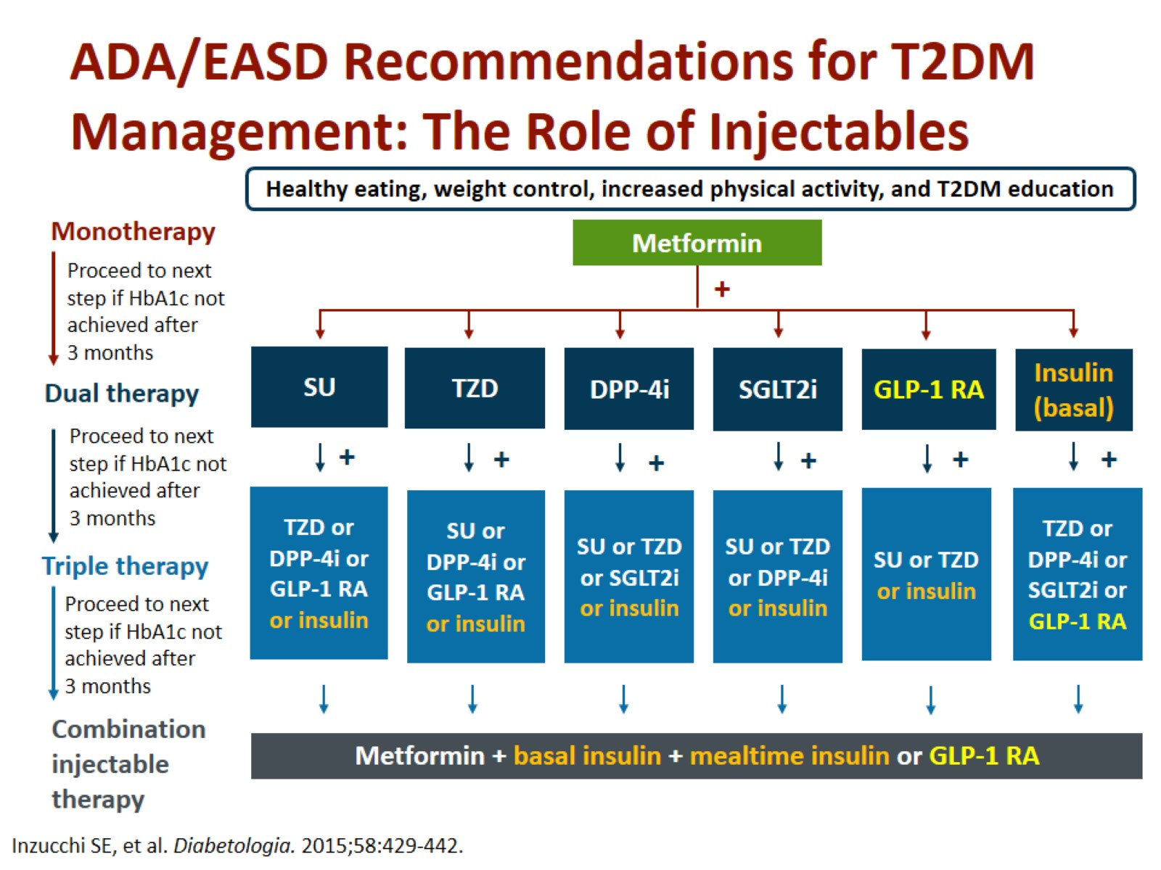
ADA/EASD Recommendations for T2DM Management: The Role of Injectables

Slide 4
Will examine their effectiveness in maintaining the glycemic goal A1C ,7% over Time
Relative effects on selected microvascular complications and CV RF
Patient-centered outcomes, such as adverse effects, acceptability, and tolerability
Cost-effectiveness
The phenotypic characteristics that underlie the success, failure, and AEs of the different combinations

Slide 5
Drug choice as the second line is based on
Patient preferences
Various patient
Drug characteristics
The goal of reducing blood glucose levels
While minimizing side effects, especially hypoglycemia
Cost information

Slide 6
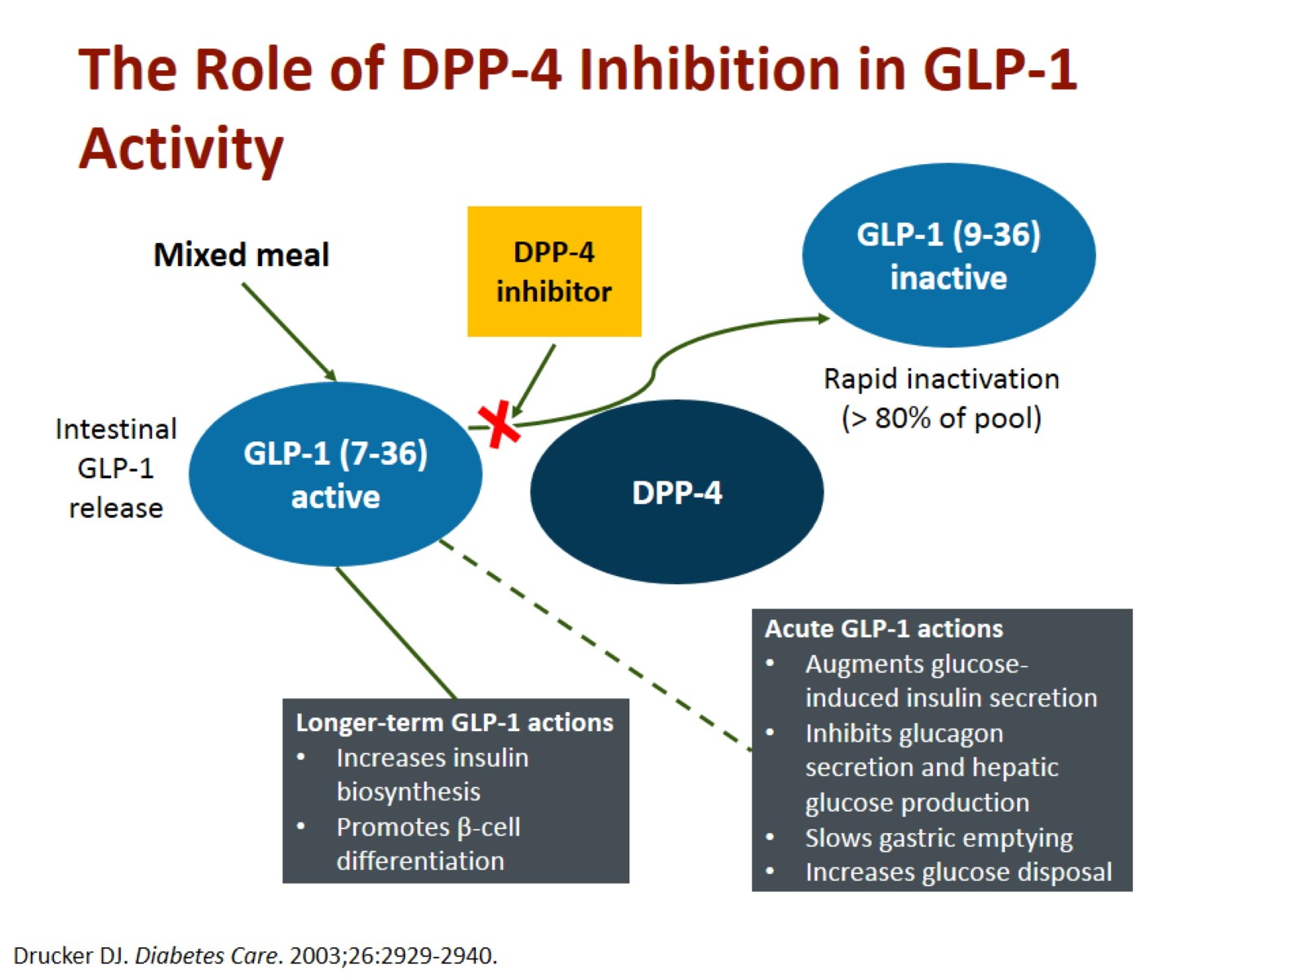
The Role of DPP-4 Inhibition in GLP-1 Activity

Slide 7
What are the currently available DPP-4 Inhibitors on the market?
Alogliptin | Linagliptin | Vildagliptin | Saxagliptin | Sitagliptin
25 mg qd | 5 mg qd | 50 mg bid | 5 mg qd | 100 mg qd | Dosage
21 hours | >120 hours | 3 hours | 2 hours | 12 hours | Approximate half-life
Renal clearance (63%) | Entero-hepatic Eliminated unchanged in feces via biliary excretion (85%) | Hepatic metabolism to active metabolite Renal :half excretion (12%-29% unchanged parent and 21%-52% as metabolite) | Hepatic metabolism to active metabolite (half:Renal excretion (12%-29% unchanged parent and 21%-52% as metabolite) | Renal clearance (75%) | Elimination
Neutral | Neutral | Neutral | Neutral | Neutral | Effect on weight
Low | Low | Low | Low | Low | Adverse events

Slide 8
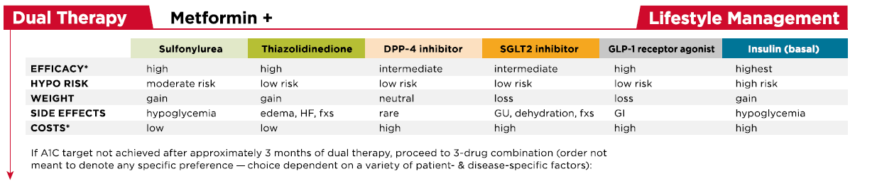
Glycemic efficacy

Slide 9
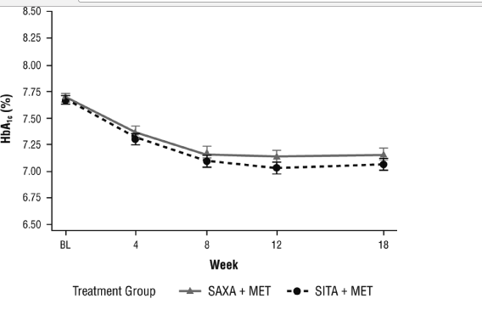
Efficacy and safety of saxagliptin in combination with metformin compared with sitagliptin in combination with metformin in adult patients with type 2 diabetes mellitus
The difference between groups in the adjusted mean change from baseline HbA1c was 0.09% (95% CI, − 0.01 to 0.20%). The upper limit of this 95% CI was below the predefined criterion for noninferiority of < 0.3%
Diabetes Metab Res Rev. 2010;26(7):540

Slide 10
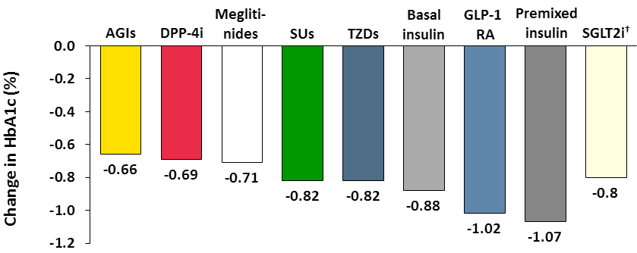
Meta-analysis: HbA1c reduction with OHA Added to Metformin
*All antihyperglycemic agents were significantly different vs placebo.
1- Liu SC, et al. Diabetes, Obesity and Metabolism 2012;14:810–820.
2- Fujita Y, et al., J Diabetes Investig. 2014; 5:265-275.

Slide 11
Is hypoglycemia commonly seen with DPP-4 Inhibitors?
DPP-4 inhibitors have an antihyperglycemic effect only when glucose levels are raised
Thus, the incidence of hypoglycemia with this class of drugs is very low
Incidence of Hypoglycemia %
Sulfonylurea | DPP4 inhibitor | name
34 | 5 | Sitagliptin (100 mg/day)
18 | 2 | Vildagliptin (100 mg/day
36 | 3 | Saxagliptin (5 mg/day)
36 | 7 | Linagliptin (5 mg/day)
Lancet. 2012;380:450-452.

Slide 12
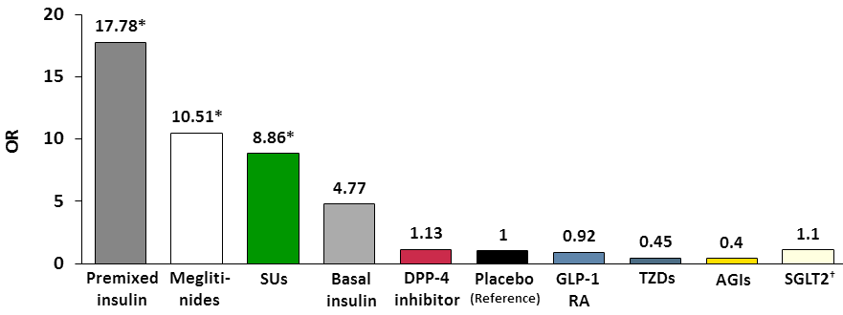
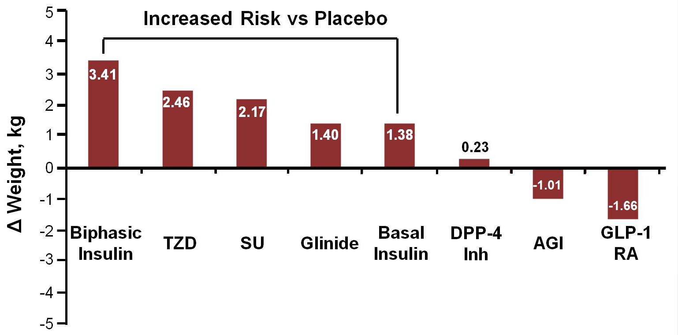
Meta-analysis: hypoglycemia risk & weight change with OHA Added to Metformin
Hypoglycemia
95%CI 0.6-2.1
*Statistically significant vs placebo.
1- Liu SC, et al. Diabetes, Obesity and Metabolism 2012;14:810–820.
2- Fujita Y, et al., J Diabetes Investig. 2014; 5:265-275.

Slide 13
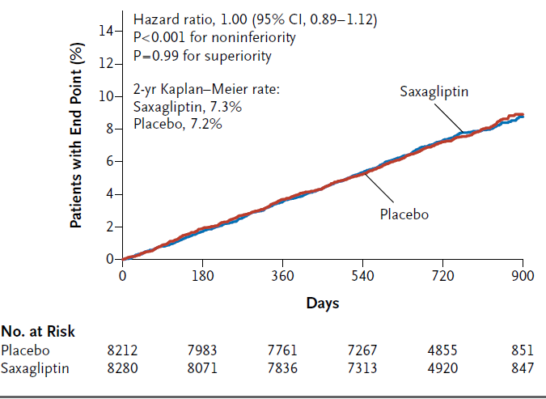
SAVOR-TIMI 53primary Endpoints ( 3-point MACE)
16,492 patients with T2DM who had a history of, or were at risk for, cardiovascular events randomized to receive saxagliptin or placebo and followed them for a median of 2.1 years

Slide 14
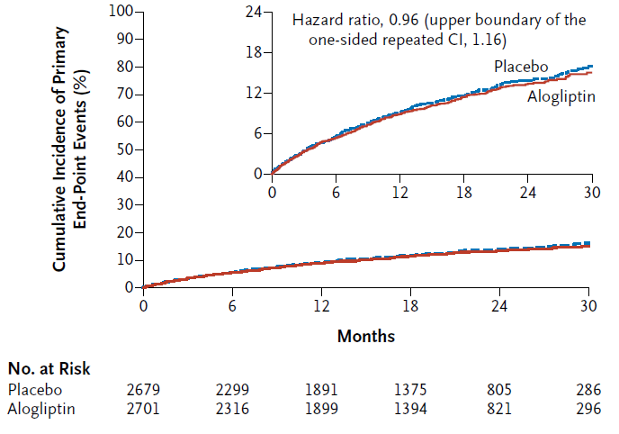
EXAMINE primary Endpoints ( 3-point MACE)
5380 T2DM patients who had had a an AMI or unstable angina requiring hospitalization within the previous 15 to 90 days to receive alogliptin or placebo with median F/U 1.5 y

Slide 15
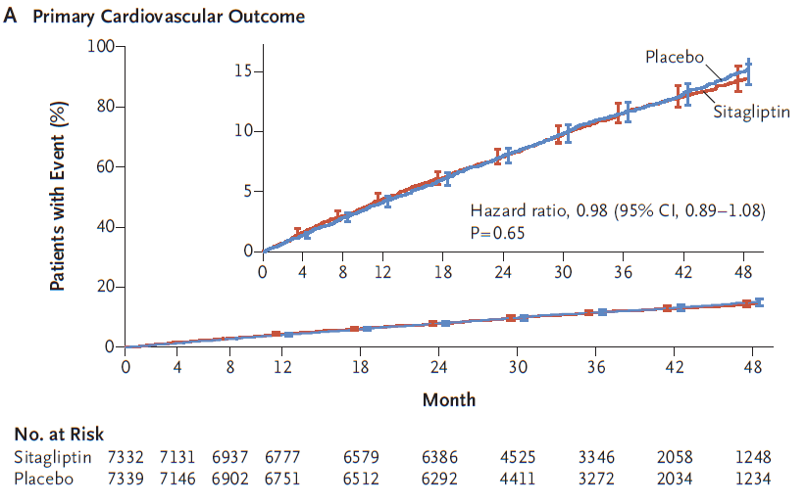
TECOS primary Endpoints ( 4-point MACE)
14,671 T2DM patients with established CVD randomized to either sitagliptin or placebo with median 3 y F/U

Slide 16
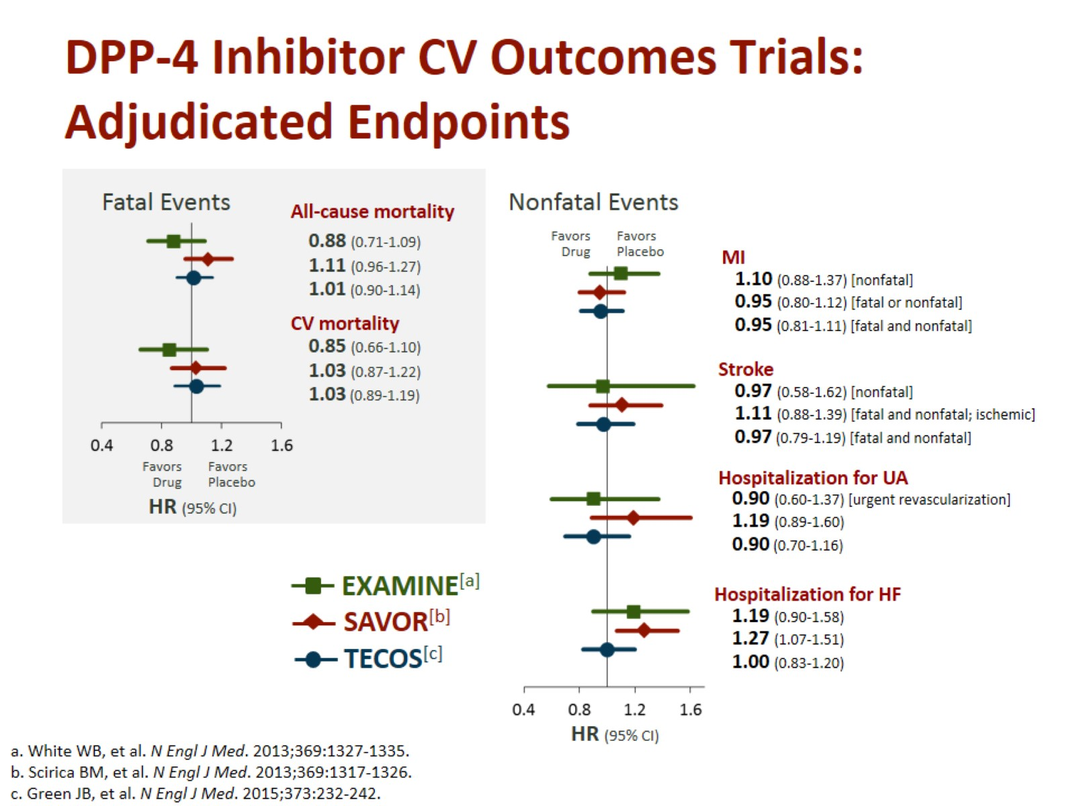
DPP-4 Inhibitor CV Outcomes Trials:
Adjudicated Endpoints

Slide 17
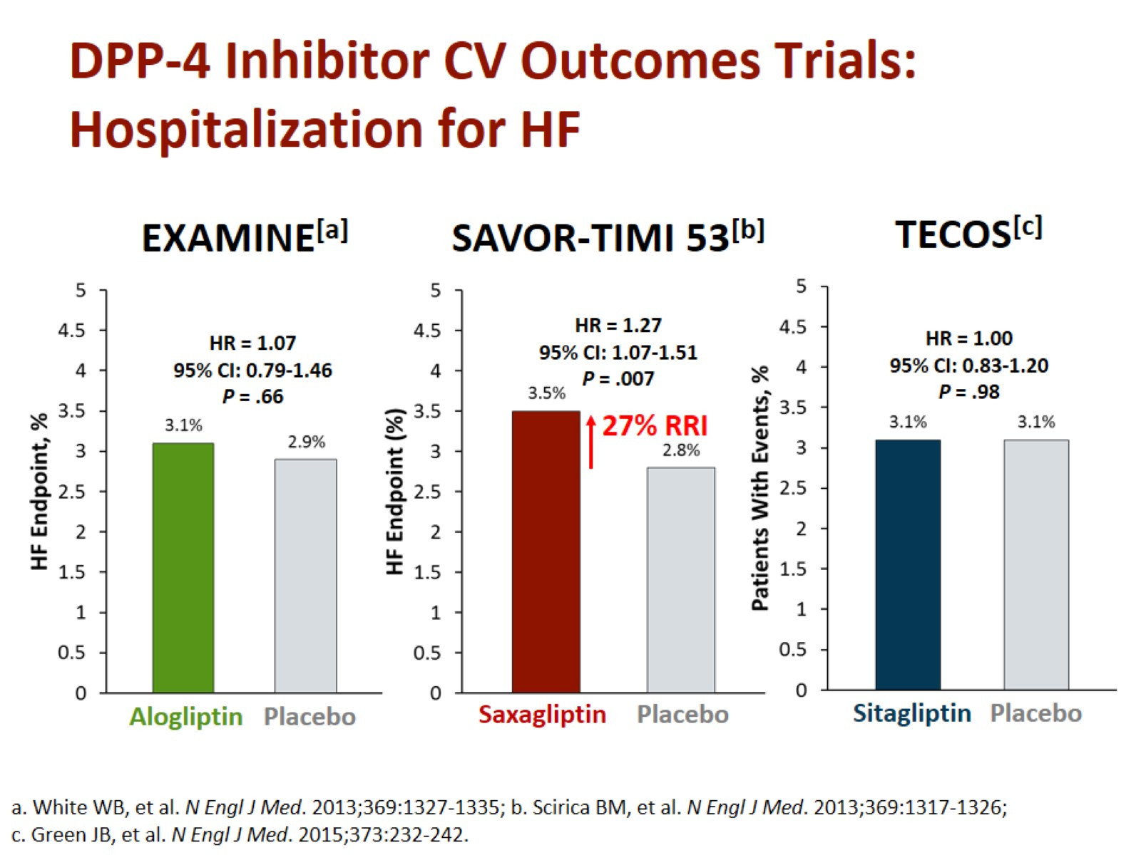
DPP-4 Inhibitor CV Outcomes Trials:
Hospitalization for HF

Slide 18
What adverse effects should clinicians be aware of when using DPP-4 Inhibitors?
The FDA and the EMA have also independently reviewed a number of observational studies to explore a possible association between incretin-based drugs and acute pancreatitis found that observational studies, have yielded inconsistent results
Limited power, inadequate outcome validation, incomplete covariate ascertainment, and inadequate confounding control
A pooled analysis of data from 14,611 pts with T2DM from 25 clinical trials in the sitagliptin database provided no compelling evidence of an increased risk of pancreatitis or pancreatic cancer
Diabetes Ther 2013;4: 119-45.

Slide 19
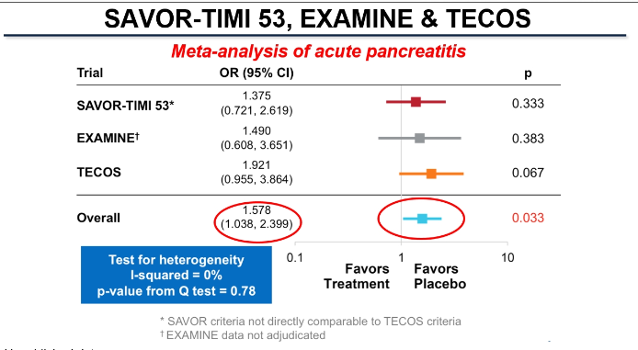

Slide 20
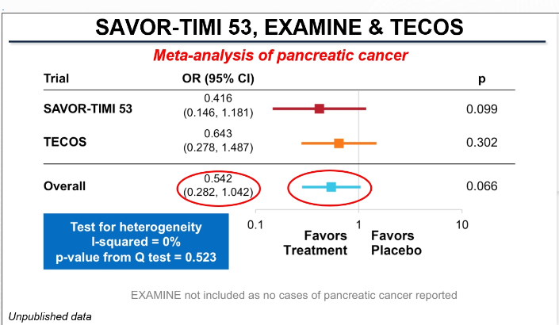

Slide 21
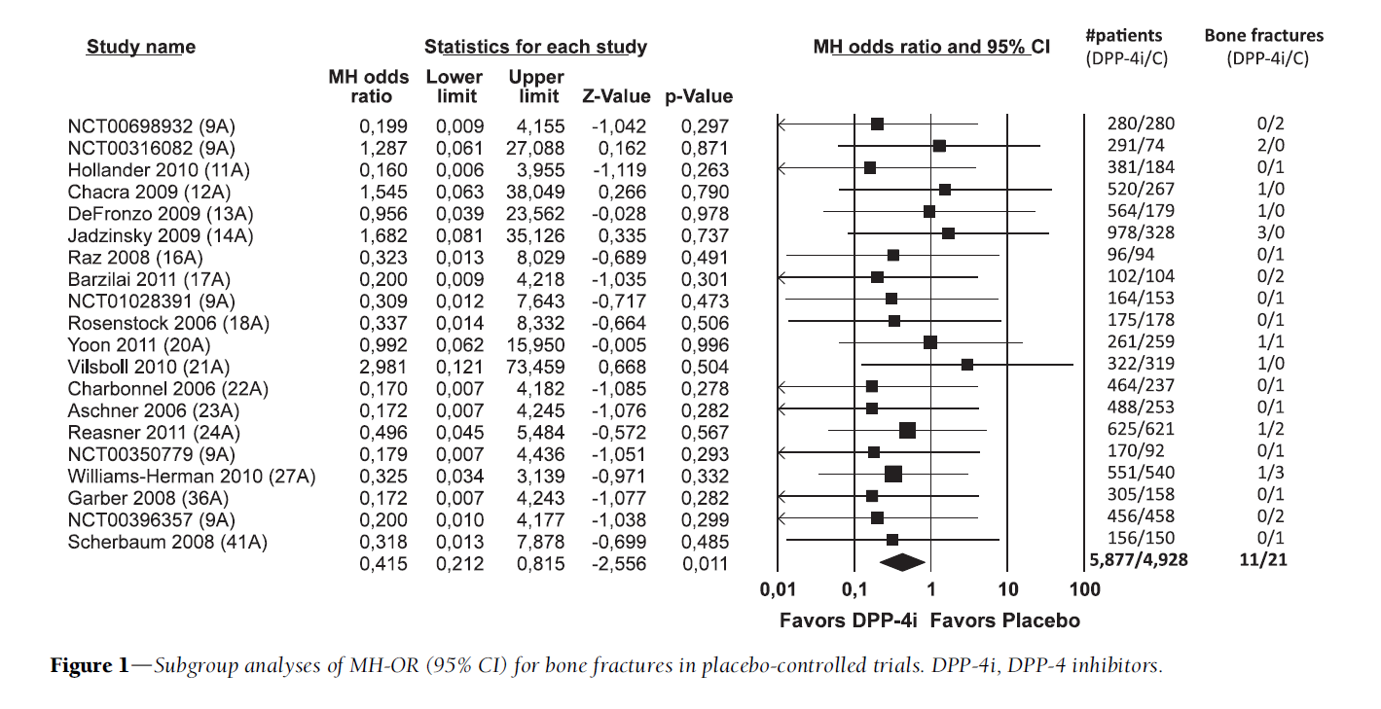
Dipeptidyl Peptidase-4 Inhibitors and Bone Fractures
DPP-4 inhibitors, compared with placebo or other treatments, were associated with a reduced risk of fractures (Mantel– Haenszel odds ratio [MH-OR] 0.60, 95% CI 0.37–0.99, P = 0.045)
Diabetes Care. 2011 Nov;34(11):2474-6

Slide 22
Pitfalls
The duration of the trials included is rather short, not allowing inferences on longer-term effects
Small number of trials with longer duration
Bone fractures were not the principal end points in any of the studies and were reported only as adverse events

Slide 23
Use in chronic kidney disease
Sitagliptin, saxagliptin, alogliptin, and vildagliptin require dose adjustment in patients with chronic kidney disease
Linagliptin is primarily eliminated via the enterohepatic system, and therefore no dose adjustment is necessary

Slide 24
Sitagliptin
The usual dose of sitagliptin is 100 mg once daily,
Reduction to 50 mg for moderate to severe renal insufficiency (GFR 30 to 50 mL/min)
25 mg for severe renal insufficiency (<30 mL/min)

Slide 25
Conclusion:
They lower glucose levels in T2DM and are well tolerated
Do not reduce or increase cardiovascular risk
Must be careful in patient with history of pancreatitis
Do not increase the risk of pancreatic cancer
Do not increase the risk of hypoglycemia
No increase risk of facture

Slide 26


