Slide 1
Management of perimenopausal and menopausal symptoms Erin R Duralde, Talia H Sobel, JoAnn E Manson
Cite this as: BMJ 2023;382:e072612

Slide 2
Introduction
Many women experience pronounced symptoms during and after the menopause transition.
Studies show that 60-86% of women experience symptoms so bothersome that they seek medical care.

Slide 3
Introduction
Undertreated menopausal symptoms:
have been associated with 1.5 million otherwise unnecessary outpatient visits annually.
26-33 million prescriptions for non-regulated treatments (costing more than $1bn annually)
and negative effects on sleep, metabolism, mental health, personal relationships, and work productivity.

Slide 4
Agenda
Epidemiology and physiology of menopause
Treatment approach by symptom or sign
Menopausal hormone therapy
Considerations for special populations

Slide 5
Sources and selection criteria
We considered studies published between 1 January 2012 and1 November 2022 to include the most up-to-date research.
We searched PubMed using the following terms; menopause, perimenopause, menopause transition, premature menopause, early menopause, primary ovarian insufficiency, surgical menopause, oophorectomy; vasomotor, hot flashes,…

Slide 6
Epidemiology and physiology of menopause
In 2021 an estimated 1.02 billion women were postmenopausal globally, with 1.65 billion anticipated by 2050.
The menopause transition; consists of perimenopause and the first 12 months after the final menstrual period (FMP),which can last for as long as 10 years.

Slide 7
Epidemiology and physiology of menopause
The onset of the transition is marked by:
changes in menses and/or development of hypoestrogenic symptoms such as hot flashes,
mood changes
impaired concentration and memory
sleep disturbance
fatigue
reduced libido
joint pain
and increased central adiposity

Slide 8
Epidemiology and physiology of menopause
The average age of menopause is 51 years.
70% of women enter menopause early between ages 40 and 45
and 1.9% enter before age 40, which is considered premature menopause.
The symptoms of natural menopause can last from 3 years to more than 11 years.
20% of women experience hot flashes into their late 50s, 10% into their late 60s, and 5% into their 70s.

Slide 9
Epidemiology and physiology of menopause
Decision making about treatment is influenced by many factors, including:
severity of symptoms
stage of menopause
need for perimenopausal contraception
presence of premature or early menopause Comorbidities
The patient’s personal preference about treatment

Slide 10
Menopausal hormone therapy
Systemic menopausal hormone therapy:
is the most effective treatment for symptoms caused by low estrogen,
Estrogen therapy alleviates vasomotor and many other menopausal symptom.
To mitigate the risk of endometrial hyperplasia and malignancy in women with a uterus:
a progestogen must be added. This can be cycled or given continuously.

Slide 11
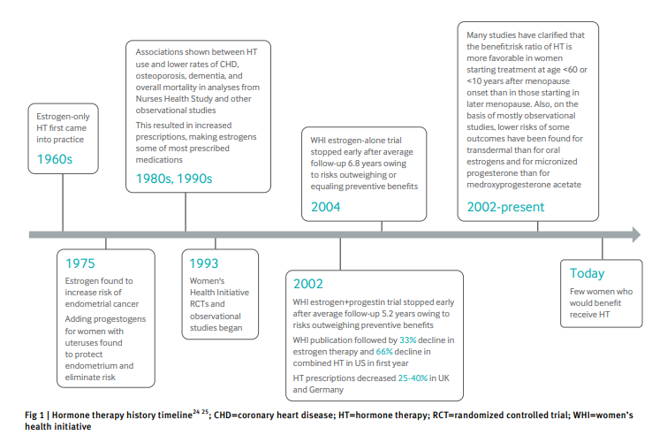

Slide 12
Indications for use
Hormone therapy is indicated:
to treat hot flashes
Genitourinary syndrome of menopause
to prevent osteoporosis
Premature and early menopause should be treated with hormone therapy until the average age of menopause

Slide 13
Hormone therapy contraindications and comorbidities
Contraindications
Breast cancer
Endometrial cancer (advanced stage hormonal or non-hormonal)
Untreated endometrial hyperplasia or cancer
Unexplained vaginal bleeding
Myocardial infarction, stroke, or transient ischemic attack
Uncontrolled hypertension

Slide 14
Hormone therapy contraindications and comorbidities
Contraindications
Peripheral artery disease
Unprovoked venous thromboembolism
Known clotting disorder
Cirrhosis
Active hepatitis
Porphyria cutanea tarda

Slide 15
Hormone therapy contraindications and comorbidities
Comorbidities of concern
Controlled hypertension
Hyperlipidemia
Diabetes
Smoking
Provoked venous thromboembolism
Chronic inflammatory states
HIV
Gallbladder disease
Ovarian or cervical cancer with suspected hormone responsiveness

Slide 16
Cardiovascular risk and the timing hypothesis
The first Women’s Health Initiative (WHI) publication showed concerning increased rates of venous thromboembolism and cerebrovascular disease, but age stratification revealed significant differences in cardiovascular disease outcomes.

Slide 17
Cardiovascular risk and the timing hypothesis
Menopausal Hormone Therapy and Long-term All-Cause and Cause-Specific Mortality: The Women's Health Initiative Randomized Trials
Randomized Controlled Trial DOI: 10.1001/jama.2017.11217
JoAnn E Manson ¹, Aaron K Aragaki ², Jacques E Rossouw ³, Garnet L Anderson ²,

Slide 19
Cardiovascular risk and the timing hypothesis
At 18 year follow-up women aged 50-59 years in both treatment groups, had no increase in all cause, cardiovascular, or cancer mortality.

Slide 20
Cardiovascular risk and the timing hypothesis
A potential explanation for the “timing hypothesis” is that women in early menopause have healthier blood vessels, which undergo vasodilation and experience overall anti-inflammatory effects in response to estrogen.
With age, the vasculature becomes more stenotic as a result of plaque accumulation, and the damaged endothelium has impaired vasodilation; on this substrate, estrogen has pro-inflammatory effects and can destabilize plaques.

Slide 21
Breast cancer risks
Hormone therapy should be avoided in women who have had breast cancer, as its use has been associated with increased risk of recurrence.
who have not had breast cancer, some formulations of hormone therapy may increase the absolute risk by a small amount, depending on formulation and duration.

Slide 22
Breast cancer risks
Table 1; provides a comparison of findings on breast cancer from the 20 year follow-up of the WHI’s RCTs and the Collaborative Group on Hormonal Factors in Breast Cancer (CGHFBC)’s meta-analysis of 58 prospective and retrospective observational studies of long term effects of hormone therapy on breast cancer.

Slide 23
Table 1; Comparison of WHI and CGHFBC findings on hormone therapy and breast cancer
Characteristic | WHI 20 year follow-up | CGHFBC
Study type | RCT | Nested case-control meta-analysis
No of participants | CEE trial: 10 739; CEE+MPA trial: 16 608 | Breast cancer cases: 128 435; controls: 366965
Estrogen alone | CEE | CEE, estradiol
Estrogen+progestogen | CEE+MPA | CEE, estradiol; levonorgestrel, MPA, NETA; small No with dydrogesterone, micronized progesteron
Comparator groups | Women with hysterectomy: CEE v placebo; women with uterus: CEE+MPA v placebo | Current users v never users; past users v never users; subdividedby treatment type
Outcomes | Primary: heart disease; secondary: osteoporosis; primary adverse event: incident invasive breast cancer | Primary: incident invasive breast cancer
Mean duration of use, years: | Estrogen alone;7.2y Estrogen+progestogen;5.6y | Ranges from 10.7 years for those starting age 40-44 to 7.9 years for age 60-69

Slide 24
Table 1; Comparison of WHI and CGHFBC findings on hormone therapy and breast cancer
Characteristic | WHI 20 year follow-up | CGHFBC
Relative risk of invasive breast cancer, HR (95% cI) Estrogen alone | All durations: 0.78 (0.65 to 0.93) | 1-4 year use—current use: 1.17 (1.10 to 1.26); past use: 1.04 (0.98 to 1.11) 5-9 year use—current use: 1.22 (1.17 to 1.28); past use: 1.09(1.03 to 1.15)
Relative risk of invasive breast cancer, HR (95% CI): Estrogen+progestogen | All durations:1.28(1.13 to 1.45) | 1-4 year use—current use: 1.60 (1.52 to 1.69); past use: 1.10 (1.05–1.16)
Relative risk of breast cancer mortality, HR (95% CI): Estrogen alone | 0.60(0.37 to 0.97) | Did not evaluate mortality
Relative risk of breast cancer mortality, HR (95% CI): Estrogen+progestogen | 1.35(0.94 to 1.95) | Did not evaluate mortality
Absolute risk of invasive breast cancer Estrogen alone Estrogen+progestogen | Reported:per10000person/y -7 9 | Estimated cases per 100 people using HT for 5 years starting at age 50, over 20 year follow-up 0.5 1.4(cycled);2(continuos)
Absolute risk of breast cancer mortality | -2 0 | Did not evaluate mortality

Slide 25
Treatment considerations by menopause phase
Premature and early menopause
Women with premature or early menopause due to primary ovarian insufficiency, bilateral oophorectomy, radiation/chemotherapy, or other causes should receive hormone therapy to support cardiovascular, genitourinary, bone and cognitive health until the average age of menopause.

Slide 26
Treatment considerations by menopause phase
Premature and early menopause
Women with premature menopause who do not receive hormonal replacement have increased rates of dementia, parkinsonism, mood disorders, cardiovascular disease, osteoporosis,sexual dysfunction, and overall mortality. Higher doses of estrogen are needed than would be used to treat symptoms in women closer to the average age of menopause, and both combined hormonal contraceptive (CHC) and hormone therapy should be considered.
.

Slide 27
Perimenopause
During perimenopause,
women can ovulate up until their FMP. Contraception is particularly important because pregnancy in perimenopause is associate with higher risk for maternal and fetal complications.
The best contraceptive option should consider the woman’s hormonal milieu, perimenopausal symptoms, comorbidities, drug treatments, and personal preferences (supplementary table A).

Slide 28
Supplementary Table A. Preferred contraception in perimenopause1
Supplementary Table A. Preferred contraception in perimenopause1
Type | Formulations | Hormone | Route | Dose range | Side effects
CHC | Oral | EE + Drospirenone Desogestrel Ethynodiol Diacetate Levonorgestrel Norethindrone NETA Norgestimate Norgestrel | Oral | Varies by contraception. 0.1-0.2mg/day EE tends to be better tolerated than 0.3mg | Abnormal bleeding, weight gain, breast tenderness, mood changes, headaches, nausea, bloating, decreased libido
 | patch | EE Norelgestromin EE Levonorgestrel | Transdermal | 0.035 mg/day 0.15 mg/day 0.03 mg/day 0.12 mg/day | Abnormal bleeding, mood changes, weight gain, breast pain, headache, nausea

Slide 29
Supplementary Table A. Preferred contraception in perimenopause1
Type | Formulations | Hormone | Route | Dose range | Side effects
CHC | Vaginal Ring | EE Etonogestrel 3-month EE Segesterone acetate 12-month | Vaginal | 0.015mg/day 0.120 mg/day 0.013 mg/day 0.15 mg/day | Abnormal bleeding, vaginitis, headache, weight gain, decreased libido
Progestin only | POP | Norethindrone Drospirenone | Oral | 0.35 mg/day 4 mg/day | Nausea, headache, irregular bleeding, breast tenderness Acne,
 | Subdermal implant | Etonogestrel | Subdermal | 68 mg | Irregular bleeding.
 | IUS | Levonorgestrel | Uterine | 52mg,19.5,13.5 | Light bleeding, amenorrhea

Slide 30
Perimenopause
Hormone therapy should not be used as contraception, as it rarely suppresses ovulation or alters cervical mucus substantially.
For those who do not smoke and have no history of venous thromboembolism or stroke, low dose CHC pills are appropriate.
CHCs contain ethinyl estradiol which is associated with higher rates of venous thromboembolism and stroke compared with the estradiol and CEEs used in hormone therapy.
Progestin-only options have fewer contraindications and low dose estradiol can be added if vasomotor symptoms are prominent

Slide 31
When to switch from contraceptive method to hormone therapy
When a woman who menstruates is no longer fertile is difficult to ascertain.
However, the recommendations in table 2 may assist in determining when contraception is no longer needed.

Slide 32
Table 2 | Determining when to discontinue contraception
Current method | Clinical evaluation | Laboratory evaluation | Contraception plan
Non-hormonal contraception | Amenorrhea for 12-24 months | - | None needed
CHC | Age ≥50 | Stop CHC for 6 weeks; use non-hormonal contraception. Check FSH twice 4-8 weeks Apart Stop CHC at age 55 | If FSH >30 IU/L both times, contraception is no longer needed. If FSH <30 IU/L either time, resume CHC and repeat approach in 1 year Spontaneous conception very rare
Depot medroxyprogesterone acetate |  | Check FSH on same day as and before DMPA dose twice | If FSH >30 IU/L on two occasions, can discontinue
Progestin implant, IUS, POP |  | Check FSH at any time while on progestin method. | If FSH >30 IU/L, continue method for 1 more year, then discontinue
Other |  |  | May stop all methods without laboratory evaluation. However, if menses resume, consider FSH testing and resumption of contraception

Slide 33
Postmenopause
Decision making differs according to whether it is a new start or continuation of hormone therapy (see fig 2 and fig 3).
When hormone therapy is newly prescribed, starting within 10 years of menopause and younger than age 60 is advisable.
If hormone therapy is started during this critical window, women may continue to take it beyond 10 years, if indicated.
Clinicians should aim to use the lowest effective dose and lower risk delivery via transdermal and intravaginal routes, when possible.

Slide 34
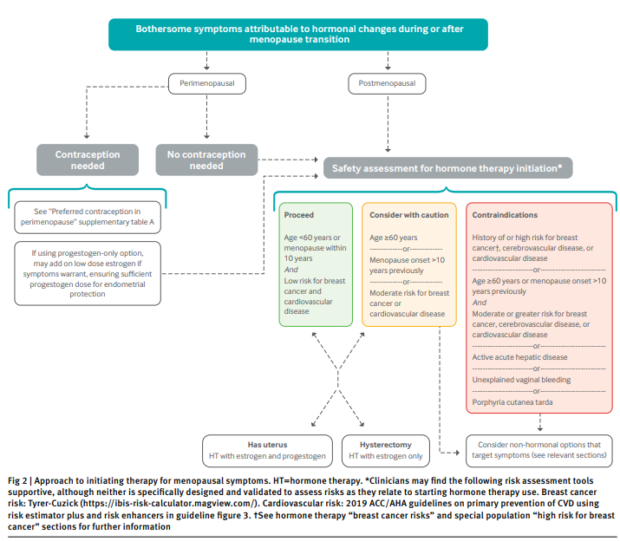

Slide 35
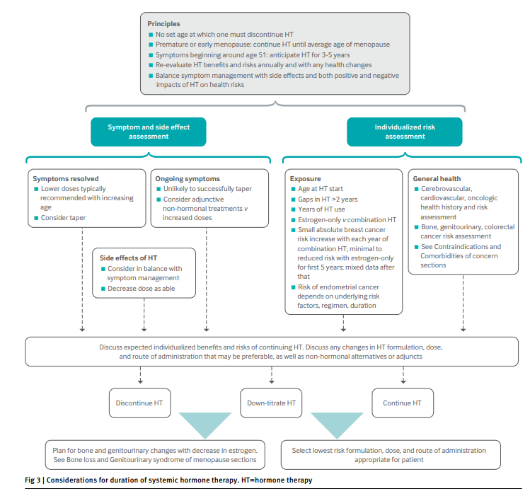

Slide 36
Hormone formulations
See table 3, table 4 and table 5 for approved hormone therapy formulations.

Slide 38
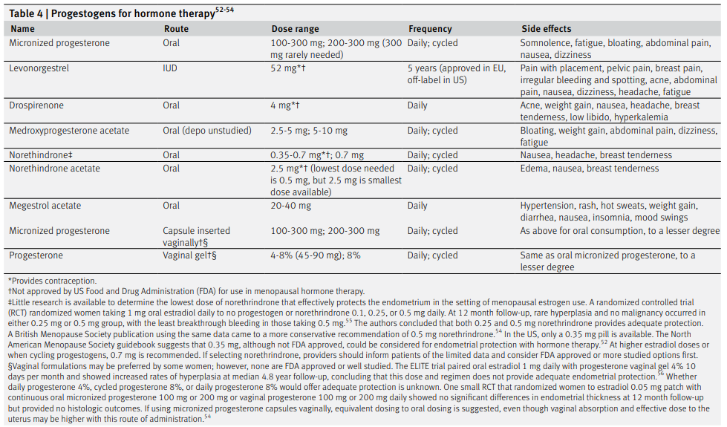

Slide 40
Routes of administration
Estrogen
Oral estrogens undergo first pass metabolism in the liver where they upregulate clotting proteins,increase sex hormone binding globulin (SHBG) and thyroid binding globulin, alter lipid handling, and may interact with other drugs metabolized by the CYP3A4 enzyme.
This effect is more pronounced with ethinyl estradiol than estradiol owing to differences in bioavailability and potency.

Slide 41
Routes of administration
Estrogen
Transdermal and intravaginal formulations avoid first pass metabolism.
Two meta-analyses of mainly observational studies with a few RCTs showed that transdermal estradiol is not associated with an increased risk of venous thromboembolism, whereas oral estrogen (most studies are of CEE) may increase risk by 1.5-fold to fourfold, dose dependently.

Slide 42
Routes of administration
Estrogen
Transdermal formulations are preferred in women with hyperlipidemia, diabetes, hypertension, or other risk factors for cardiovascular disease.
Observational studies have not found significant differences in risk of breast cancer between transdermal and oral estrogens, but no RCTs have compared them.

Slide 43
Routes of administration
Progestogens
With adequate progestogen use, the risk of endometrial neoplasia is not increased.
1
Oral progestogens undergo first pass metabolism, and some synthetic progestins including medroxyprogesterone acetate are associated with increased rates of stroke, CHD, and venous thromboembolism when combined with estrogen.
Studies show low to no risk of these with oral micronized progesterone, low dose norethindrone acetate, and dydrogesterone.

Slide 44
Routes of administration
Cycled versus continuous progestogen
The choice between cycled and continuous progestogens is made by balancing the benefits and side effects for each patient.
Continuous progestogen use minimizes hormone fluctuations but is associated with more irregular bleeding and spotting in the first six months of use.
Cycled progestogens given for 12-14 consecutive days during anticipated or simulated luteal phases more often yield predictable withdrawal bleeds but may worsen side effects because of the higher dose needed and biphasic dosing.

Slide 45
Treatment adjustment
If a patient develops venous thromboembolism or another condition precluding hormone therapy, hormone therapy should be stopped immediately.
Risk of venous thromboembolism is highest in the first year of treatment.
In the event of gallstone disease, oral estrogen may be switched to a non-oral route as observational studies show a lower risk of gallstones with transdermal estrogens, although no RCT data are available to support this pursued.

Slide 46
Treatment adjustments in first six months of hormone therapy
Symptom | Cause and action
Breast tenderness | Most likely due to excess estrogen; decrease consider progestogen selection and dosing as well
New onset or more frequent spotting or bleeding than previously; increased abdominal cramping | Most likely due to excess estrogen, although can occur with reduction in estrogen; modify Consider progestogen: may need higher dose or different formulation or route of administration more likely to occur in women with underlying adenomyosis, fibroids, polyps; consider treatment. If endometrial cancer risk factors present, and begins >3 months after hormone therapy start, consider investigation for abnormal uterine bleeding
Hot flashes persist | Insufficient estrogen most likely; if dose is high, consider alternative routes of administration and causes inquire into how estrogen is used, any missed doses, patches falling off, etc
Skin irritation from patches | Contact or allergic dermatitis; switch to another brand with different adhesive or another route of administration without adhesives

Slide 47
Treatment goals and follow-up
Achieving a 70% reduction in symptoms with few to no side effects is a reasonable goal and expectation.
When starting or modifying treatment, follow-up should be done within eight to 12 weeks.
Treatment modification should be driven by the patient’s preferred balance of symptom control with side effects and risks.
Once patients are taking stable doses, at least annual clinical follow-up should be pursued.
For women on thyroid replacement and oral estrogens, thyroid stimulating hormone should be monitored and thyroid dosing adjusted as needed.

Slide 48
Discontinuation of hormone therapy
The American College of Obstetrics and Gynecology (ACOG) and North American Menopause Society (NAMS) have stated and reinforced that no particular age or years postmenopause exists at which patients must stop using hormone therapy if indications for it remain.

Slide 49
Treatment approach by symptom or sign
Vasomotor symptoms
Hot flashes; Low estrogen leads to upregulation of neurokinin B in the preoptic area, which acts on hypothalamic neurokinin 3 receptors, precipitating inappropriate hot and cold sensations.
Vasomotor symptoms often begin in perimenopause and moderate to severe symptoms last on average 7 to 11 years.

Slide 50
Vasomotor symptoms Treatment
Hormonal options:
Estrogen is the most effective treatment available for hot flashes.
In a meta-analysis of RCTs, both oral CEE and transdermal estradiol were 70-95% effective at reducing hot flashes.
Non-hormonal options:
The UK National Institute for Health and Care Excellence’s 2019 treatment guidelines for vasomotor symptoms recommend hormone therapy as first line treatment, with selective serotonin reuptake inhibitors (SSRIs), serotonin-norepinephrine reuptake inhibitors (SNRIs) and clonidine as second line (table 7).

Slide 51
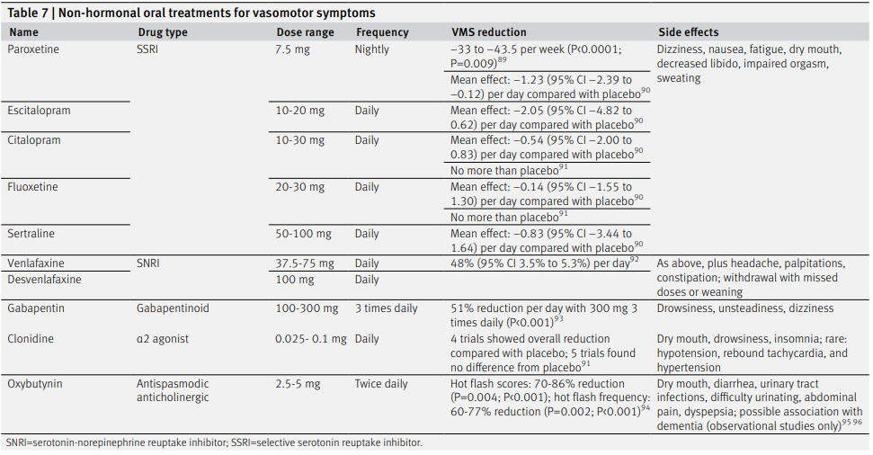
Non-hormonal options

Slide 52
Vasomotor symptoms Treatment
Before menopause, estrogen binds to and inhibits activity in the kisspeptin, neurokinin B, and dynorphin (KNDy) neurons.
With menopausal loss of estrogen, KNDy neurons can stimulate the hypothalamic thermoregulatory center inappropriately, causing vasomotor symptoms.
A novel class of non-hormonal neuromodulators includes the recently approved fezolinetant.

Slide 53
Mood and cognitive changes
Compared with premenopause, women in perimenopause have three times the risk of a major depressive event regardless of previous history, this may be due to the fluctuations in estrogen and progesterone during the menopause transition and an increase in life stressors during this time.
Cognitive changes are common early in the menopause transition. These include challenges with learning and recalling new information and completing complex tasks, as well as shortened attention span.

Slide 54
Mood and cognitive changes Treatment
For women who meet the diagnostic criteria for depression or anxiety, antidepressants are the first line of treatment.
When mood symptoms are correlated with hormonal fluctuations and symptoms of low estrogen in perimenopause, hormone therapy improves mood with or without antidepressant therapy. This has not been shown in postmenopausal women.
In the SWAN study, women who started hormone therapy before their FMP had improvement in verbal memory and processing speed compared with women who started hormone therapy postmenopause.

Slide 55
Disordered sleep
New onset or worsening of sleep disorders is common in the menopause transition with 40-60% of women experiencing major sleep difficulties.
Frequent awakenings are a hallmark of sleep disturbance in the menopause transition.
Sleep apnea, periodic limb movement, restless leg syndrome, and incidence of nocturia increase after menopause.

Slide 56
Disordered sleep Hormonal treatments
According to a recent meta-analysis, hormone therapy improved self-reported sleep outcomes but not sleep parameters on polysomnography.
Both estradiol and CEE improved sleep quality, and the transdermal route was more beneficial than the oral route.
Micronized progesterone reduced sleep disturbance more than medroxyprogesterone acetatedid, although both helped.

Slide 57
Disordered sleep non-hormonal options
Sleep hygiene counseling is first line.
Cognitive behavioral therapy (CBT) for insomnia is the most efficacious treatment for insomnia in perimenopausal and postmenopausal women.
First line drugs include GABA agonists such as zolpidem, certain benzodiazepines, and dual orexin receptor antagonist.

Slide 58
Decreased sexual desire
During the menopause transition, decline in sexual desire is common and multifactorial and can cause distress.
A woman with at least six months of distressing low desire not primarily driven by extrinsic or directly treatable causes has hypoactive sexual desire disorder (HSDD).

Slide 59
Common causes of reduced sex drive
Life and relationship stressors
Decline in estrogen
Decline in testosterone
Reduced genital sensation
Genital pain
Impaired sleep
Mood disorders
Comorbidities
Drug side effects: selective serotonin reuptake inhibitors, tricyclic antidepressants,
Antipsychotics, antiepileptics, narcotics, antihistamines, β blockers,
Antihypertensives, statins, gonadotropin releasing hormone agonists/antagonists,
Oral contraceptive pills, antiandrogens, tamoxifen, and chemotherapy agents

Slide 60
Decreased sexual desire
If a contributing condition is clinically suspected, laboratory testing such as complete blood count, iron studies, thyroid function tests, testosterone, SHGB, prolactin, estradiol, and folliclestimulating hormone can be ordered, but these are not required to make the diagnosis of HSDD.

Slide 61
Hypoactive sexual desire disorder
According to the 2019 global consensus position statement on testosterone therapy (not FDA approved) in women, testosterone has sufficient efficacy and safety data to be indicated for postmenopausal women with HSDD.
In the 2021 (ISSWSH) clinical practice guideline on systemic testosterone for HSDD in women, RCTs consistently show testosterone to be more effective than placebo in improving sexual desire, arousal,orgasm frequency, genital responsiveness, frequency of satisfying sexual events, and self-image when given with or without hormone therapy.

Slide 62
Hypoactive sexual desire disorder
Short term safety data are encouraging, but long term data are lacking.
A meta- analysis of 7 trials of transdermal testosterone 300 μg patch daily versus placebo with or without hormone therapy for 24 weeks showed that common adverse effects were acne and hair growth, with no alopecia, Clitoromegaly or voice deepening. Lipid profiles, cardiometabolic markers and liver and kidney function were unchanged.
Short term studies showed no increase in breast cancer or cardiovascular events, but long term safety data beyond two years are limited and inconclusive.

Slide 63
Menopausal hormone therapy
Research in premenopausal and postmenopausal women suggests that estradiol can modulate central sexual desire.
However, in a Cochrane metaanalysis that included multiple routes of estrogen administration, estrogen was found to reduce sexual pain but not directly augment sexual desire.
In the KEEPS RCT, although both transdermal and oral estrogen improved vaginal dryness and dyspareunia,only transdermal estradiol improved libido and sexual satisfaction.

Slide 64
Bone loss
Women reach peak bone mass around age 30, followed by relative stability and then a 2% annual bone mass loss starting one to three years before menopause and lasting for five to 10 years.
This results in a 10-15% average reduction in bone mineral density (BMD) across the menopause transition. After this period, BMD declines by 0.4% annually.
ln the US, more than half of all women 65 and older have osteopenia, and nearly one quarter have osteoporosis. These progress with aging, and more than one third of women have osteoporosis by age 80.

Slide 66
Bone loss
The Association of Clinical Endocrinologists (AACE) and the US Preventive Services Task Force recommend:
BMD testing for premenopausal women with strong risk factors or significant fracture history, postmenopausal women at increased risk for bone loss and fracture, and all those 65 and older.
Testing should be done at diagnosis for premature or early menopause.
All postmenopausal women should be clinically assessed for osteoporosis and fracture risk using dual energy x ray absorptiometry (DEXA) scanning.

Slide 67
Treatment
Bisphosphonates or denosumab are first line for most women.
For those at very high risk, anabolic therapy should be used first for rapid reduction of fracture risk and BMD improvement, followed By potent antiresorptive agents.
Adverse events of bisphosphonates and denosumab include osteonecrosis of the jaw and atypical femur fracture, both of which are rare.
Raloxifene is an ERAA used for prevention and treatment of osteoporosis in postmenopausal women.
It is not as effective as the therapies mentioned above.
Common side effects include hot flashes and vaginal dryness, and adverse events include stroke and venous thromboembolism.

Slide 68
Genitourinary syndrome of menopause
The signs and symptoms include;
Vaginaldryness
Pruritis
insufficient vaginal lubrication
pain with sex
Urinary urgency, dysuria, and (UTIs).
As the hormonal environment changes, the vaginal pH increases and the microbiome shifts, increasing the risk of urinary and vaginal infections. GSM affects 50-84% of postmenopausal women in the US, but only 50% receive treatment, often owing to discomfort discussing the topic on the part of patient and provider.

Slide 69
Local vaginal hormonal treatments
A systematic review of 53 studies found that vaginal estrogen products were the most effective treatment for GSM, with superiority over vaginal lubricants and moisturizers.Vaginal hormone therapies have been shown to reduce the risk of recurrent UTIs,whereas systemic estrogen has not.

Slide 70
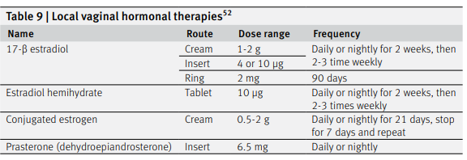

Slide 71
Systemic hormone therapy
For women whose symptoms are limited to GSM, local vaginal therapies are preferred to systemic hormone therapy.
Women with moderate to severe GSM who also have concurrent vasomotor symptoms or osteopenia can consider hormone therapy with added local therapy as needed.

Slide 72
Weight gain and metabolic syndrome
During the menopause transition, visceral and overall body fat increase while lean body mass decreases.
Basal metabolic rate also declines, resulting in an average weight gain of 1.5 lb (0.7 kg) annually.
Elevations ;total cholesterol low density lipoproteins non-high density lipoproteins have been seen in women after menopause, along with an increased risk of metabolic syndrome.
Characteristic impaired sleep, stress, and mood changes can contribute to weight gain and obesity.

Slide 73
Weight gain and metabolic syndrome
Treatment:
Oral and transdermal hormone therapy have not been shown to affect weight in women but they have been shown; decrease visceral fat increase lean body mass a meta-analysis of 107 trials with 33 315 women, hormone therapy was found increase lean body mass and high density lipoproteins, improve insulin resistance, and reduce type 2 diabetes, abdominal obesity, low density lipoprotein, average blood pressure, and lipoprotein(a)
oral hormone therapy had pronounced benefits, whereas transdermal hormone therapy showed mild benefits.
Oral hormone therapy, however, was associated with an increase in triglycerides, coagulation factors, and C reactive protein.

Slide 74
Irregular and abnormal uterine bleeding
For women not taking hormone therapy, all postmenopausal bleeding is abnormal and requires diagnostic investigation.
In perimenopause; longer or shorter menstruation increased or mildly decreased intermenstrual length long periods of amenorrhea are all common and unconcerning.
Irregular bleeding can be disruptive and lead to iron deficiency and anemia.
Hormonal treatment for benign causes includes; a progestogen course, CHC, progestin-only pills, and progestin intrauterine device
Non-hormonal treatments include; NSAID, Tranexamic acid, D&C, Uterine artery embolization, Hysterectomy

Slide 75
Irregular and abnormal uterine bleeding
For postmenopausal women on cyclic hormone therapy, bleeding is expected with progestogen withdrawal. Progestogen dosing can be adjusted.
For postmenopausal women on continuous hormone therapy, bleeding persisting beyond six months or beginning after this timeframe is abnormal.

Slide 76
Conclusions
Symptoms of low and fluctuating sex hormones are common and bothersome for many women during the menopause transition and postmenopause.
In perimenopause, contraception must be considered.
Postmenopause, hormone therapy is the most effective treatment for most symptoms and should include a progestogen for women with a uterus.
Risks vary by hormone formulation, dose, and route of administration.

Slide 77
Conclusions
Consideration of individualized cardiovascular and oncologic risks is essential for informed, shared decision making.
New frontiers include neurokinin modulating therapy for vasomotor symptoms, testosterone for HSDD, and novel treatments for GSM.
Women should receive education about the symptoms of menopause and be aware that menopause can present in various ways.
Ample treatment options are available; clinicians should provide anticipatory guidance and engage women about their symptoms early and regularly.

