Slide 2
Thyroid Cancer
short-term & long-term follow-up
H. Delshad Endocrinologist
Research Institute for Endocrine Sciences

Slide 3
The objectives of follow-up
Maintain adequate thyroxin therapy
Detect persistent or recurrent loco-regional or distant disease.
The large majority of local recurrences develop and are
detected in the first 5 years after diagnosis.
In a minority of cases, local or distant recurrence may
develop even 20 years after the initial treatment.

Slide 4
Key points
Local or regional recurrences : 5 – 20%
Distant metastases in Lungs, Bones and Brain: 10%
10- years survival is 76 – 93%
When appropriately treated, 2/3 with local disease and 1/3 with distant metastases , may achieve complete remission.

Slide 5
DTC : PROGNOSIS
High cure rates are achieved after initial treatment of PTC and FTC
Some patients are at a high risk of recurrence and death.
They can be identified at the time of the diagnosis by prognostic factors.
Specific therapeutic strategies can be considered in relation to the prognosis.

Slide 6
Prognostic factors associated with
poor survival and recurrence
Patient characteristics:
- older age > 45-y
- male gender
- family history
Histology:
- PTC: Tall cells, Columnar cells
- FTC: Widely invasive, Poorly differentiated,
Trabecular or Insular

Slide 7
Prognostic factors associated with poor survival and recurrence
Tumor burden:
- Large tumor size >4 cm
- Extension beyond the thyroid capsule
- Distant metastases
- Lymph-node metastases ( If large, multiple, bilateral or mediastinal)
- Tumor gene mutations
Treatment :
- Time of treatment ( > 1-y)
- Incomplete tumor resection
- No postoperative RAI therapy

Slide 8
BRAF mutation in PTC
Association with Lymph Node Metastasis
Association with Extra-thyroidal Invasion
Predicting Recurrence

Slide 9
BRAF mutation in PTC
Association with Lymph Node Metastasis
Nikiforova et al, 2003
Namba et al, 2003
Xu et al, 2003
Puxeddu et al, 2004
Fugazzola et al, 2004
Kim et al, 2004
Sedliarou et al, 2004
Xing et al, 2005
Trovisco et al, 2005
Kim et al, 2005a
Kim et al, 2005b
Liu et al, 2005
Adeniran et al, 2006
Kim et al, 2006a
Kim et al, 2006b
Lee et al, 2006
Jin et al, 2006
Park et al, 2006
Jo et al, 2006
Sapio et al, 2006
Abrosimo et al, 2007
Mitsiades et al, 2007
Durante et al, 2007
Lupi et al, 2007
Rodolico et al, 2007
Kebebew et al, 2007
Wang et al, 2007
All Studies
0
2
4
6
8
10
12
14
16
18
20
Odds Ratio

Slide 10
Good Prognostic factors
Histology:
- Encapsulated and follicular variants (Favorable prognosis)
- Diffuse sclerosing variants (Intermediate prognosis)
Autoimmune thyroid disease :
- PTC has better prognosis with Hashimoto's thyroiditis
- The risk of cancer in palpable thyroid nodules is 3-fold
higher in Grave ̀s disease
● Children have a low mortality rate, despite extensive disease with
frequent metastases at presentation and a high recurrence rate.

Slide 11
thyroid cancer risk stratification
(to estimate the risk of persistent/recurrent disease)
ATA

Slide 12
Very low risk
Uni-focal or multifocal microcarcinomas (<1 cm)
In patients < 45 years old: tumors< 4 cm confined to the thyroid
Excludes tumors with aggressive* histology or vascular invasion
*Aggressive histology:
- PTC: Tall cell, Insular, Columnar, Diffuse sclerosing, Trabecular, Poorly differentiated
- FT C: Hurthle cell variant, Widely invasive, Poorly differentiated

Slide 13
Low risk
(All criteria must be met)
All macroscopic tumor has been resected
No tumor invasion of loco-regional tissues or structures
No aggressive histology or vascular invasion
If 131I was given, no 131I uptake outside the thyroid
bed on the post-therapeutic WBS.

Slide 14
Intermediate risk
(any criteria)
Microscopic invasion of tumor into the perithyroidal
soft tissues at initial surgery.
Cervical lymph node metastases or 131I uptake outside
the thyroid bed on the post-therapeutic WBS.
Tumor with aggressive histology or vascular invasion.

Slide 15
High risk
(any criteria)
Macroscopic tumor invasion.
Incomplete tumor resection.
Distant metastases.
Tg out of proportion to what is seen on the post-ablative scan.

Slide 16
According to the ATA guidelines
Excellent response :
-No clinical, biologic, or imaging abnormality
-The risk of recurrence is low.
2. Biochemical incomplete response:
- Elevated serum Tg level but no other evidence of disease.
- In many patients, the serum Tg will normalize with time in
the absence of any subsequent treatment.
- Serum Tg may increase in some patients who will develop
structural disease.

Slide 17
According to the ATA guidelines
3. Structural incomplete response:
- Imaging evidence of disease.
- These patients require specific treatment modalities.
- Disease-specific mortality risk is observed only in this group ; morbidity may be significant.
4. Indeterminate response:
- Low but detectable serum Tg.
- Presence of anti-Tg antibodies.
- Small and avascular abnormalities in the thyroid bed.
- Small lymph nodes on neck ultrasonography.
- Many of these patients will end up with no evidence of disease,
but some may develop structural disease.

Slide 18
Follow-up modalities
Neck physical examination and US
FT4 and TSH measurement
Thyroglobulin(Tg ) and Anti-thyroglobulin Ab. (Anti-Tg)
Chest and Bones X-ray
Neck, Mediastinal and Chest CT/or MRT
WBS with RAI
FDG/PET Scan

Slide 19
Clinical and US examination
Palpation of the thyroid bed and lymph node: not sensitive
US is more sensitive and may detect LN as small as 2-3 mm
LNs that are small (< 5mm), thin or oval located in the posterior neck chain, especially if they decrease in size after an interval of 3 months , are considered benign.
US suspicious LN, > 8 to 10 mm in the smaller diameter, should be biopsied for cytology and Tg measurement in the aspirate fluid.

Slide 20
Neck Ultrasonography
In cases of LN metastases, the Tg concentration in the aspirate fluid is often > 10 ng/ml.
A Tg concentration in the aspirate fluid between 1 and 10 ng/ml is moderately suspicious for malignancy ( compare with serum Tg.)

Slide 21
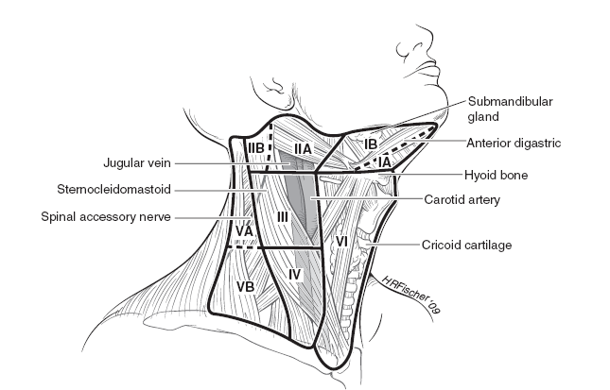
Lymph node mapping by levels

Slide 22
Regional cervical lymph nodes metastases
Occurs in 20 % of all thyroid malignancy
Papillary Car. : 40% of adult , 90% of child.
MTC : 50 % of patients
Internal jugular chain of cervical lymph nodes, particularly on the ipsilateral side

Slide 23
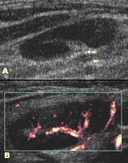
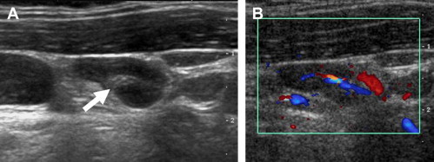
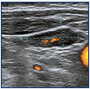
Normal lymph node
Hypoechoic cortex &
central hyperechoic fatty hilus
Hilar vascularity
Benign lymph node

Slide 24
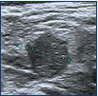

Malignant lymph node
● Absence of a hilum
● Round shape
● Increased short axis > 5mm
● Increased central
vascularization
● Microcalcification
● Partially cystic appearance
● Located in level 3,4,6

Slide 25
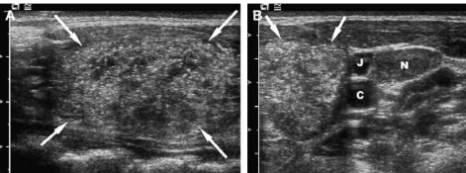
PTC with cervical LN metastases
N
Thyroid nodule with microcalcification
Multiple enlarged LNs

Slide 26
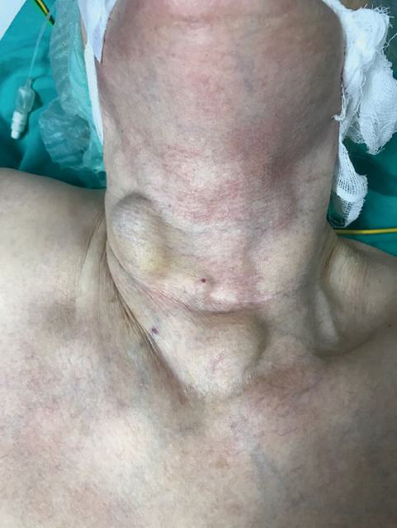
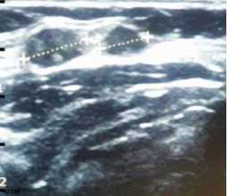
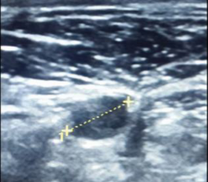
Skin metastasis on the neck: an unusual presentation of recurrence of papillary thyroid carcinoma

Slide 27
Measurement of serum Thyroglobulin
Tg is a glycoprotein secreted by thyroid follicular cell only.
An important factor to monitor patients for residual or recurrent disease
Two important factors must be considered when a serum Tg value is interpreted: serum TSH and presence of anti Tg-Ab.
The highest degrees of sensitivity for serum Tg are noted following thyroid hormone withdrawal or stimulation using rhTSH.
In the absence of Tg Ab., serum Tg has a high degree of sensitivity and specificity to detect thyroid cancer.

Slide 28
Measurement of serum Thyroglobulin
After thyroid ablation and in the absence of tumor, serum Tg should
be theoretically undetectable, but in clinical practice stimulated serum
Tg < 2 ng/ml is considered as evidence of no residual disease.
Serum Tg may remain detectable for a few weeks or months after initial treatment (median half life= 30 hours).
Only serum Tg more than 3 months after surgery should be taken into account
A serum Tg rising with time while on suppressive LT4 therapy is highly suggestive for tumor recurrence or progression.

Slide 29
Tg in disease-free status
Total thyroidectomy with RAI ablation:
- During TSH suppression = Tg < o.2 ng/ml
- After stimulation ( T4 withdrawal or rhTSH) = Tg< 1 ng/ml
Total or near-total thyroidectomy without RAI ablation:
- During TSH suppression = Tg < o.2 ng/ml
- After stimulation ( T4 withdrawal or rhTSH) = Tg< 2 ng/ml
Lobectomy : (specific criteria have not been defined)
- Most patients with an excellent response : Tg < 30 ng/ml
- A rising value over time is suspicious for thyroid cancer

Slide 30
Measurement of serum Thyroglobulin
Serum Tg is undetectable on LT4 :
- 20% of patients with isolated LN metastases or small amounts of
residual tumor
- 5% of patients with small lung metastases
- 1% of patients with distant metastases
Even Tg may fail to identify clinically significant tumors ( scan pos. ,Tg neg.):
- Presence of interfering anti-Tg Abs
- De-differentiation of the tumor cells
In aggressive or poorly differentiated tumors, basal or stimulated Tg is low.

Slide 31
Measurement of serum Thyroglobulin
● In 20% of patients who are clinically free of disease
(Tg<1 ng/ml on LT4), Tg may be detectable (> 2ng/ml)
following withdrawal of LT4, one year after initial treatment:
-It will decrease in 2/3 of patients without any treatment
-1/3 will have identification of persistent or recurrent disease.
● A Tg cutoff level > 2ng/ml following rhTSH stimulation is highly
sensitive in identifying persistent tumor.

Slide 32
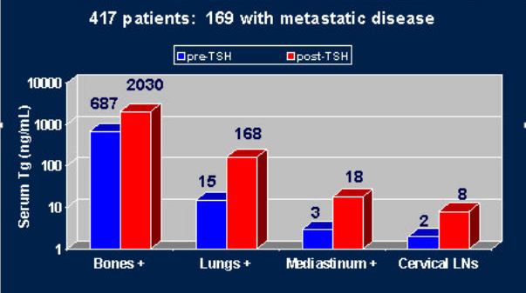
Serum Tg helps localize site of disease
Robbins RJ et al. J Clin Endocrinol Metab. 2004; 89: 6010-6016

Slide 33
Negative WBS, Positive Tg
False elevation of Tg due to interfering anti-Tg Ant.
Inadequate TSH elevation.
Stable iodine contamination ( recent contrast dye radiography).
Microscopic metastases too small to visualize.
De-differentiation of the tumor such that it can still produce Tg but has lost its iodide trapping ability.

Slide 34
Measurement of serum anti-Tg Ab
Reference range < 4 IU/ml
Median half life = 10 weeks
Increased Anti-Tg Ab:
-Differentiated thyroid cancers
-Hashimoto thyroiditis
-Chronic urticarial
-Thyroid auto-immune diseases ( 30 – 50%)

Slide 35
Measurement of serum anti-Tg Ab
25% of thyroid cancer patients
10% of general population
Falsely lowers Tg in immunometric assay
May rise transiently postoperatively or after ablation therapy with RAI
Following total thyroidectomy and RAI therapy, anti-Tg Abs disappear over a median of about 3 years
Falling levels of anti-Tg Abs may indicate successful therapy
New appearance or rising titers indicates recurrence or persistent disease

Slide 36
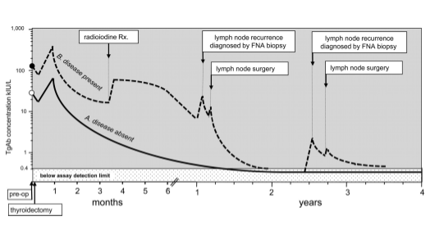
Typical changes in TgAb trends after thyroidectomy:
in patients rendered disease-free by surgery (pattern A)
in patients with persistent/recurrent disease (pattern B).
Notes:
Fig. 1 Typical changes in TgAb trends after thyroidectomy in patients rendered disease-free by surgery (pattern A) vs. patients with persistent/recurrent disease (pattern B). TgAb concentrations may rise or become detectable de novo in response to increases in Tg antigen after thyroidectomy, lymph node recurrence(s), lymph node resection(s) FNA biopsy of metastatic lymph nodes, or radioiodine therapy.
36

Slide 37
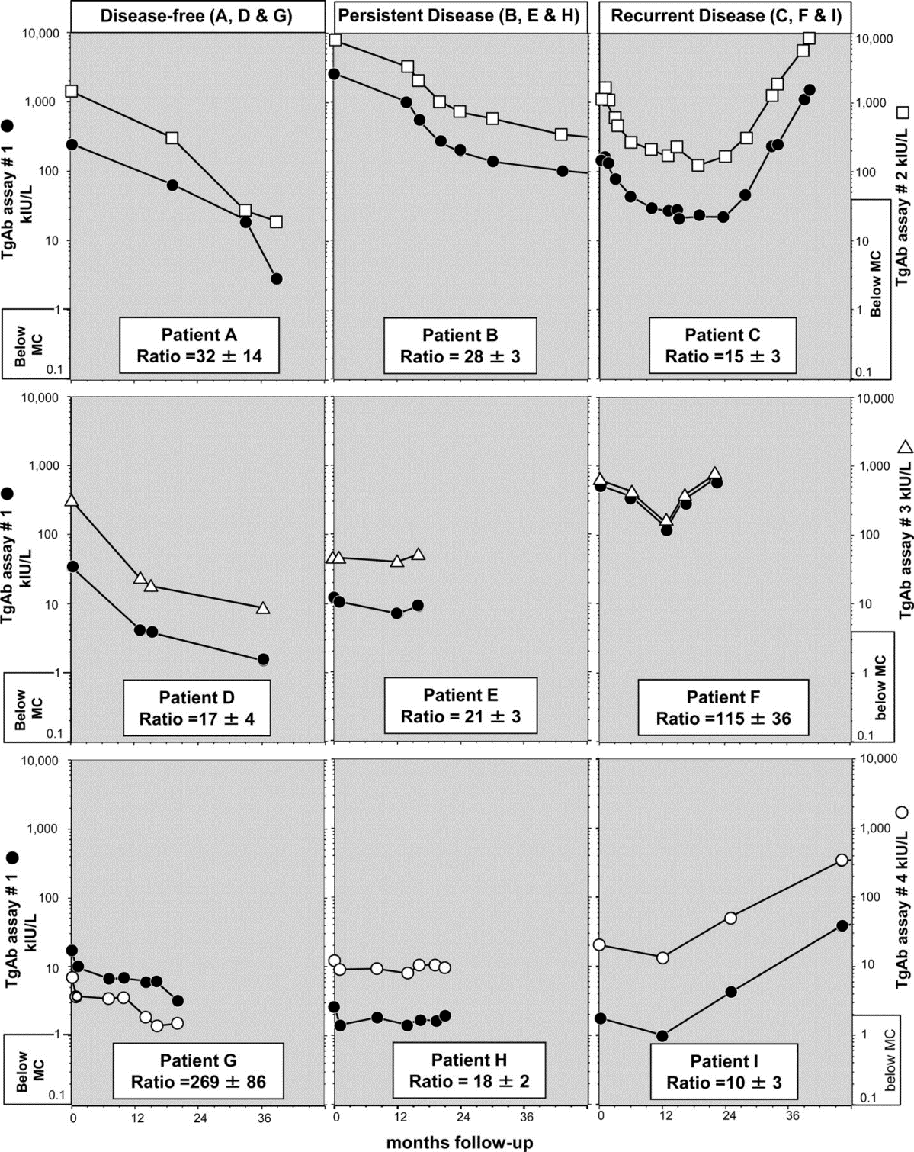
The trend in serial serum TgAb measurements
for nine DTC patients monitored over 1–4 yr.
Patients A, D, and G were judged disease-free after thyroidectomy (declining trend in TgAb values).
Patients B, E, and H had evidence of disease and maintained stable, detectable TgAb values.
Patients C, F, and I had recurrences detected characterized by rising TgAb values.
Notes:
Fig. 2 The trend in serial serum TgAb measurements (on ordinates) made for nine DTC patients (A–I) monitored over 1–4 yr. Each specimen had TgAb measured by a reference assay (assay 1, Kronus/RSR, solid circles) and one of three test assays: (assay 2, Siemens Immulite, open squares) for patients A–C; assay 3 (Beckman Access, open triangles) for patients D–F; and (assay 4, Nichols Advantage, open circles) for patients G–I. The clear boxes at the bottom of each patient's plot show the mean (± sd) of the ratios between the TgAb values reported by test divided by the reference method. These ratios were highly patient- and method-specific and were independent of both the TgAb trend and the TgAb concentration, illustrating the qualitative differences in TgAb secreted by different patients. Patients were selected from three clinical categories. Patients A, D, and G were judged disease-free after thyroidectomy (± radioiodine) and, irrespective of the assay used, showed a declining trend in TgAb values. Patients B, E, and H had evidence of disease and maintained stable, detectable TgAb values. Patients C, F, and I had recurrences detected characterized by rising TgAb values. MC, Manufacturer's recommended cutoff for a detectable TgAb. The data were taken from previous studies (39, 42).
37

Slide 38
Diagnostic whole-body RAI scan
Patients who do not require routine diagnostic WBS during follow-up:
Low risk patients with :
-An undetectable Tg on LT4
-Negative anti-Tg Ab
-Negative neck US

Slide 39
Diagnostic whole-body RAI scan
A diagnostic WBS may be indicated in three clinical settings during follow-up:
Patients with abnormal uptake outside the thyroid bed on post-therapy WBS
Patients with poorly informative post-ablation WBS because of large thyroid remnants with high uptake of I131
Patients with TgAb, at risk of false-negative Tg measurement

Slide 40
Whole-body RAI SPECT/CT
Is associated with :
An increased number of patients with a diagnosis of metastatic LN
A decreased frequency of equivocal findings
The CT portion of the SPECT/CT provides additional information on non-iodine-avid lesions
It avoids the need for further cross-sectional imaging studies such as contrast CT or MRI

Slide 41
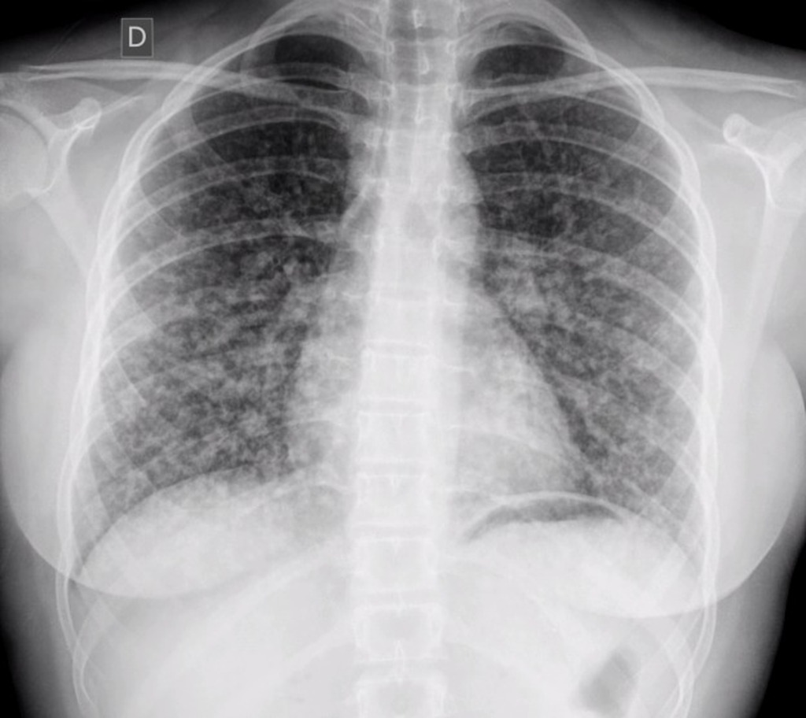
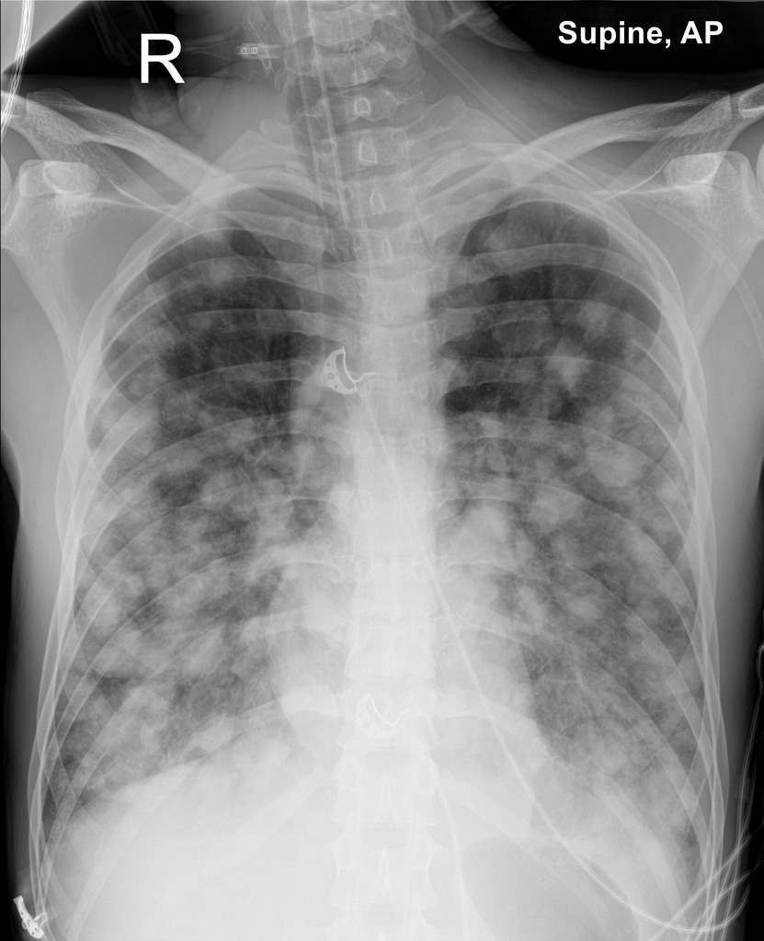
X-Ray : Chest
Multiple bilateral micronodular opacities, with diffuse distribution, predominantly in the lower two thirds of both hemithorax.
Multiple bilateral macronodular opacities, with diffuse distribution, predominantly in the lower two thirds of both hemithorax.

Slide 42
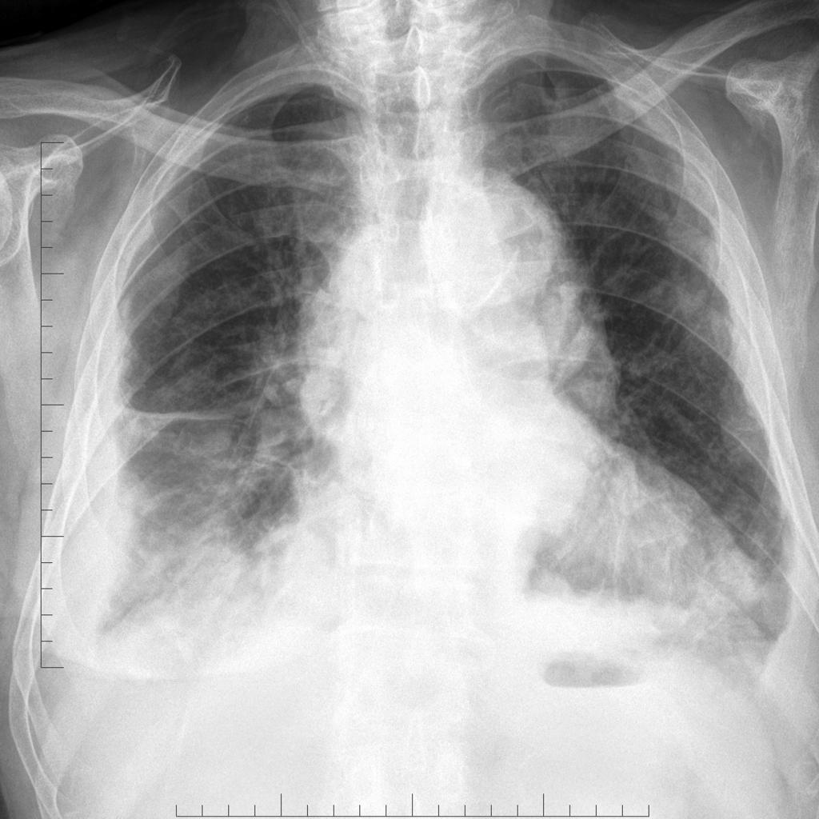
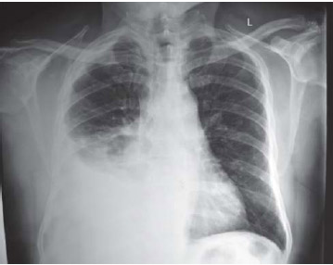
Metastatic PTC
Numerous nodular appearing masses expand Malignant Pleural Effusion
the pleural cavity and widen the mediastinum

Slide 43
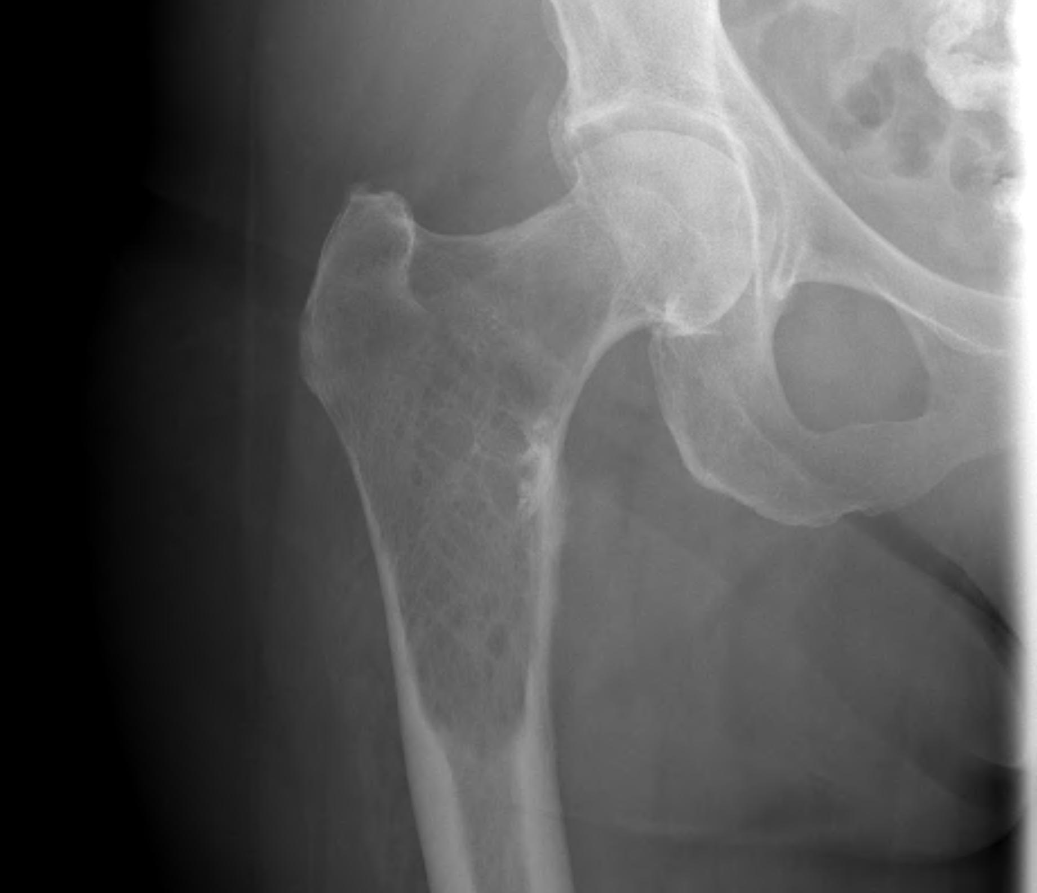
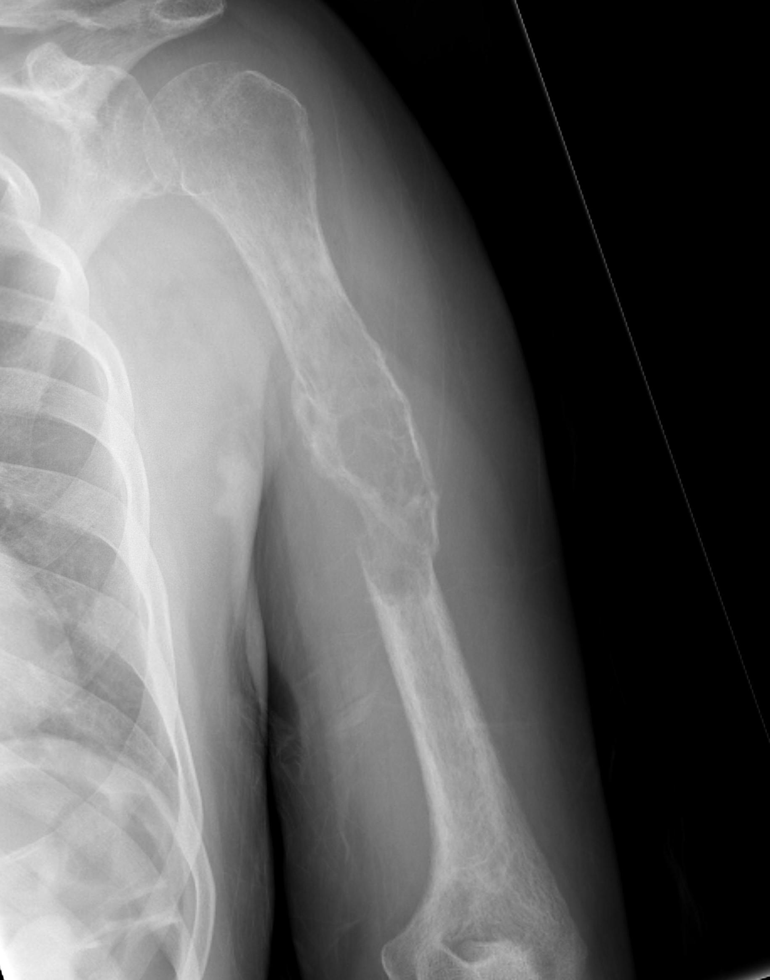
X-Ray: Bones
Osteolytic bone Metastasis

Slide 44
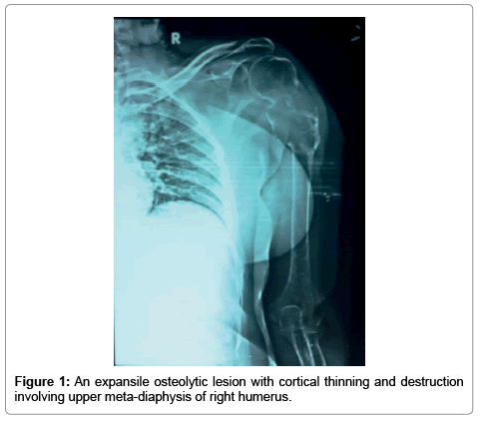
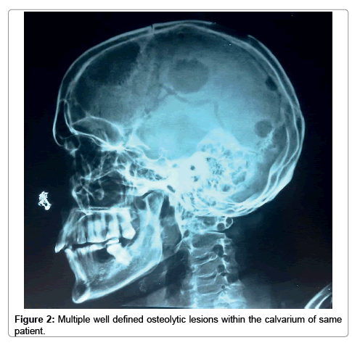

Slide 45
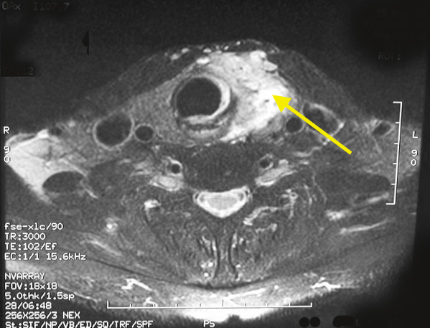
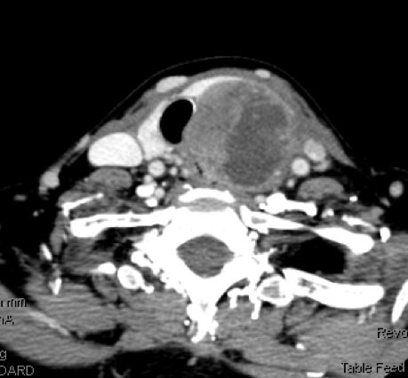
● Bulky and widely distributed recurrent nodal disease
● In the assessment of aero-digestive tract
● High Tg, negative neck US
CT and MRI
Thyroid cancer which is more invasive and aggressive and has invaded through the natural covering of the thyroid gland into the overlying muscles .

Slide 46
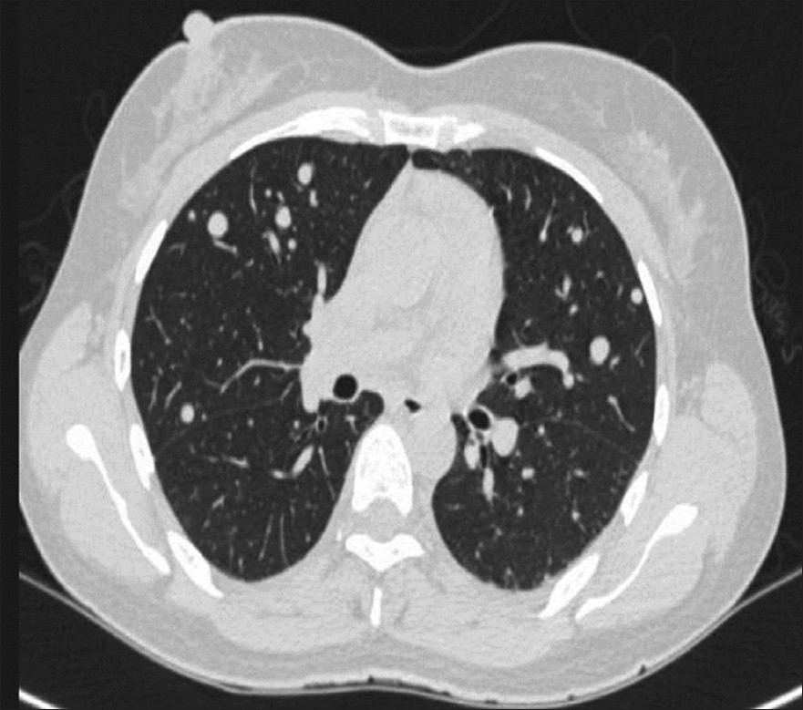
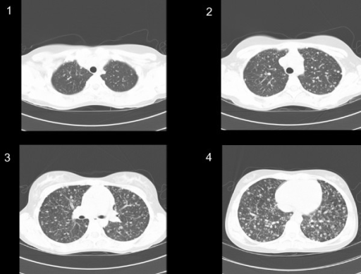
Chest CT Scan
Multiple bilateral nodules suggestive of bilateral pulmonary metastasis

Slide 47
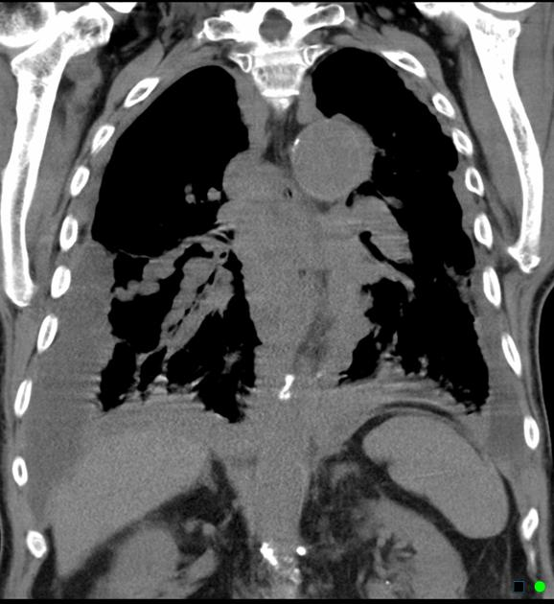
Chest X-Ray
Coronal non-contrast MRI
Extensive bilateral pleural metastatic disease is noted coating both the parietal and mediastinal surfaces and extending into the pulmonary fissures.

Slide 48
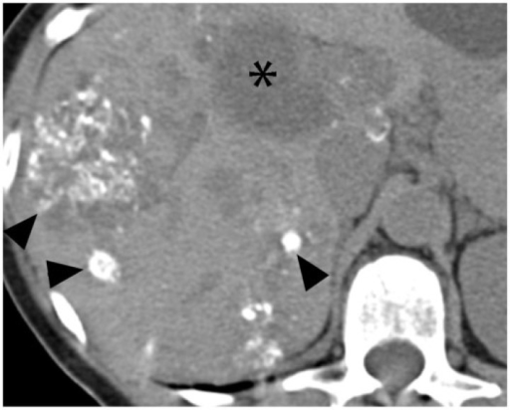
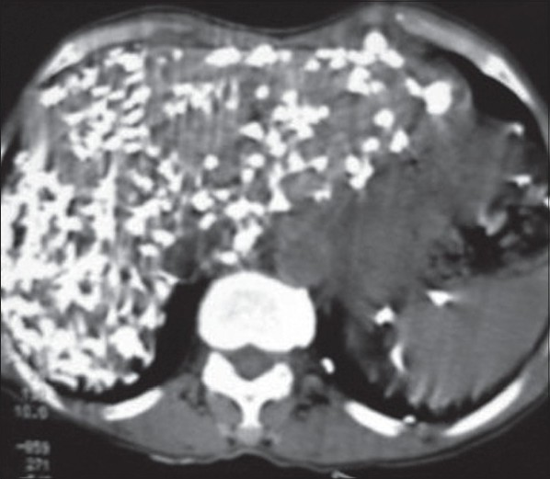
Liver CT Scan
Axial noncontrast CT image demonstrates scattered extensively calcified metastases and noncalcified metastases in the liver.
Concentration of the calcific deposits in the liver, with parenchymal distortion

Slide 49
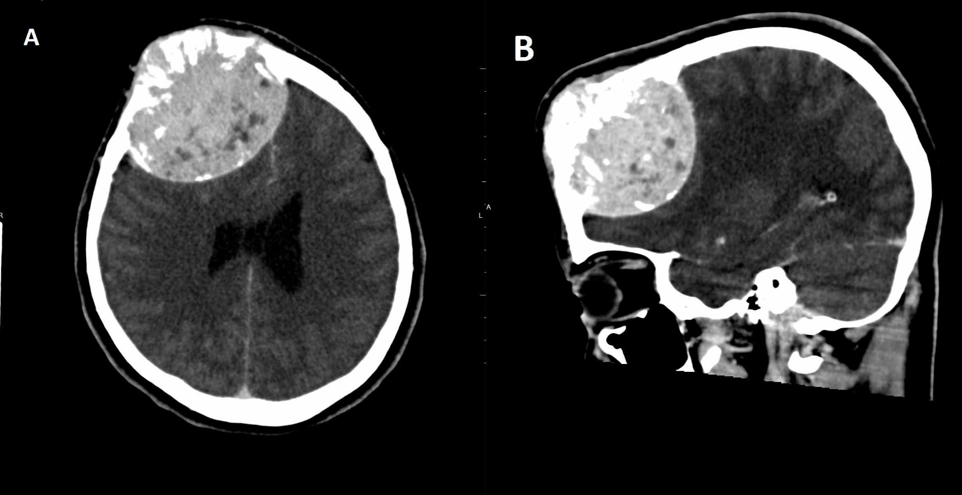
Skull CT Scan
CT image of skull mass with calvarian lesion.
Giant frontal mass with heterogeneous enhancement after contrast medium, involving right frontal bone

Slide 50
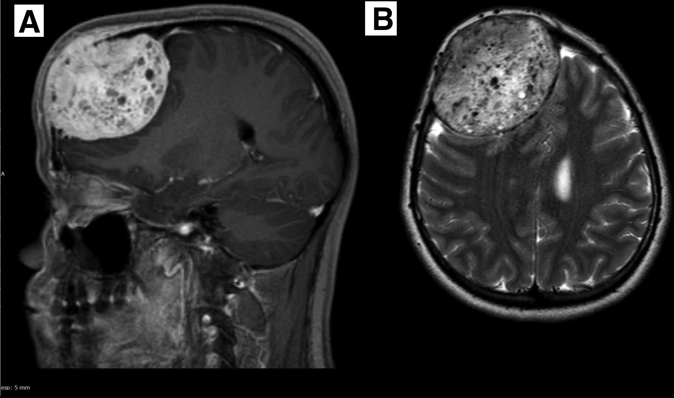
Brain MRI
Sagittal (A) : T1-weighted after contrast shows a frontal expansive lesion. Axial (B) : T2-weighted shows a well-delimited lesion with microcysts.

Slide 51
̀18FDG-PET scanning
Should be considered in high-risk DTC with high Tg (>10 ng/ml) with negative RAI imaging.
Is more sensitive in patients with an aggressive histologic subtype
It is being more sensitive for some locations such as the retropharyngeal or the retro-clavicular regions.

Slide 52
̀18FDG-PET scanning
FDG uptake on PET in metastatic DTC is a major negative predictive factor for response to RAI treatment.
It is recommended to consider FDG-PET only in DTC patients with a stimulated Tg ≥ 10 ng/ml after THW or >5ng/ml after rhTSH or >2ng/ml on TH.
In Tg negative, Anti-Tg positive, FDG-PET may localize disease.

Slide 53
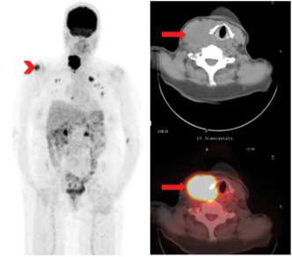
18 FDG PET/CT
A 46-year-old woman with PTC
18 FDG PET/CT
demonstrates intense uptake in:
Primary thyroid mass
Right humeral
Lymph node
Pulmonary metastases.

Slide 54
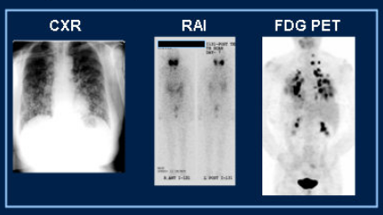
64-year-old female, tall cell variant PTC

Slide 55
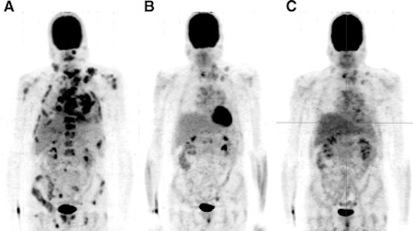
18 FDG PET/CT
FDG-PET scans of a 43-year-old man with metastasized medullary thyroid cancer before (A) and at 12 (B) and 24 (C) weeks after start of treatment with 300 mg of Vandetanib per day.

Slide 56
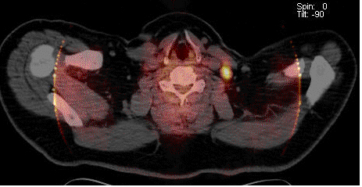
65-y old male with history of thyroid cancer. Elevated Tg. Negative iodine studies
PET/CT revealed two hypermetabolic foci in the neck, one on the right and one on the left (only one is shown above).
The patient was sent to surgery with the aid of PET/CT and two metastatic lymph nodes were removed.

Slide 57
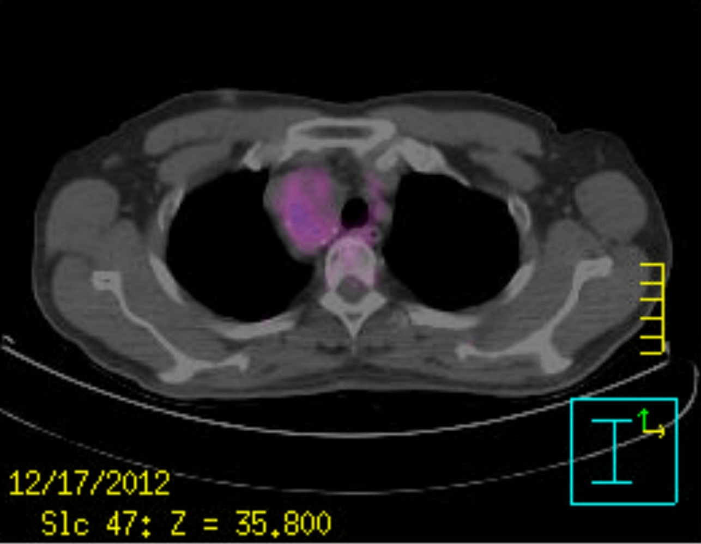
A case with right paratracheal mass ( metastatic PTC)
On fusion image of 18F-FDG PET CT, the mass shows
diffuse strong FDG uptake

Slide 58
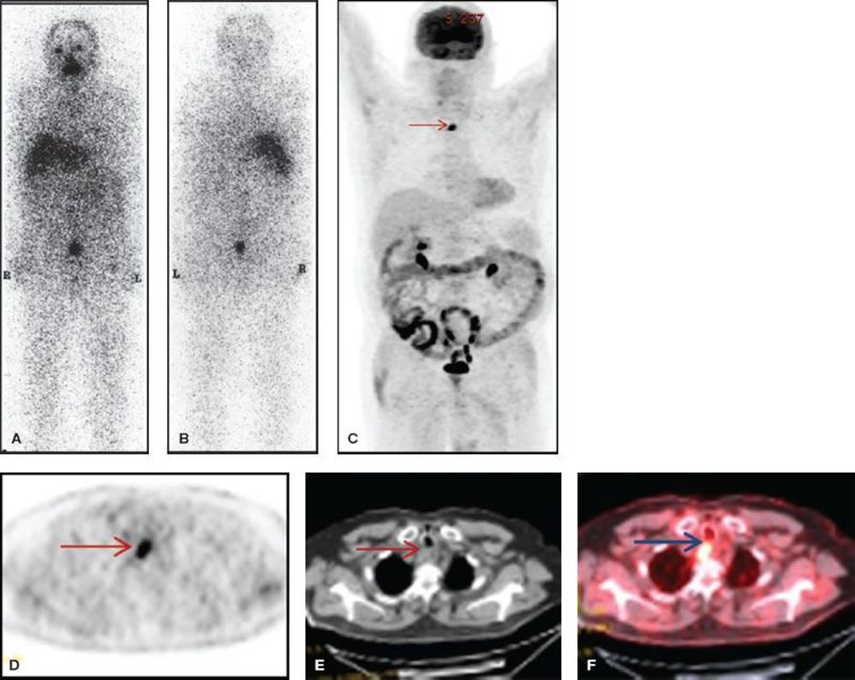
The post-therapy scan obtained following 200-mCi ¹³¹I ingestion failed to demonstrate any focus of increased uptake on anterior (A) and posterior (B) images.
¹⁸F-FDG PET/CT images (C, D, E, F ) PET/CT showed an FDG-avid metastatic lesion in the esophageal wall (arrow).

Slide 59
Identification of
Recurrent Disease

Slide 60
Detection methods have evolved over the years:
●1950s RAI Scanning
●1980s Thyroglobulin
●1990s Neck Ultrasound
●2000 FDG-PET Scan

Slide 61
Paradigm Shift:
Approach to detection of recurrent disease
Away from routine WBS
A move toward
Thyroglobulin
Neck Ultrasound
Increased sensitivity for detection of small volume disease

Slide 62
Follow-up
Initial therapy
TT+ RAI
LOW RISK : 0.5 – 2.0 mIU/l
Intermediate: 0.1 – 0.5 mIU/l
HIGH RISK : < 0.1 mIU/l
3 months: FT4, TSH
6-12 months: Tg on LT4, NU
Basal Tg undetectable: rhTSH Tg

Slide 63
6-12 months: Tg on LT4, NU
Basal Tg undetectable: rhTSH Tg
Undetectable Tg
No other abnor.
Detectable Tg
Neck US is negative
Biochemical incomplete
Structural incomplete
Indeterminate response
Excellent
response
Basal Tg> 2ng/ml and
Very low risk patients
No need for rhTSH stimulation
Follow-up
●Neck CT and MRI
●Chest X-Ray & CT
●Spine X-Ray & MRI
●Bone scan
●131 I WBS
●FDG/PET Scan
TSH: 0.5 – 2.0 mIU/L
Yearly evaluation:
FT4, TSH, Tg, Neck US

Slide 64
6-12 months: Tg on LT4, NU
Basal Tg undetectable: rhTSH Tg
Detectable Tg
Loco-regional dis.
I131 WBS
Unesectable
Resectable
Surgery
Adequate
RAI Uptake
Inadequate
RAI Uptake
100-200 mCi I131
Post treatment WBS
EBRT
Kinase Inhibitors

Slide 65
Locoregional Recurrences
Locoregional recurrences occur in 5% to 20% of patients with DTC.
More than a third of reoperations for persistent or recurrent disease are related to inadequate initial thyroid surgery.
Small lymph node metastases may be treated with radioiodine, but their persistence after two or three treatments should lead to surgery.

Slide 66
Detectable Tg
Imagings indicate
Distant metastases
6-12 months: Tg on LT4, NU
Basal Tg undetectable: rhTSH Tg
Lung ,Liver, Bones
CNS
Metastases
Adequate
RAI Uptake
Inadequate
RAI Uptake
Solitary lesion:
●Neurosurgery
●Stereotactic
radiosurgery
100-200 mCi I131
Post treatment WBS
EBRT
Surgery
Kinase Inhibitors
Multiple lesions:
●EBRT
●Surgery if possible

Slide 67
6-12 months: Tg on LT4, NU
Basal Tg undetectable: rhTSH Tg
Detectable Tg
NU, CT, MRI, I 131WBS
Negative
●Tg> 2 ng/ml on LT4
●Tg> 5 ng/ml with rhTSH
●Tg> 10 ng/ml after THW
FDG/PET SCAN
Positive
Negative
EBRT, RFA,
Tumor embolization
Kinase inhibitors
I131 therapy
Post Rx WBS

Slide 68
Metastatic DTC that persists despite
EBRT & RAI
Observation
Kinase inhibitors ( Lenvatinib & Sorafenib )
Cytotoxic chemotherapy

Slide 69
Metastatic DTC that persists despite
EBRT & RAI
Observation:
Stable metastatic disease(tumors< 1 to 2 cm & growing less than
20% per year)
Kinase inhibitors:
Metastatic unresponsive DTC(tumors > 1 to 2 cm & growing by
at least 20% per year)
Cytotoxic chemotherapy:
Unable to tolerate or who fail several attempts at kinase
inhibitor therapy

Slide 70
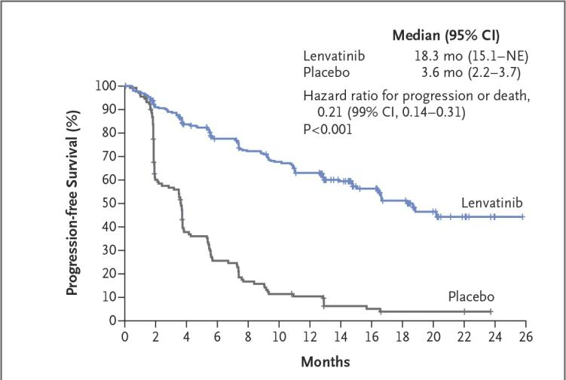
Chemotherapy for Differentiated Thyroid Cancer
Lenvatinib Phase III Trial: Progression-Free Survival
Schlumberger M et al. N Engl J Med 2015;372:621-630.

Slide 71
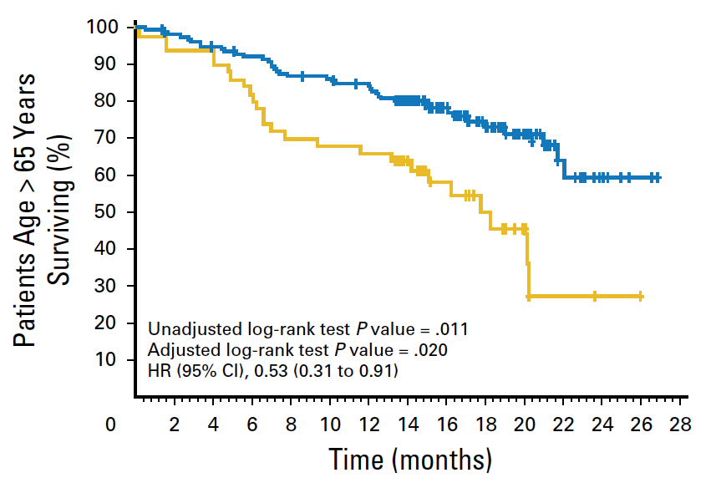
Chemotherapy for Differentiated Thyroid Cancer
Lenvatinib Phase III Trial: Overall Survival
Lenvatinib
Placebo
Brose M et al. J Clin Oncol 2018 (June 14);71:6472.

Slide 72
Metastatic
PTC

Slide 73
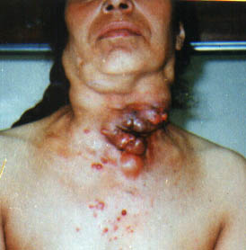
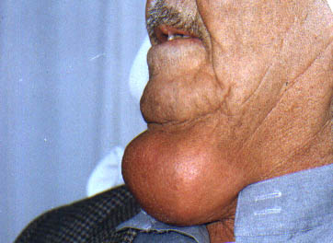
Very huge Lymphadenopathy from
papillary thyroid carcinoma
Huge multiple lymph node metastasis of 15 year duration, Histology: PTC

Slide 74
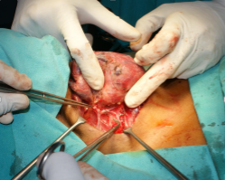
Advanced thyroid cancer
with sternal metastases

Slide 75
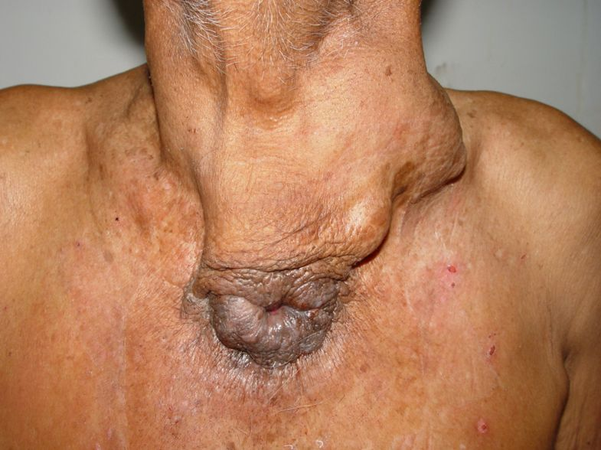
carcinoma of thyroid with sinus extending downwards and opening in front of the manubrium.

Slide 76
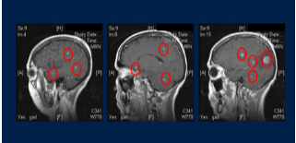
41-YEAR-OLD female: locally aggressive, poorly differentiated, widespread progressive distant metastases
Just needed whole brain radiation

Slide 77
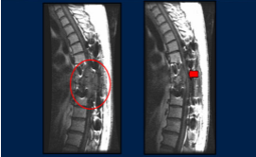
58-year-old male with widespread metastatic Hurthle cell carcinoma
Need Surgery and External Beam Radiation

Slide 78
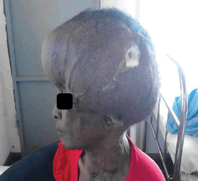
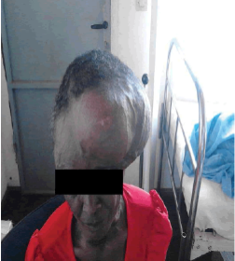
An Exceptional Case of Cutaneous Metastasis of Differentiated Thyroid Cancer
60-year-old female with large cutaneous metastasis with significant collateral circulation

Slide 79
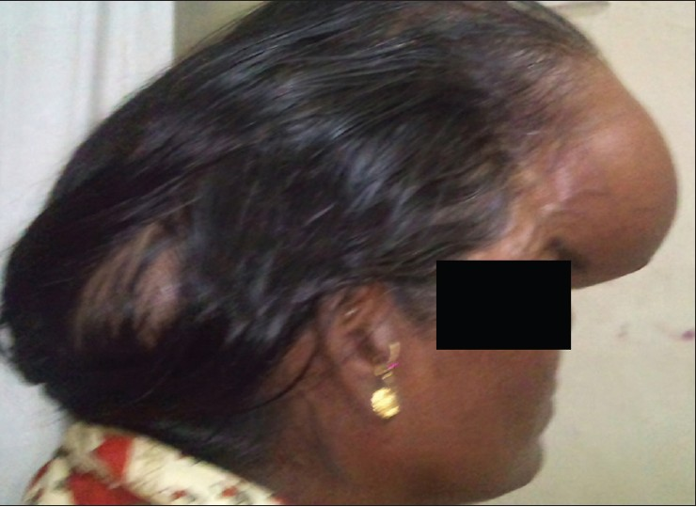
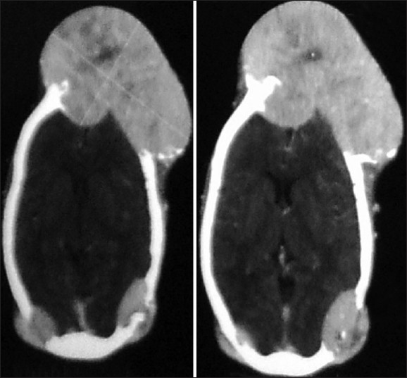
Metastasis from follicular thyroid carcinoma in right parieto-occipital region of skull

Slide 81
PCND is a matter of debate in cN0 PTC
n= 186 with cN0 PTC
(Jan. 2000 to Dec. 2015)
n=74
pCND+TT
n=112
pCND+TT
Complication : 39.2% p=0.0006 17.8%
overall survival and recurrence rates did not differ between two groups
Dobrinja C. et al
Int J Surg. 2017 May

Slide 82
Evaluating the effectiveness of prophylactic central neck dissection with total thyroidectomy for cN0 PTC: An update meta-analysis
Zhao WJ et al. Eur J Surg Oncol. 2017 Aug 3.
n=6930
cN0 PTC
22 studies
2381
pCND+TT
4009
TT alon
LRR = (OR= 0.66, 95% CI= 0.48-0.89)
cCR= (OR=0.40, 95% CI= 0.22-0.73)
Significant reduce of loco-regional recurrence

Slide 83
Postoberative I¹³¹
Age < 15 y or > 45 y
Radiation history
Known distant metastases
Bilateral nodularity
Extrathyroidal extension
Tumor > 4 cm in diameter
Cervical lymph node metastases
Aggressive variant

Slide 84
131-I Use Recommended by 2015 ATA Guideline
ATA Risk Category | Characteristics | 131-I Recommendation
Low | Intrathyroidal DTC with no extrathyroidal extension, vascular invasion, or metastases | Not routinely recommended (Weak recommendation, Low-quality evidence)
Intermediate | Microscopic extrathyroidal extension, cervical node metastases, RAI-avid neck disease outside thyroid bed, vascular invasion, or aggressive histology | Should be considered (Weak recommendation, Low-quality evidence)
High | Gross extrathyroidal extension, incomplete tumor resection, distant metastases, or inappropriate postoperative serum thyroglobulin | Routinely recommended (Strong recommendation, moderate-quality evidence)
Notes:
3

Slide 85
TSH Suppression Recommended by 2015 ATA Guideline
ATA Risk Category | Characteristics | TSH Suppression Recommendation
Low | Intrathyroidal DTC with no extrathyroidal extension, vascular invasion, or metastases | TSH may be maintained at the lower end of the ref. range (0.5–2.0 mU/L). (Weak recommendation, Low-quality evidence)
Intermediate | Microscopic extrathyroidal extension, cervical node metastases, RAI-avid neck disease outside thyroid bed, vascular invasion, or aggressive histology | TSH suppression to 0.1–0.5 mU/L is recommended. (Weak recommendation, Low-quality evidence)
High | Gross extrathyroidal extension, incomplete tumor resection, distant metastases, or inappropriate postoperative serum thyroglobulin | TSH suppression to <0.1 mU/L is recommended. (Strong recommendation, moderate-quality evidence)
Notes:
3
(C) For low-risk patients who have undergone remnant ablation
and have undetectable serum Tg levels, TSH may be
maintained at the lower end of the reference range (0.5–
2mU/L) while continuing surveillance for recurrence. Similar
recommendations hold for low-risk patients who have
not undergone remnant ablation and have undetectable serum
Tg levels.
(Weak recommendation, Low-quality evidence)
(D) For low-risk patients who have undergone remnant
ablation and have low-level serum Tg levels, TSH may be
maintained at or slightly below the lower limit of normal
(0.1–0.5 mU/L) while surveillance for recurrence is continued.
Similar recommendations hold for low-risk patients
who have not undergone remnant ablation, although
serum Tg levels may be measurably higher and continued
surveillance for recurrence applies.
(Weak recommendation, Low-quality evidence)
(E) For low-risk patients who have undergone lobectomy,
TSH may be maintained in the mid to lower reference
range (0.5–2 mU/L) while surveillance for recurrence is
continued. Thyroid hormone therapy may not be needed if
patients can maintain their serum TSH in this target range.
(Weak recommendation, Low-quality evidence)

